Slide 1
Mixing questions, mixing methods
Carl May

Slide 2
My research interests (1) empirical investigation
Interaction (individualized knowledge) Interaction processes, boundaries of relations, genetics, rheumatology, terminal care | Chronicity (illness trajectories) Back Pain, cancer, diabetes, medically unexplained symptoms, menorrhagia
Innovation (intervention trajectories) Informatics, telemedicine, shared-decision-making tools, medical devices. | Evidence (generalized knowledge) Randomized trials, pragmatic evaluations, guideline development.

Slide 3
My research interests (2) explanatory models
Understanding the dynamics of the adoption and implementation of new health technologies and organizational innovations.
  Multiple empirical studies and systematic reviews, leading to novel theory (Normalization Process Theory).
Understanding how innovation in healthcare technique, delivery and organization affects patient and caregiver experiences.
  Multiple empirical studies and systematic reviews, leading to novel theory (Burden of Treatment Theory)

Slide 4
MRC Framework for complex intervention evaluation
Complex interventions in health care, whether therapeutic or preventative, comprise a number of separate elements which seem essential to the proper functioning of the interventions although the 'active ingredient' of the intervention that is effective is difficult to specify. (...)

Slide 5
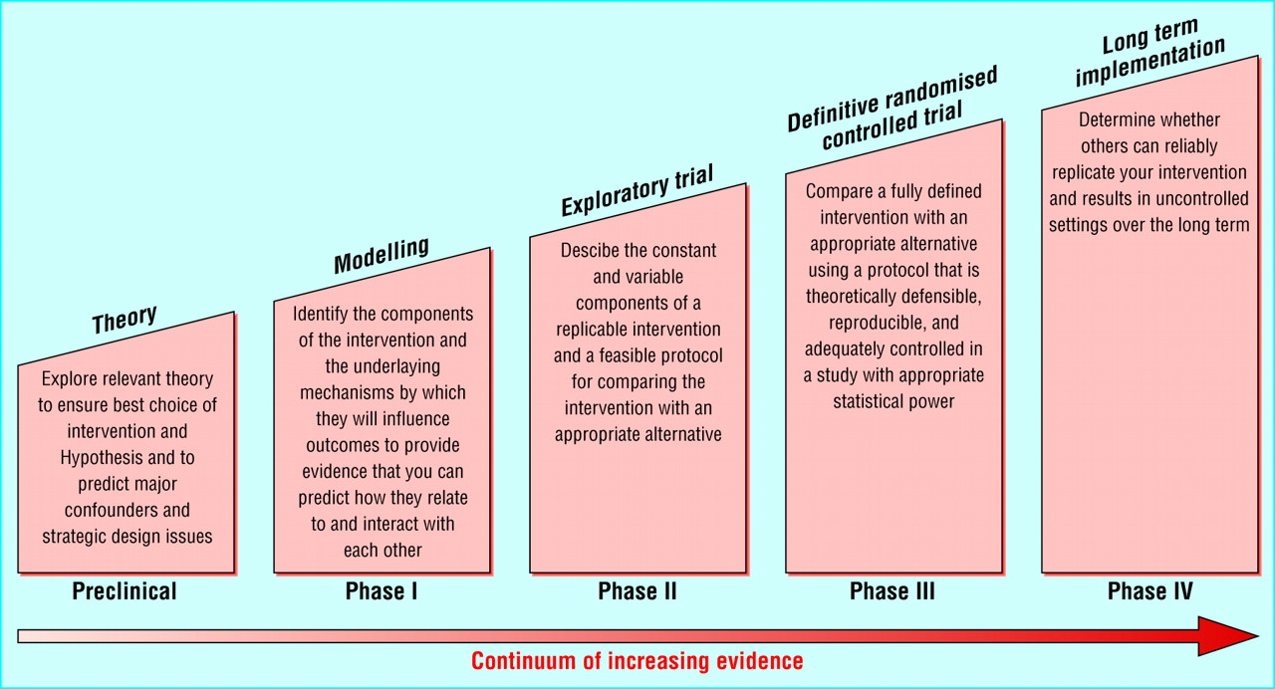

Slide 6
Almost all of my work involves some sort of mixed methods
Ethnographies in concert with randomised controlled trials
Attribution analyses in concert with systematic reviews
Interview studies in concert with decision tree modelling
But I was scarred by the…..

Slide 7
Some methods are more mixed than others, but that’s not a problem (or is it?)
Typically, when we think about mixed methods we don’t think about
  Participant Observation + Attribution Analysis
  Econometric Modelling + Decision Tree Modelling
  Clinical Trials + Prospective Cohort Studies
  Status Passage Modelling + Thematic Descriptive Analysis

Slide 8
The methodology wars of the 1980s: subjectivists and objectivists in mortal combat
Quantitative methods: objective measures of beliefs, behaviors and outcomes
Deduction
Qualitative methods: subjective interpretation of beliefs, behaviors and outcomes
Induction
The problem of reliable knowledge
(No-one won, by the way….)

Slide 9
But here’s the thing: when we mix methods, we mix many other things….
  different paradigms call for different questions,
  different questions call for different methods,
  different methods call for different answers.

Slide 10
So, we can either live in a world of uneasy epistemological compromise
(and, really, who doesn’t?)
Or….we can attack a problem from many angles, with many methods, until we have a set of solutions that can be worked together.
But to get there, we need to….

Slide 11
Qualitative investigation:
Identifies empirical regularities that warrant explanation
Theory building:
Theory is the bridge between paradigms, methods, and questions
Quantitative investigation:
Tests theories, offers generalizable explanations
Use theory as a bridge between methods

Slide 12
If we treat mixed methods only as a methodological problem, then we leave a half of the answers to our questions behind.

Slide 13
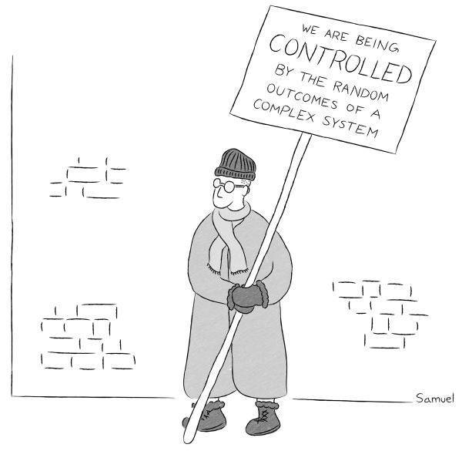
Thank
you!
Carl May | Professor of Medical Sociology | Faculty of Public Health and Policy |London School of Hygiene and Tropical Medicine | Skype CarlRMay | Twitter @CarlRMay | email carl.may@lshtm.ac.uk

