Slide 1
Doing MDM & SDM in Practice
Notes:
This is a crash course in exposing to you some of the things we have observed and experienced in the past years of developing this work.

Slide 2
You are Sarah, a 35 year-old, mother of 3, and you are seeing your primary care clinician of many years. Not only does your clinician see you, but has taken care of your extended family for many years. Your parents are in poor health, living with multiple chronic conditions each and you have helped them manage clinic visits, hospitalizations, and worsening health in their home over the years. You have done this with little support from your husband, and your kids are still too young to lend a hand. Additionally, you have type 2 diabetes, hypertension, and have struggled with losing weight for many years. These are the conditions that you are seeing your clinician for today. You also smoke regularly as a mechanism to cope with the stress, although you have tried to quit multiple times. You know going into this visit that your clinician is again going to bring up the fact you should lose some weight and stop smoking. You also feel that your life is slowly slipping away from you, and struggle to find meaning in activities that previously seemed important to you.

Slide 3
Activity

Slide 4
Pair up. Decide which person will play “patient” and the other “clinician.”
Patients – take time to read Sarah’s story and assume your role as her.
Clinicians, when the patient is ready, begin the conversation with Sarah by asking “What can I do for you today?”

Slide 5
Debrief
Notes:
What was that experience like? How did you feel as a patient? As a clinician?

Slide 6
Evidence
synthesis
Observation
clinical encounters
Initial prototype
Designers
Study team
Patient advisory groups
Clinicians
Stakeholders
Field
testing
Modified
prototype
\
Final Communication Tool
Evaluation (trial)
Notes:
The reason we prompt you to begin the conversation in this is because this is what we most commonly observed when we began to try to develop a discussion aid for discussing issues of workload and capacity

Slide 7
Life
Burden of treatment
Workload
access
use
self-care
Outcomes
Capacity
Burden of illness
Scarcity
Shippee N et al JCE 2012
Notes:
So, we have now talked about the current healthcare situation exacerbates the burden of treatment. What does BoT look like from the patient’s perspective?

Slide 8
The Burden of Treatment
Emotional Problems
Role and activity limitations
Financial challenges
Confusion about medical information
Systemic problems
Eton et al. 2012

Slide 9
Biography
Resources
Social Network
Realization of Work
Environment

Slide 10
Evidence
synthesis
Observation
clinical encounters
Initial prototype
Designers
Study team
Patient advisory groups
Clinicians
Stakeholders
Field
testing
Modified
prototype
\
Final Communication Tool
Evaluation (trial)
Notes:
The reason we prompt you to begin the conversation in this is because this is what we most commonly observed when we began to try to develop a discussion aid for discussing issues of workload and capacity

Slide 11
Activity

Slide 12
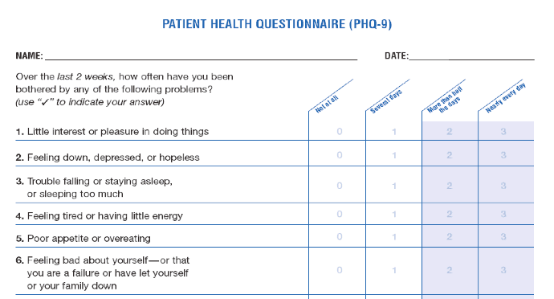
Notes:
Even tools designed to get at capacity, often do not get practically used in conversation

Slide 13
Debrief

Slide 14
Activity

Slide 15
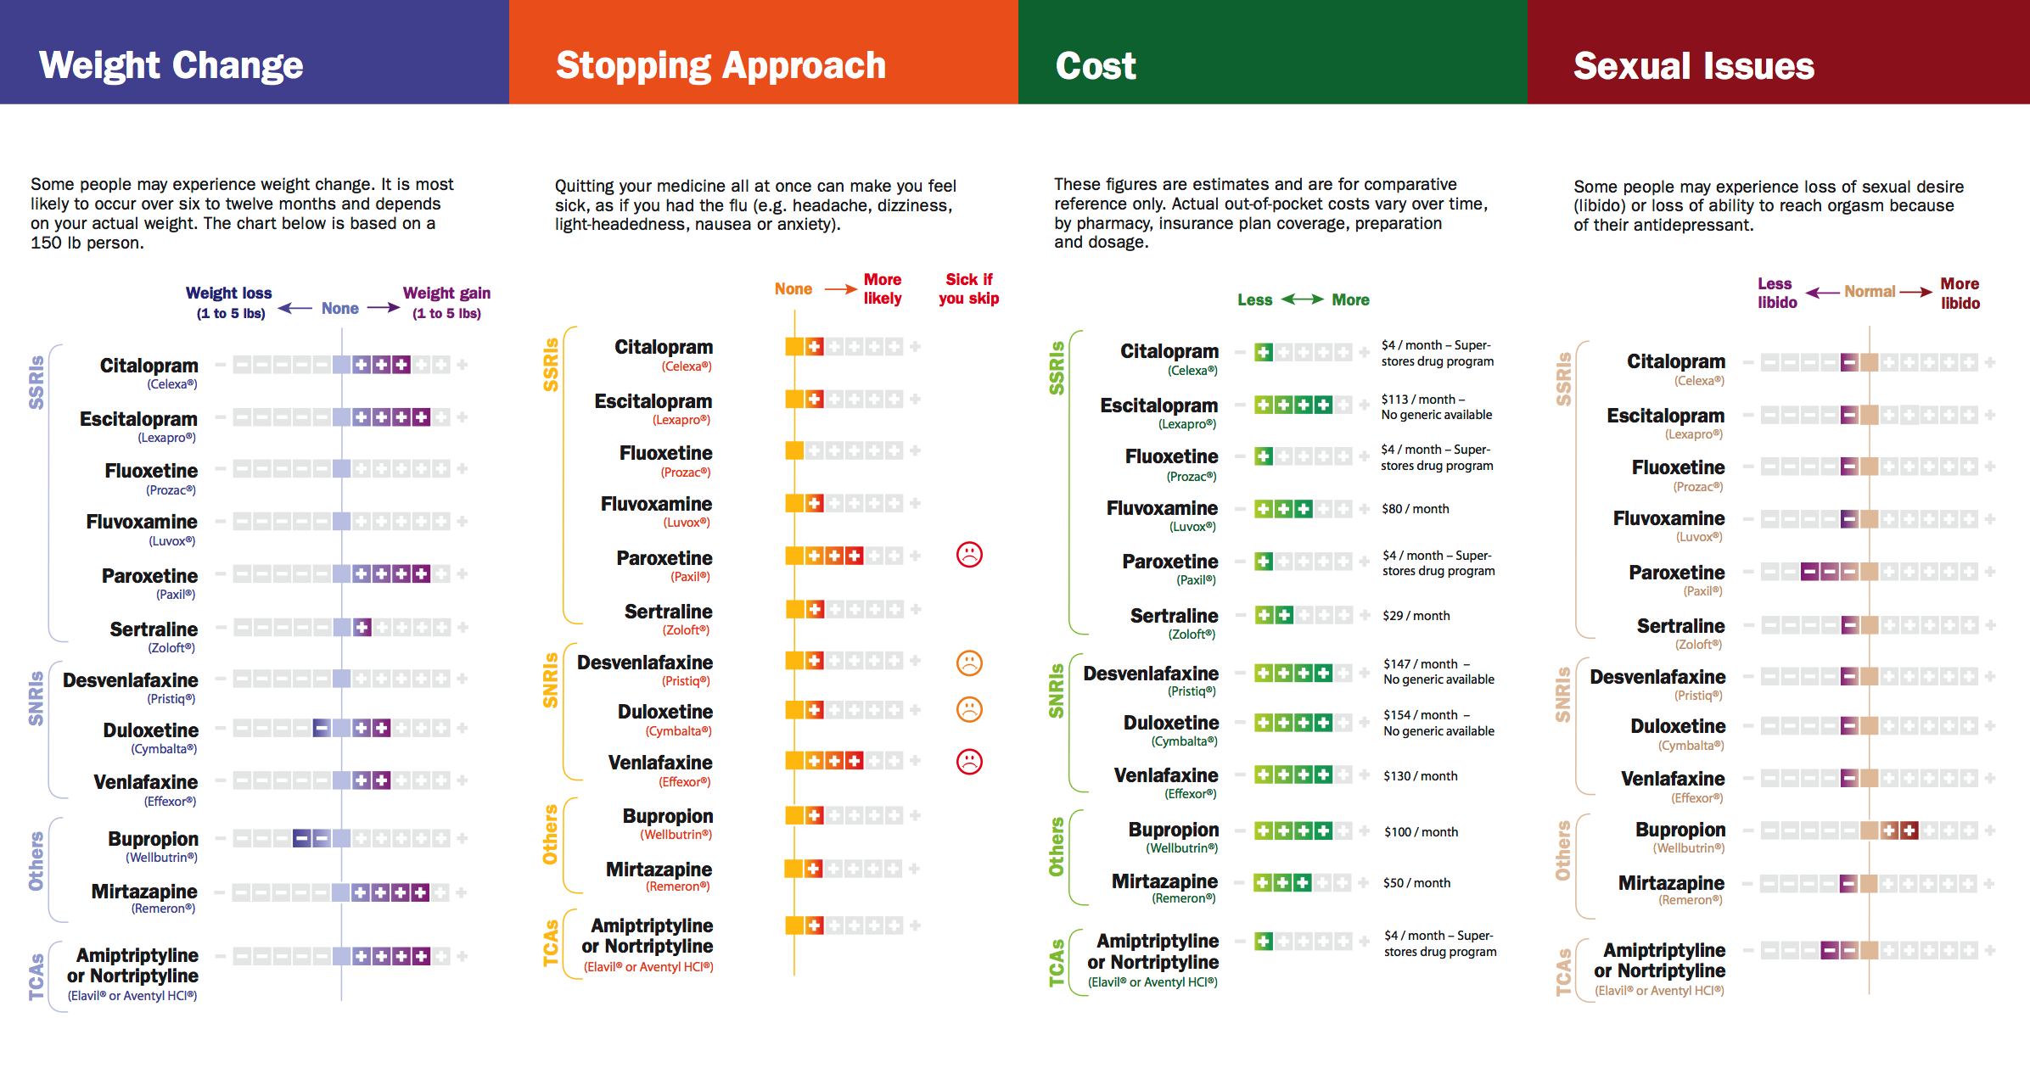
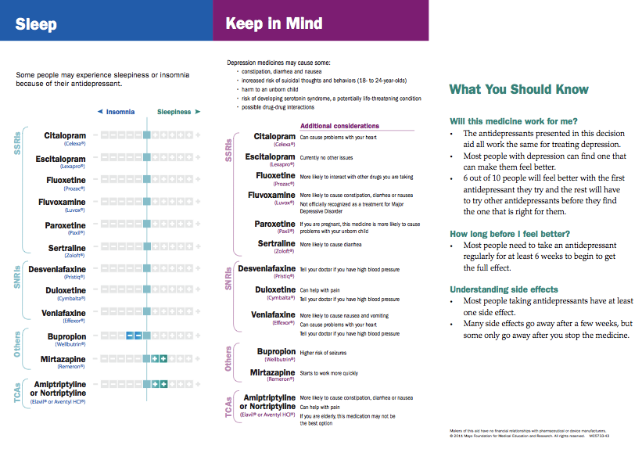
LeBlanc A et al. JAMA Int Med 2015
Notes:
Tailoring by what matters to patients

Slide 16
Debrief

Slide 17
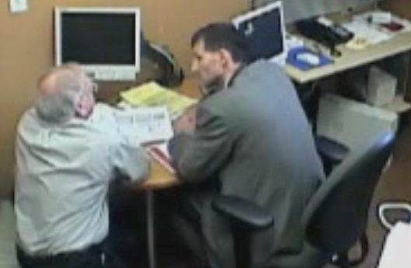
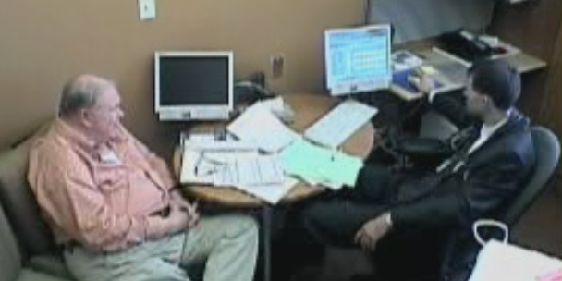

Slide 18


Slide 19
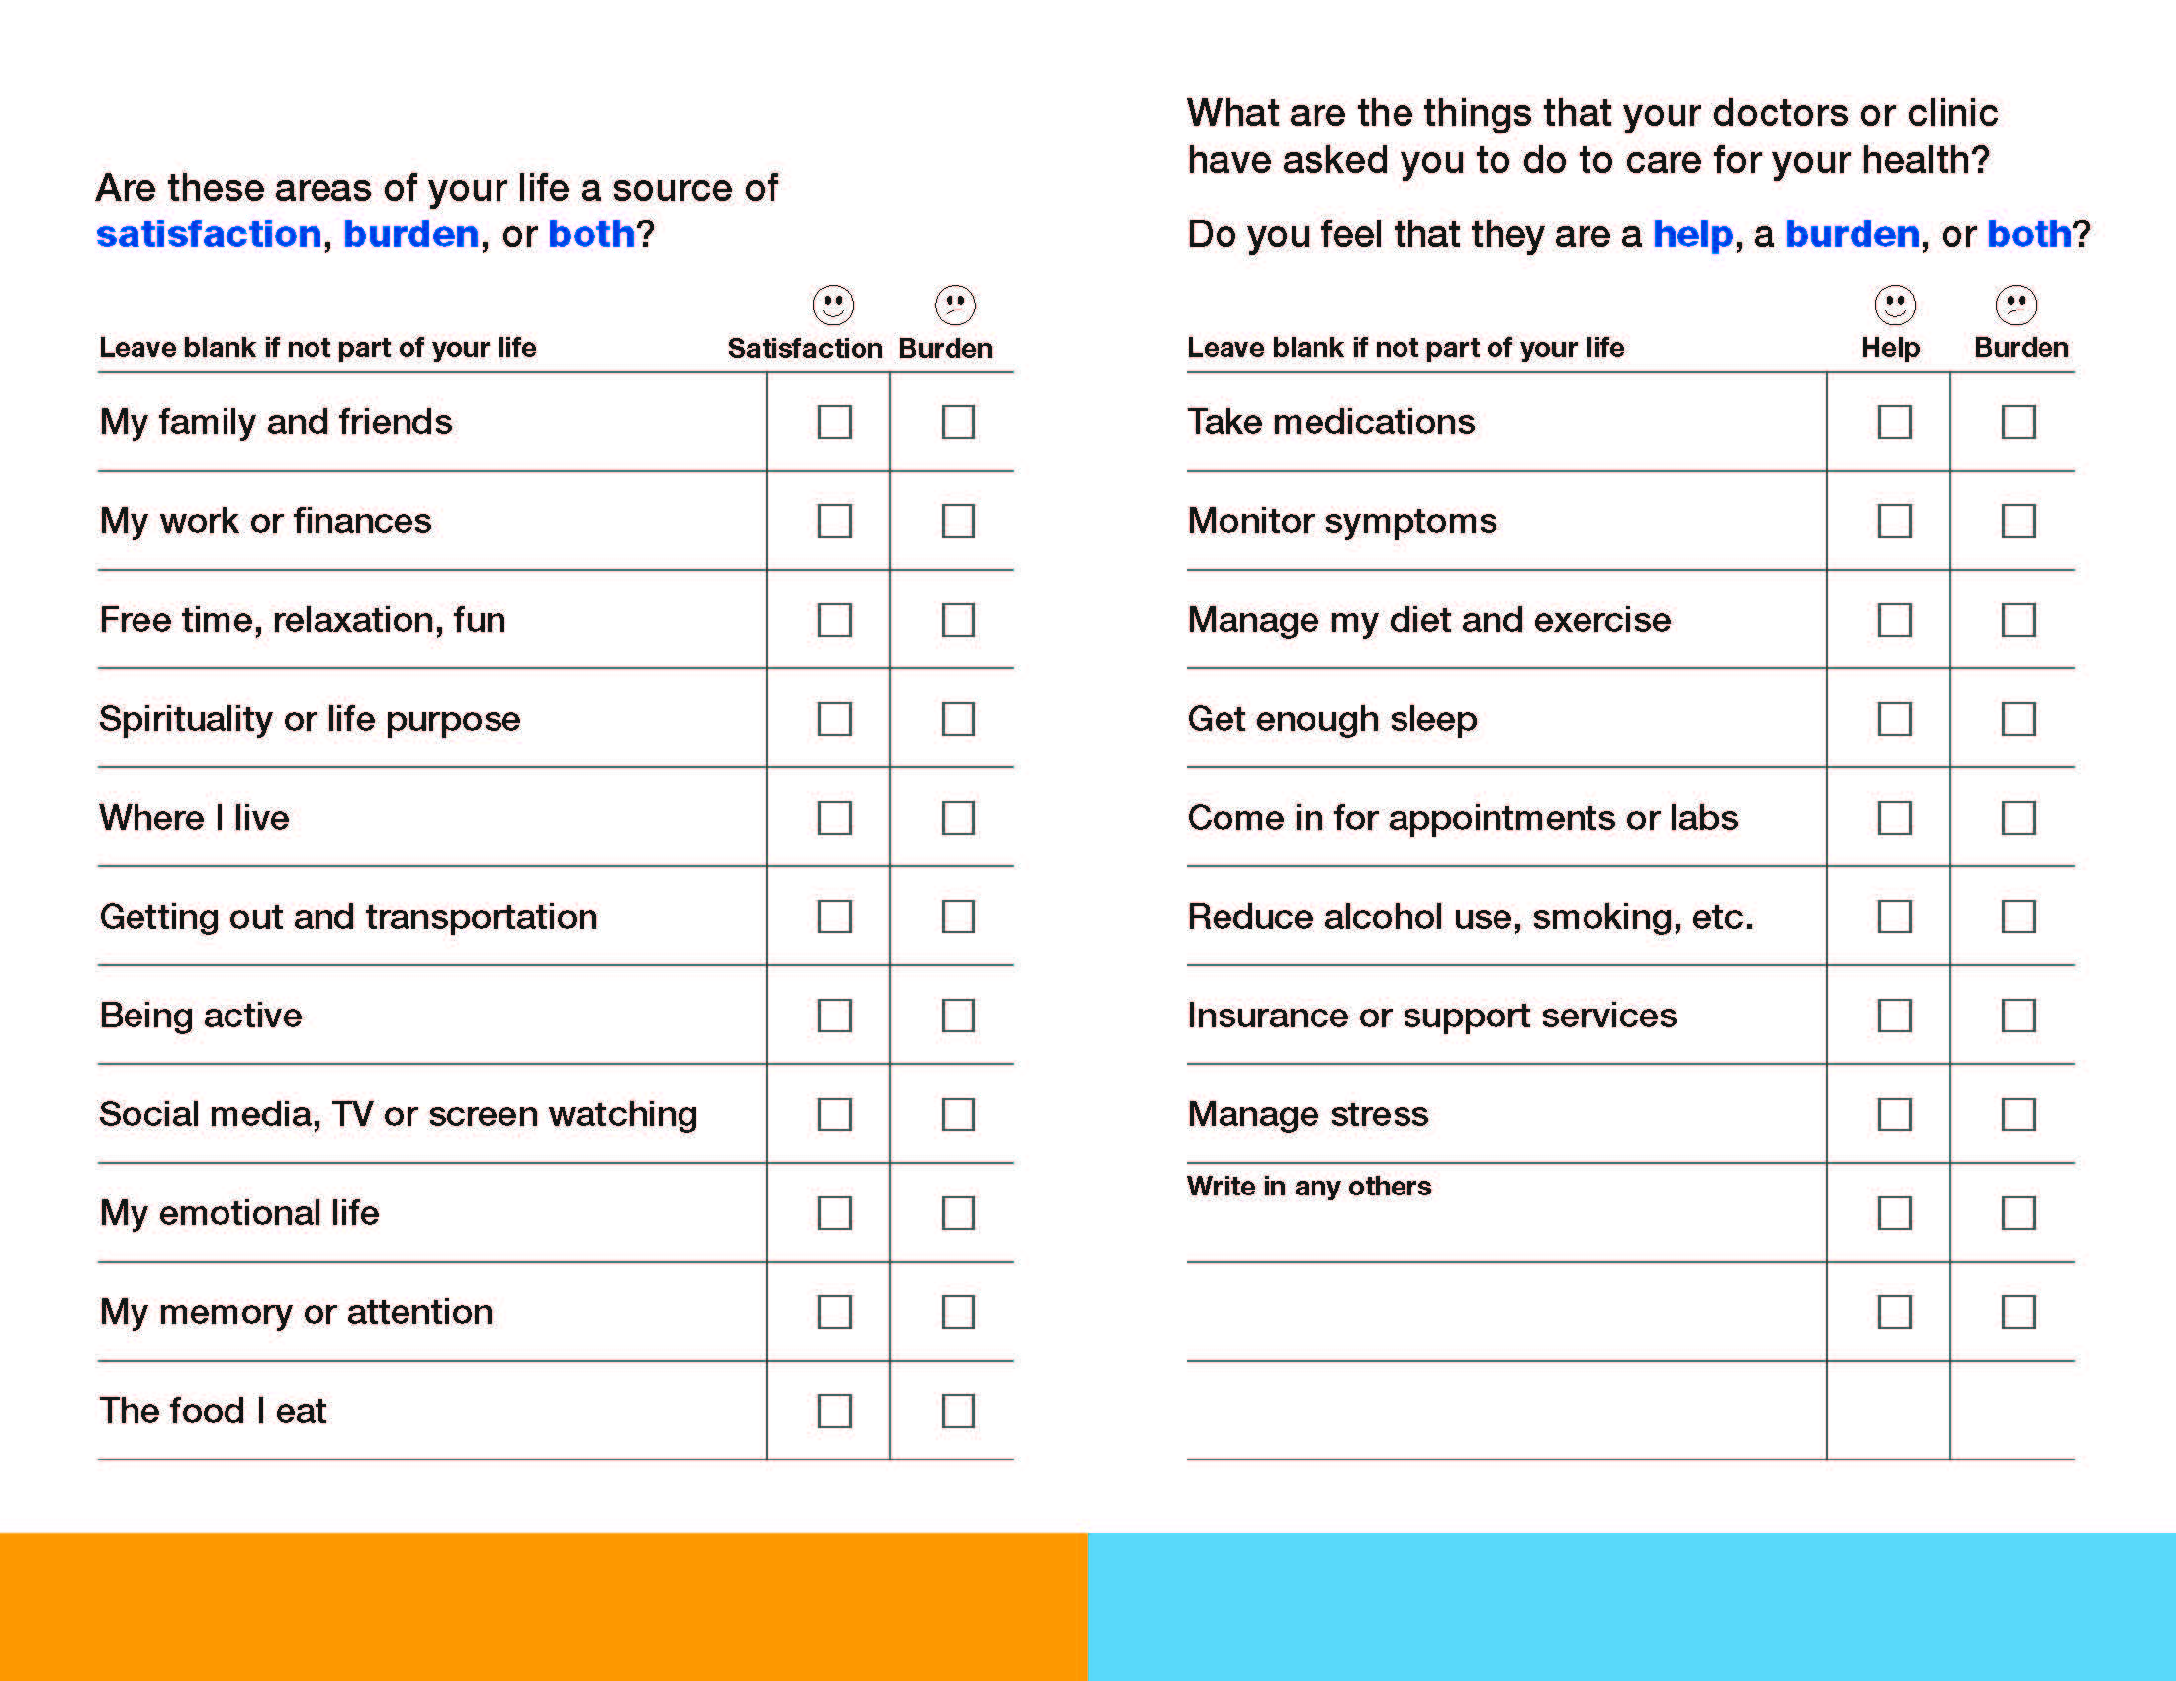
Boehmer KR, et al. 2016, BMC Health Serv Res.
Notes:
You can talk more about how ICAN Works here

Slide 20
Debrief

Slide 21
Evidence
synthesis
Observation
clinical encounters
Initial prototype
Designers
Study team
Patient advisory groups
Clinicians
Stakeholders
Field
testing
Modified
prototype
\
Final Communication Tool
Evaluation (trial)

Slide 22

Notes:
Capacity sometimes comes up naturally
It’s not well harnessed

Slide 23

Notes:
Healthcare is a learned behavior

Slide 24


Slide 25
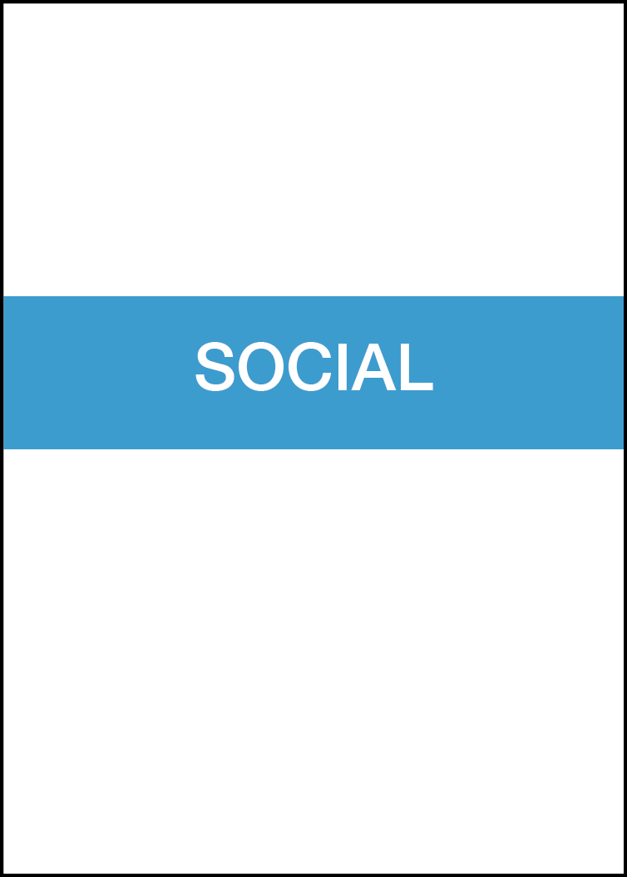
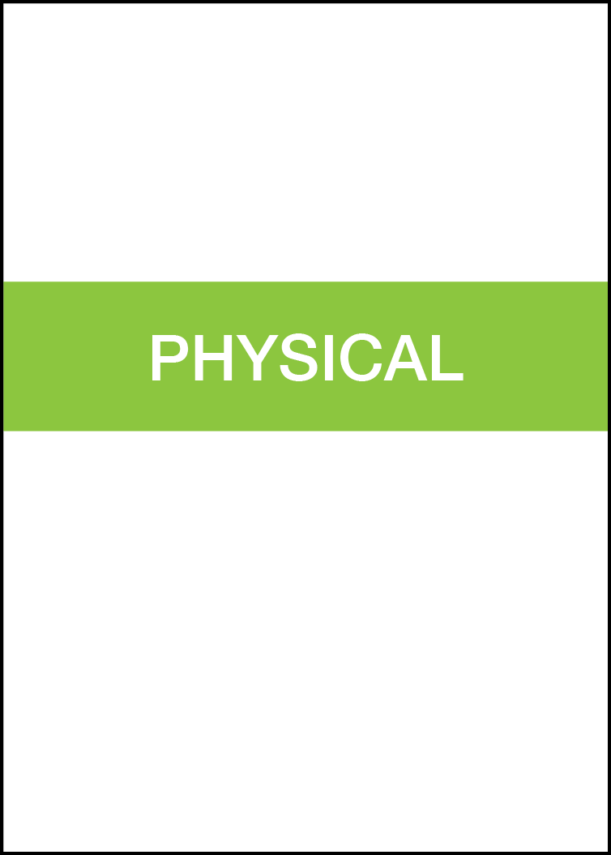
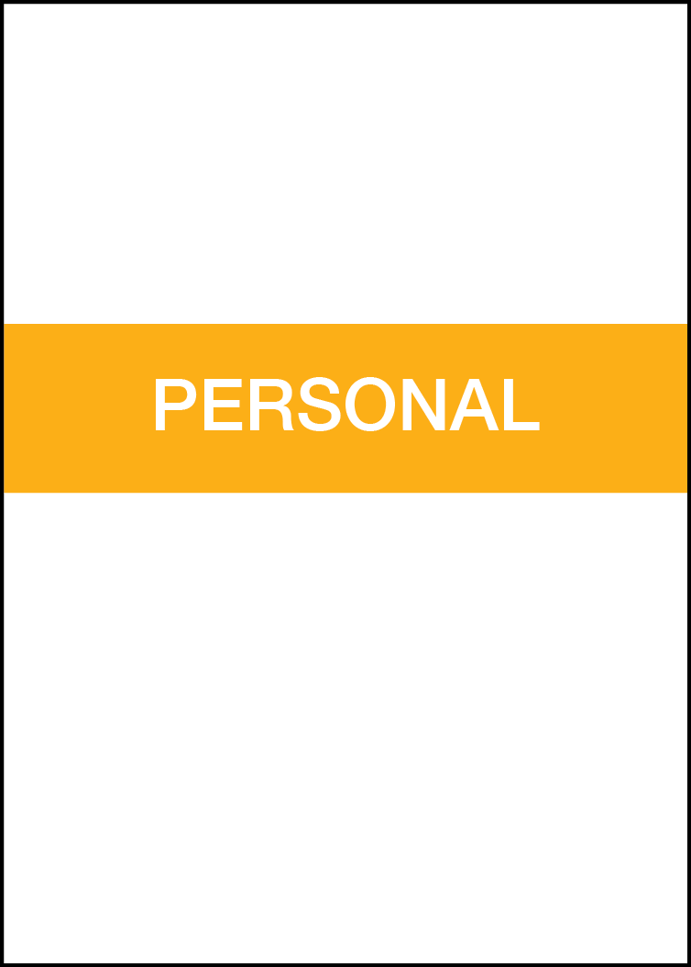
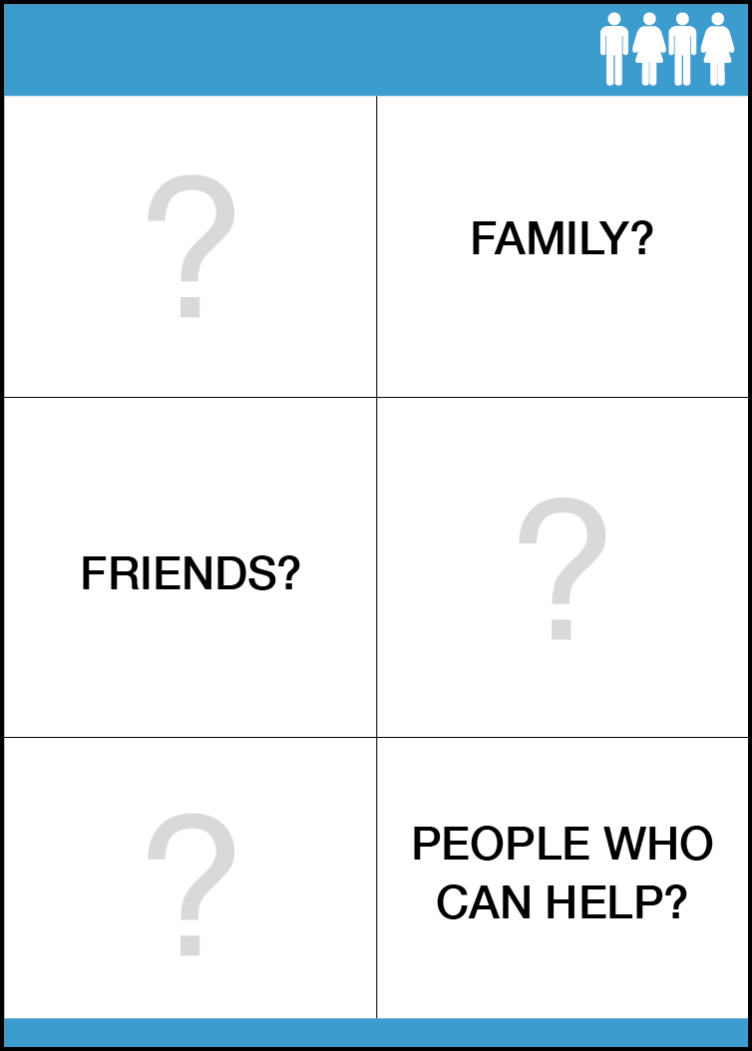
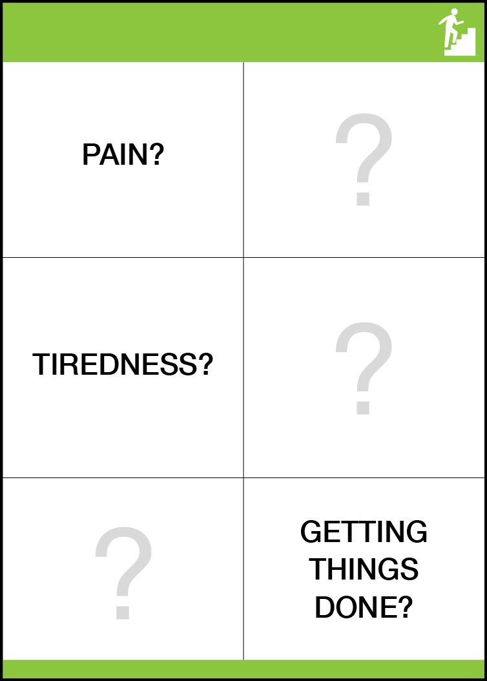
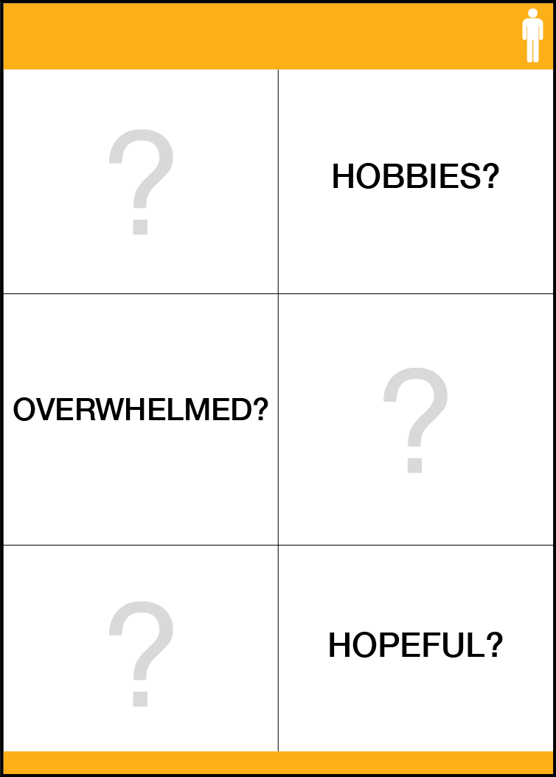

Slide 26
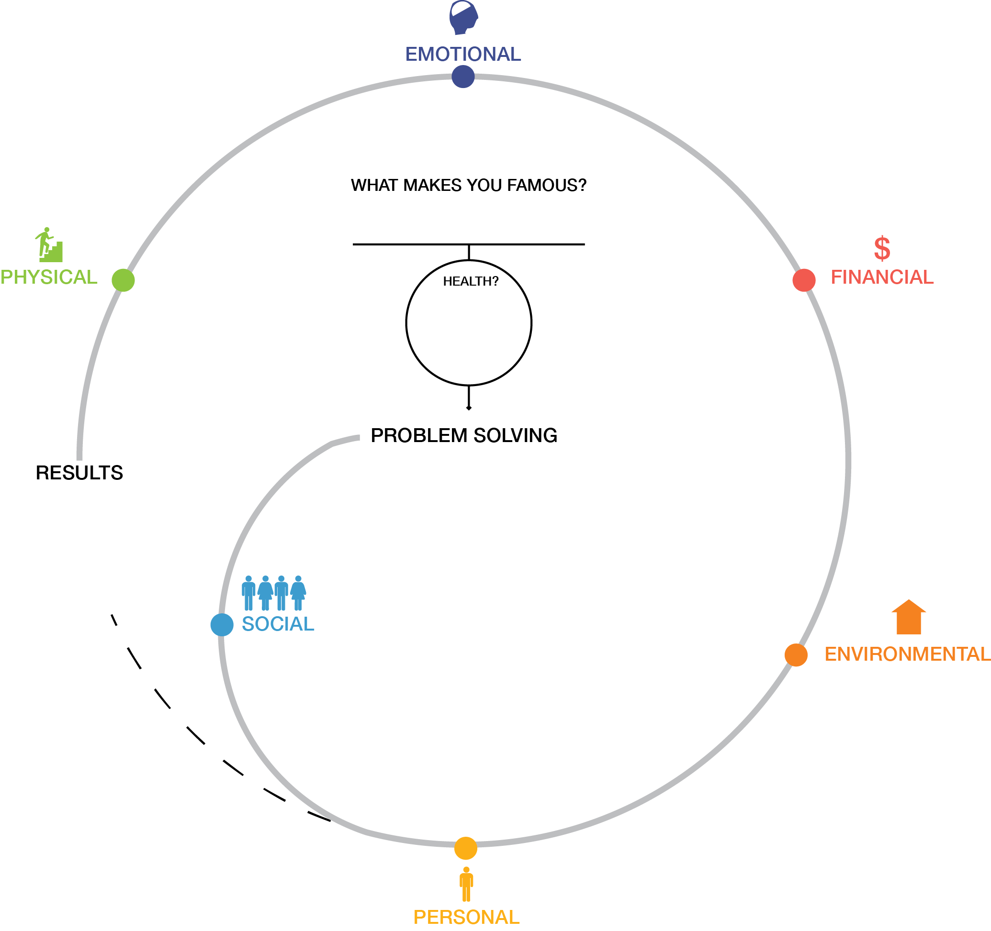

Slide 27
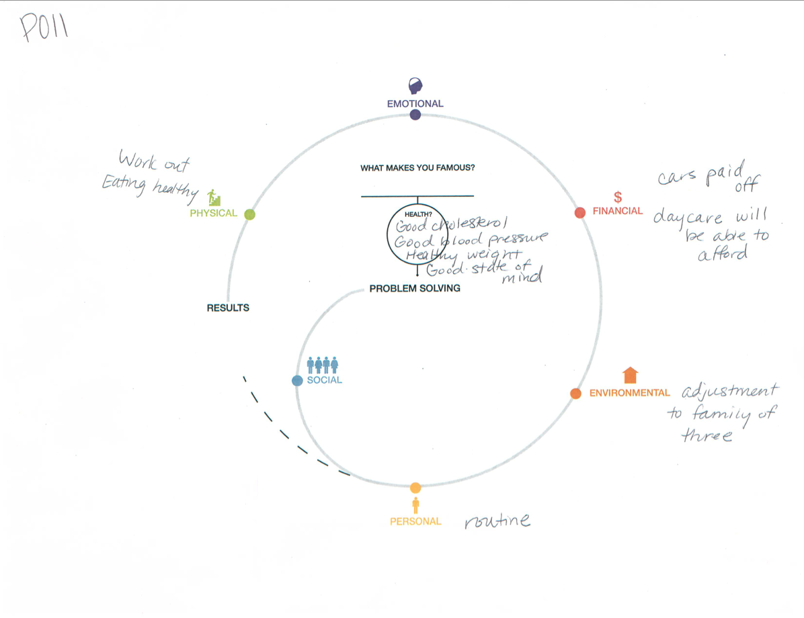

Slide 28
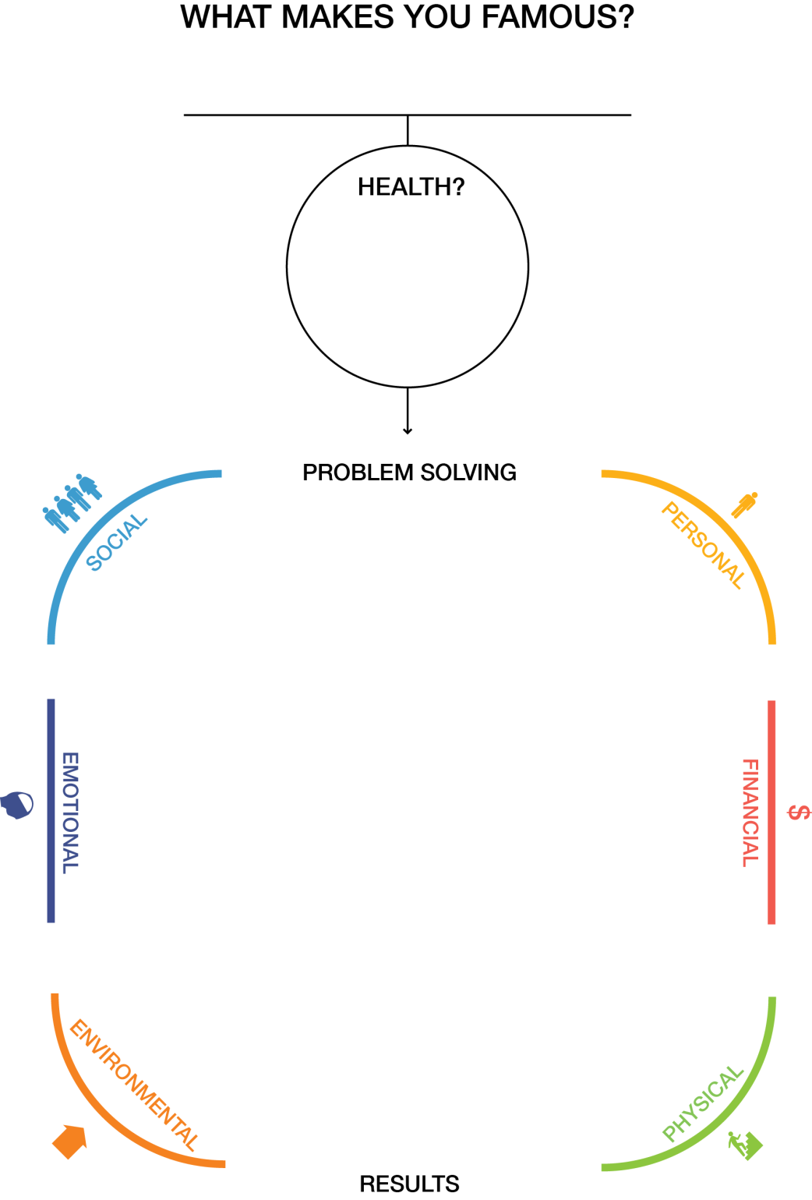

Slide 29
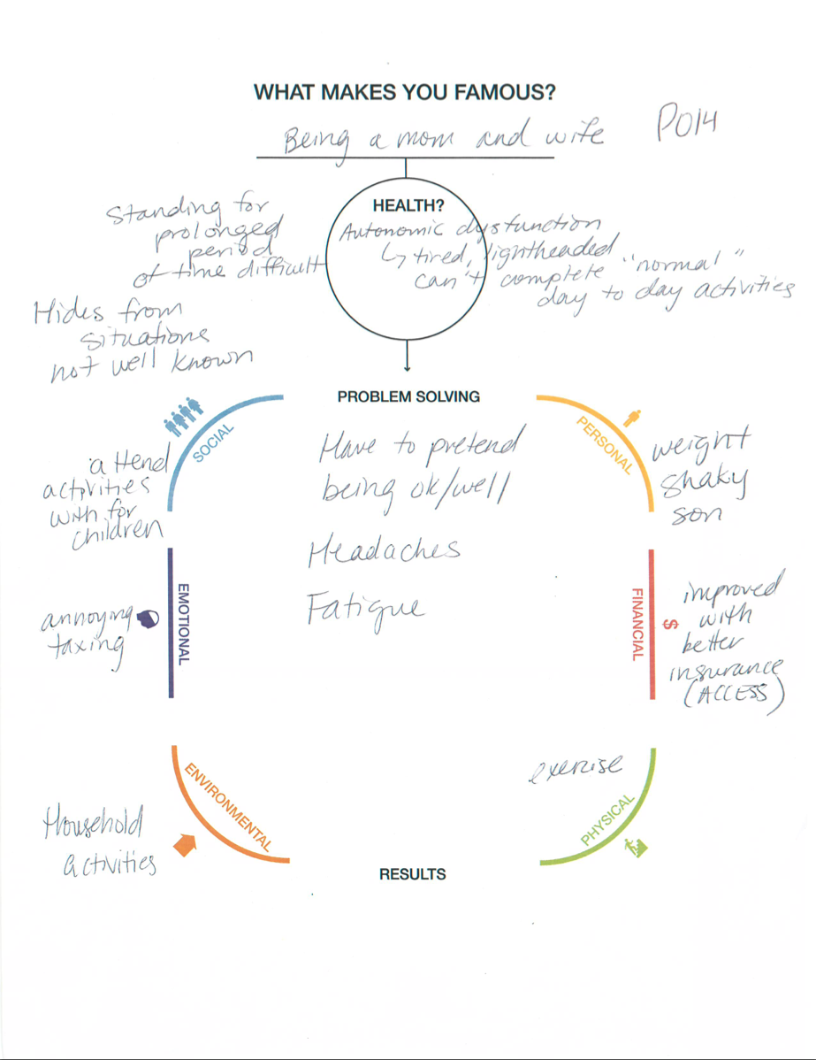

Slide 30
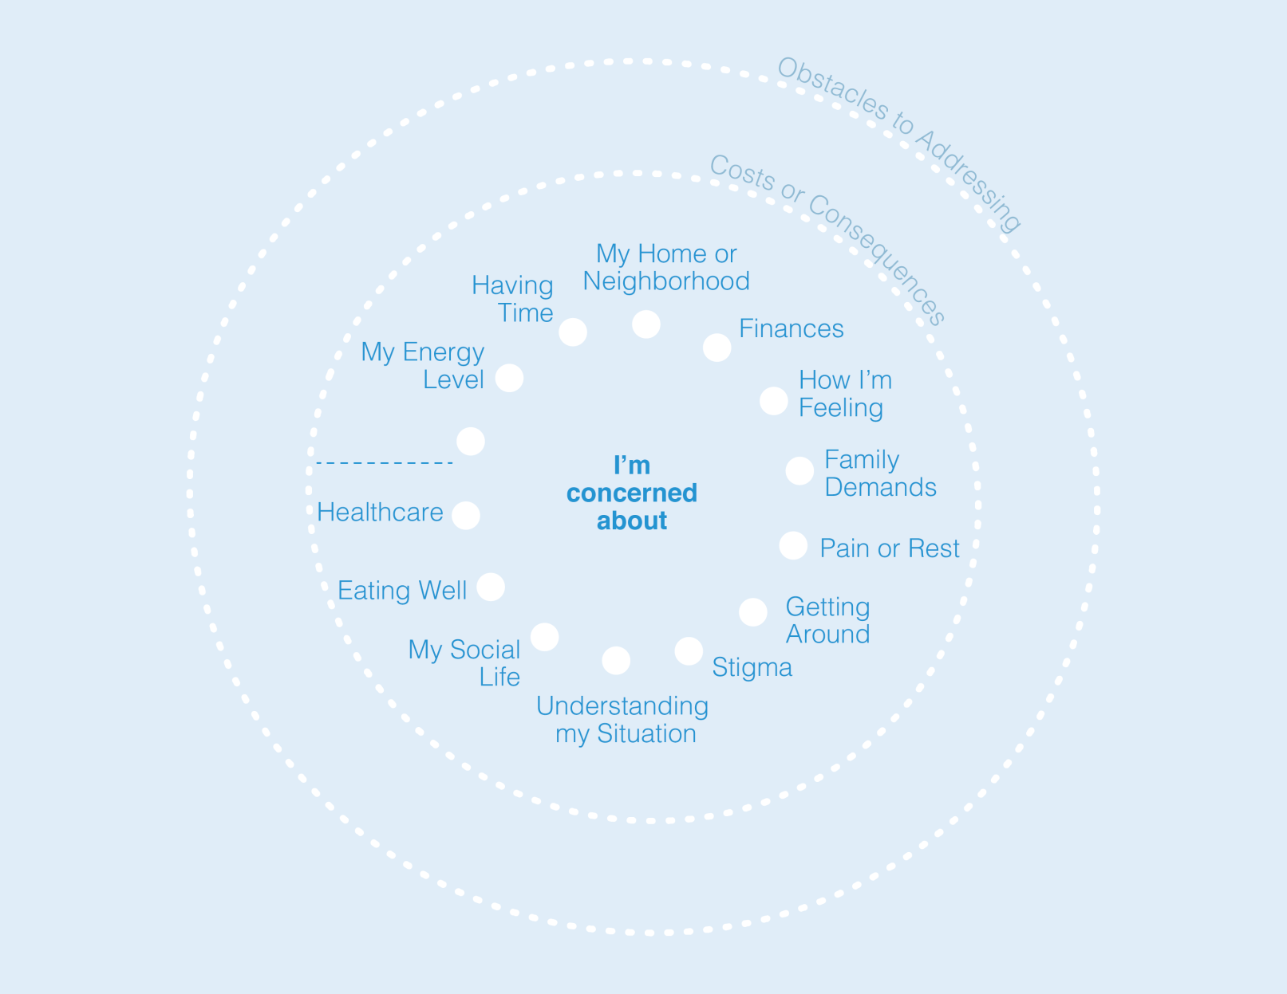

Slide 31
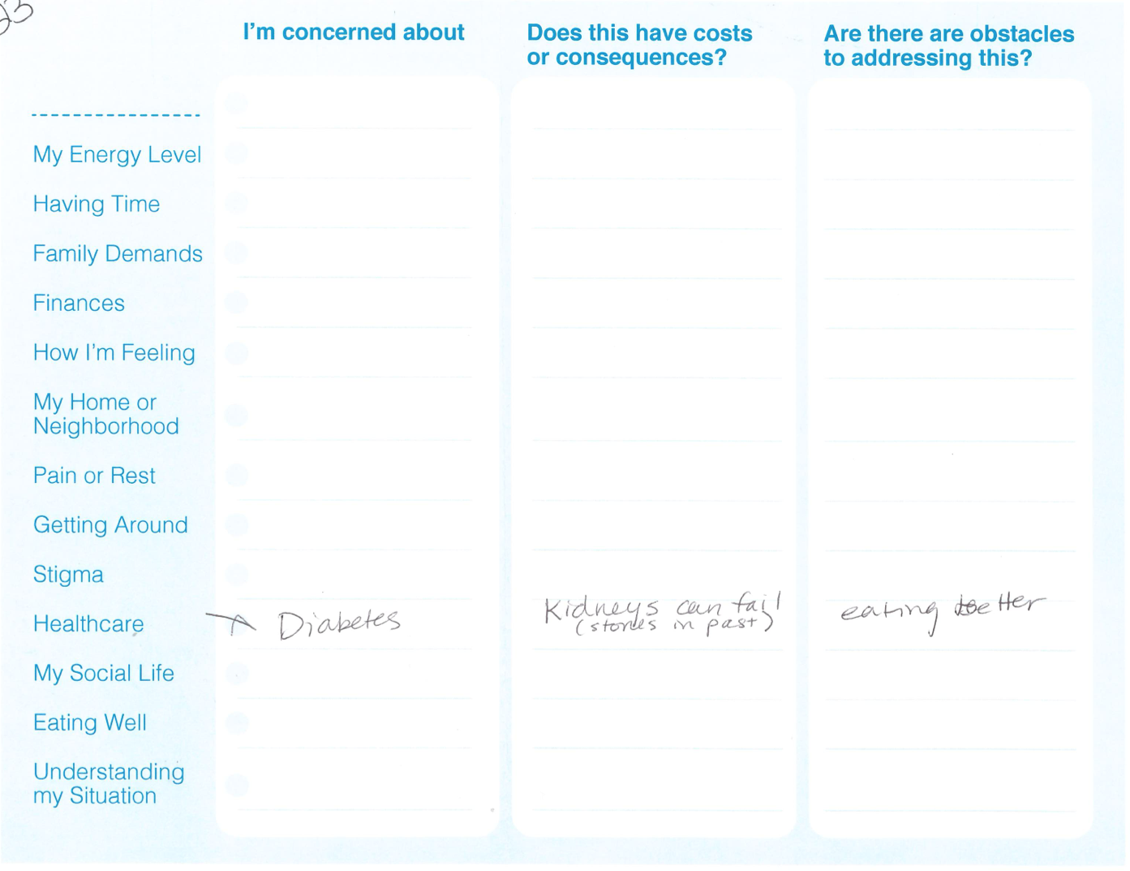

Slide 32
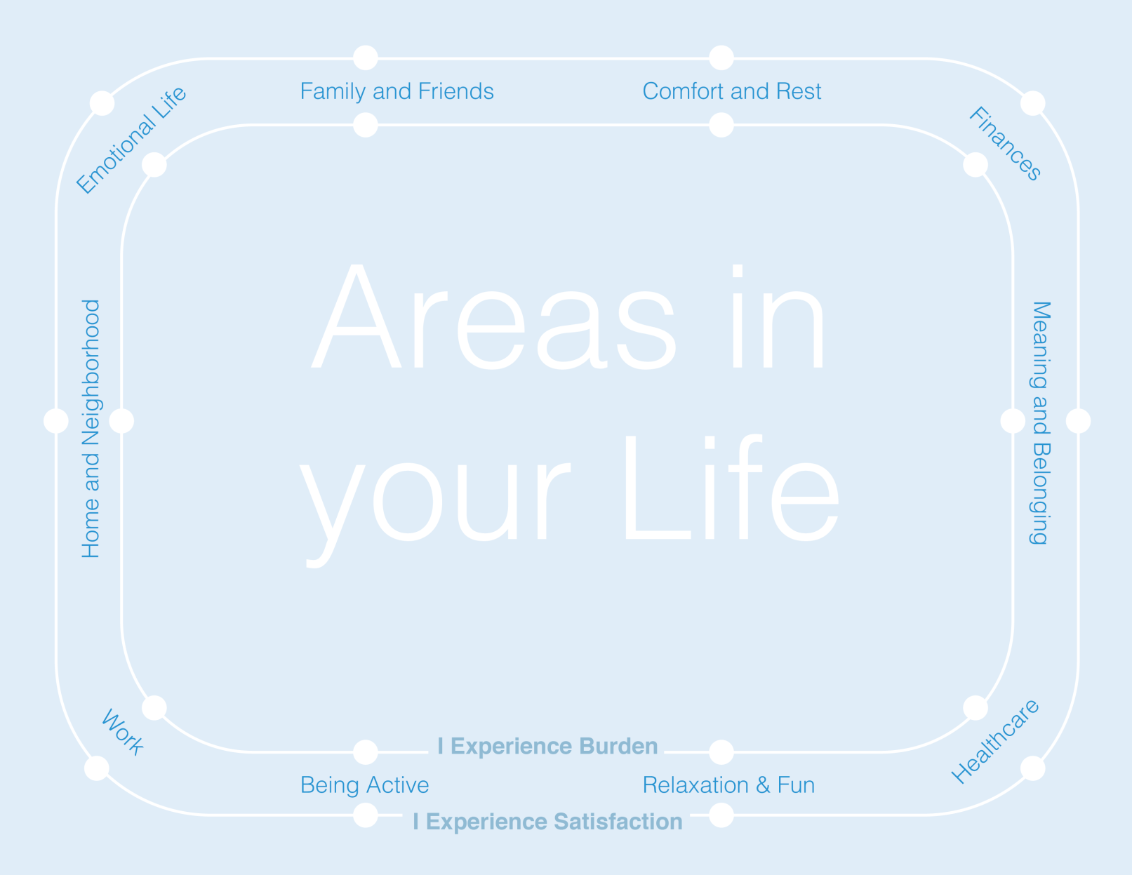

Slide 33
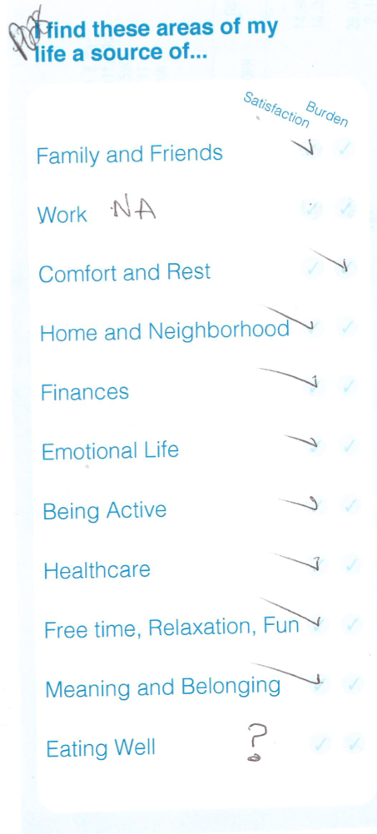

Slide 34
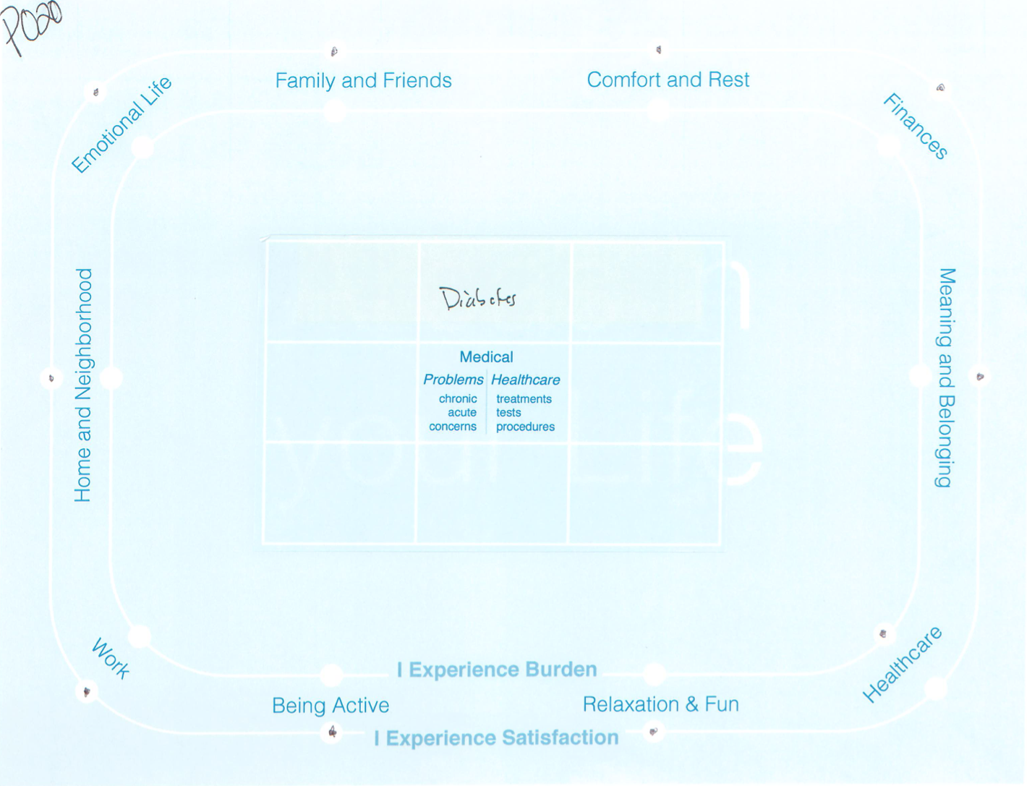

Slide 35
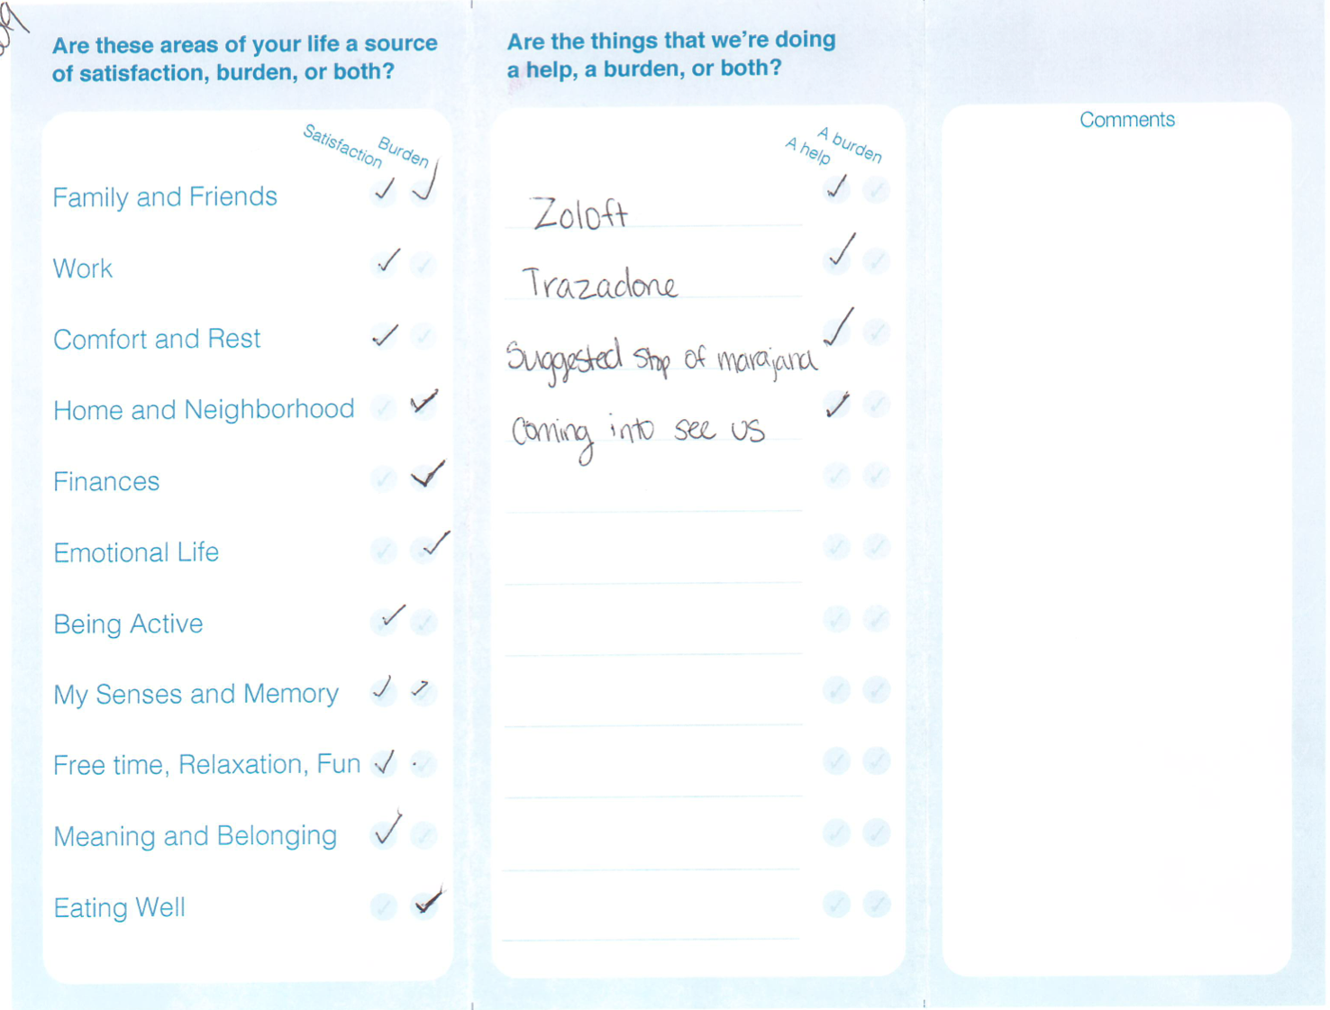

Slide 36
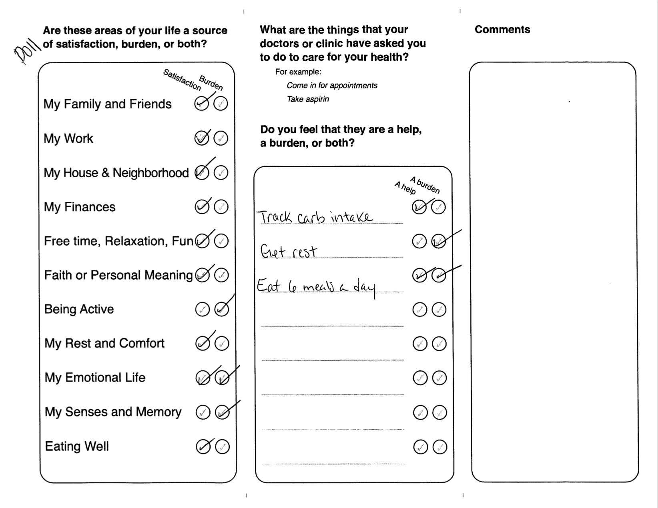

Slide 37
Two Communicative Strategies
Remove ambiguity by making definite
  Define, Assess, Interpret, Diagnose
Make ambiguity productive for the people involved
  Invention, meaning making

Slide 38
Life | Healthcare
Notes:
Treated categorically/grammatically we would seek to define and asses each of these categories
Treated topically, these two words are commonplace terms having no inherent meaning—they gain substance as we explore the relation of the two

Slide 39
Where do you find joy?
Notes:
Summer: Tell how Sarah’s story ends….
She had struggled with her weight for many years … We have to remember everyone has a reason for doing what they do and in that same respect, as I share with my patients, when we discuss trying to lose weight or quitting smoking, I have yet to meet a patient that does not recognize their weight and/or smoking is impacting their overall well-being – often they are overwhelmed by other work in their life or lack capacity …
So with Sarah, when we utilized the discussion aid to shape our conversation around her visit on wanting to lose weight – I assumed we would talk about her diet, exercise, I would recommend some options to change both, offer a dietician, etc and then follow up – but that was not the case. She listed family & friends as a satisfaction & burden - sharing insight into her stressors well beyond what I thought I knew, rest and comfort as a burden related to lack of sleep – down playing it by saying “I know it will get better eventually” …
Probably the most enlightening response was when I used one of those open-ended questions in the middle of our discussion – I asked what brings her joy and she could not find anything that she did that was enjoyable to her – I certainly couldn’t increase her capacity around trying to lose weight without helping her find joy and purpose in her life. When we were able to acknowledgeable this fact and work together on a plan that worked for her – success occurred …

