Slide 1




Fitting Care:
Setting up our time together
Kasey R. Boehmer, PhD, MPH
KER UNIT
Late Stage Translational Research
Center for Clinical and Translational Sciences
Mayo Clinic
Boehmer.kasey@mayo.edu
@krboehmer
@kaseyrebekah

Slide 2

Notes:
I welcomed my son into the world two months into my Masters.
I worked full time while doing my master’s and phd

Slide 3
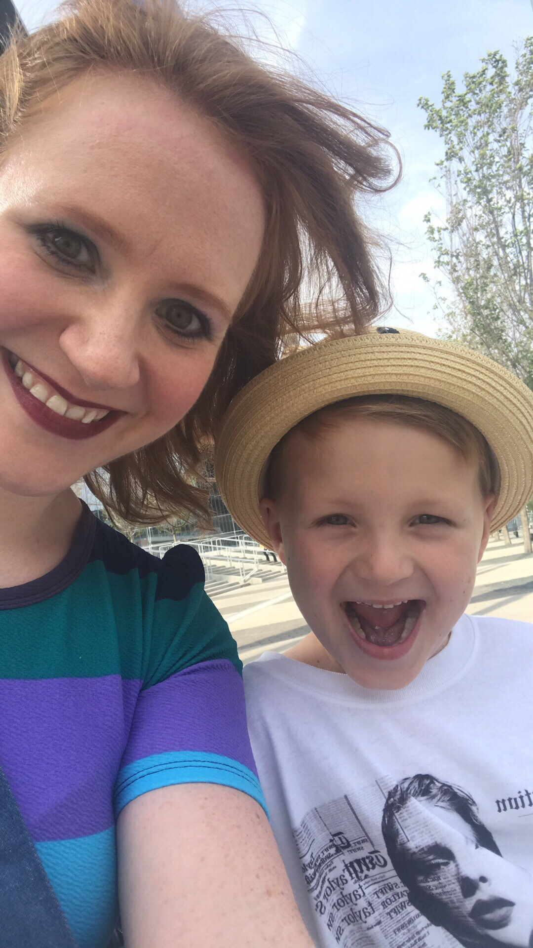
Notes:
Y’all introduced yourselves, now my turn. We’re going to get real personal and you’ll see why.
I’m 29 years old
I’m a wife and mother
I enjoy going to Taylor Swift Concerts

Slide 4

2011
Notes:
I’ve been in KER Unit for 7.5 years and my research has always focused on improving care for patients, particularly those living with chronic illness

Slide 5
Problem

Slide 6
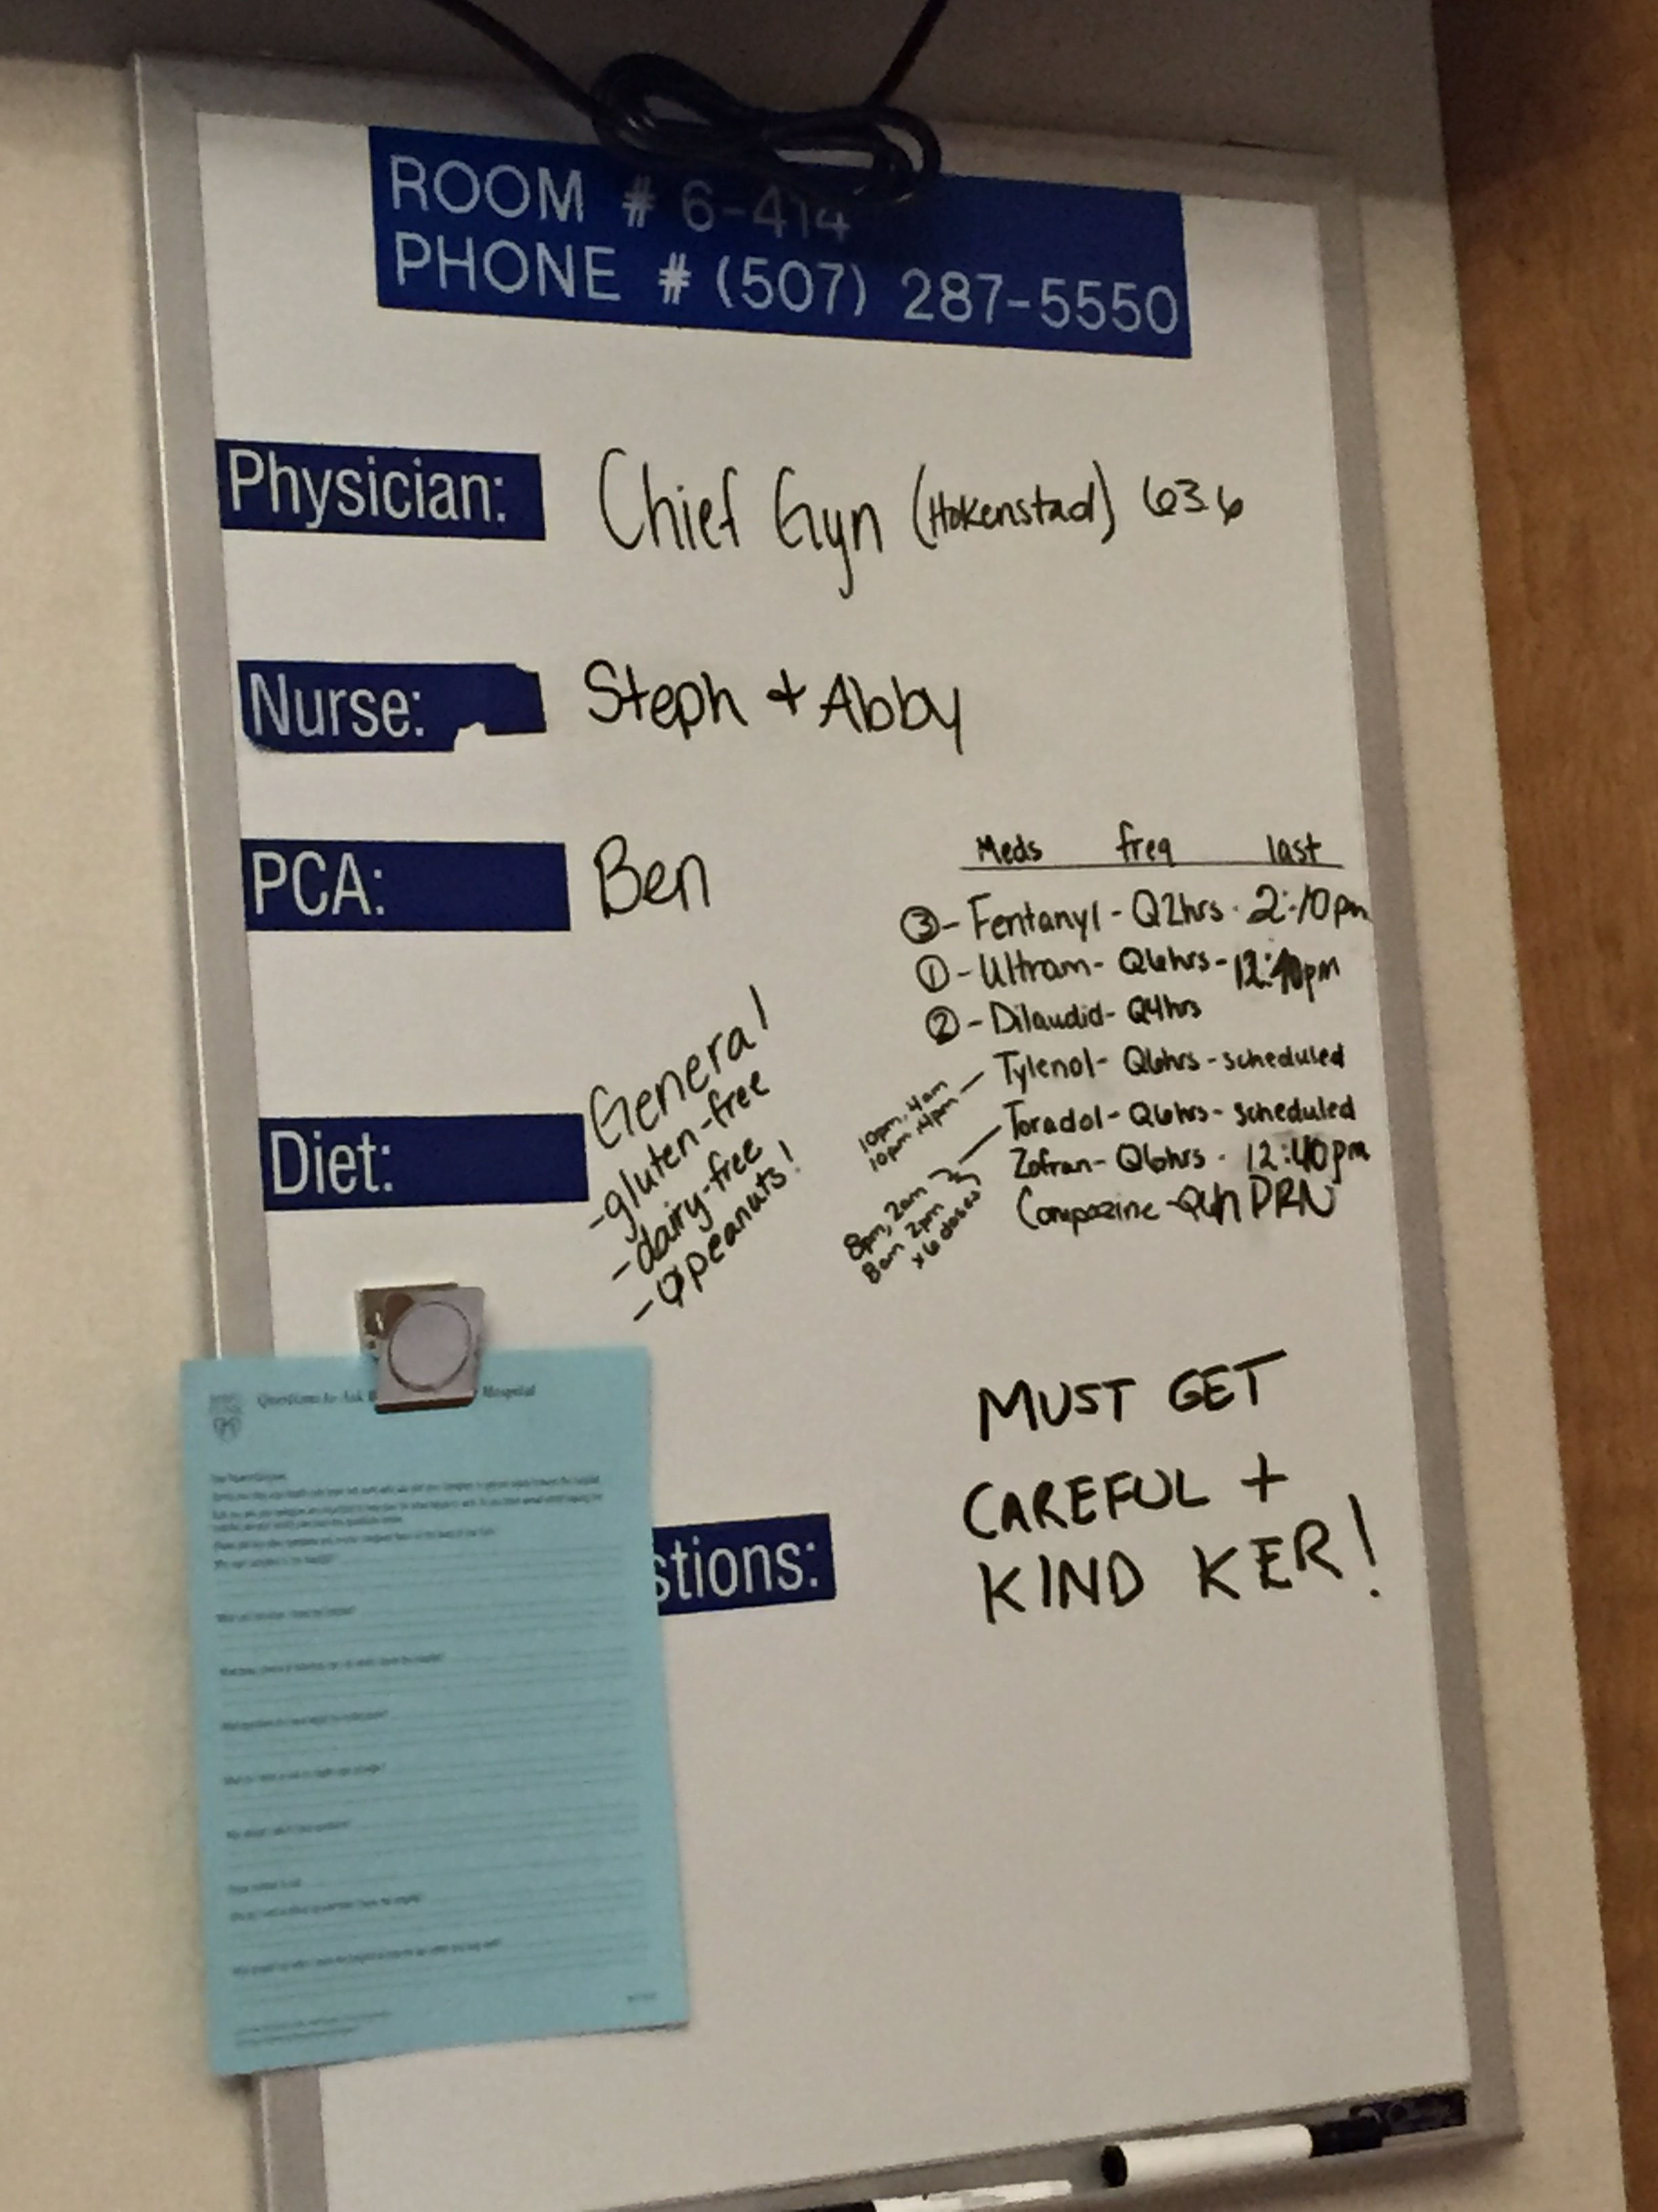
Notes:
In 2016, in my second semester of my phd, I developed debilitating pelvic pain
Eventually I was hospitalized and underwent exploratory surgery
Hospital Picture

Slide 7
Accessing care
Problem

Slide 8
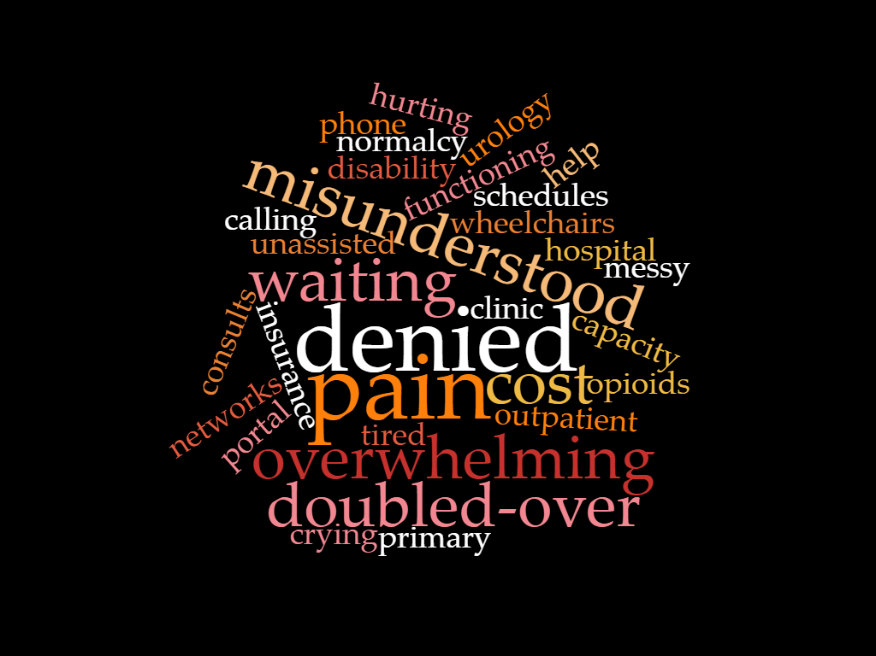
Notes:
But nothing was found during the surgery, and I was sent home to sort through what seemed like an endless pathway of potential diagnoses with no formal support from within the healthcare system, all while medicated on opioid pain meds to be able to endure the pain
As I narrowed in on a diagnosis, by process of elimination, and a good knowledge of my own body, I was shocked by a roadblock that was completely unexpected.
My eventual diagnosis, interstitial cystitis, a painful bladder condition, prevented me from receiving care. Despite a referral from my primary care clinician for diagnostic confirmation and treatment consultation, I was turned away bluntly from urology by an appointment desk coordinator. And I cried in the lobby of a place I was supposed to feel helped.

Slide 9

Notes:
I connected, through unofficial means, with the urogynocologist who oversaw the chief resident that performed my surgery. He agreed it was not unlikely that I could have interstitial cystitis.
But he also told me something that shook me to my core: he would never put interstitial cystitis as a diagnosis on my problem list.
He explained, I would likely be discriminated against by future clinicians, and even potentially denied care when I needed to seek it.

Slide 10
Understanding
Accessing care
Problem

Slide 11
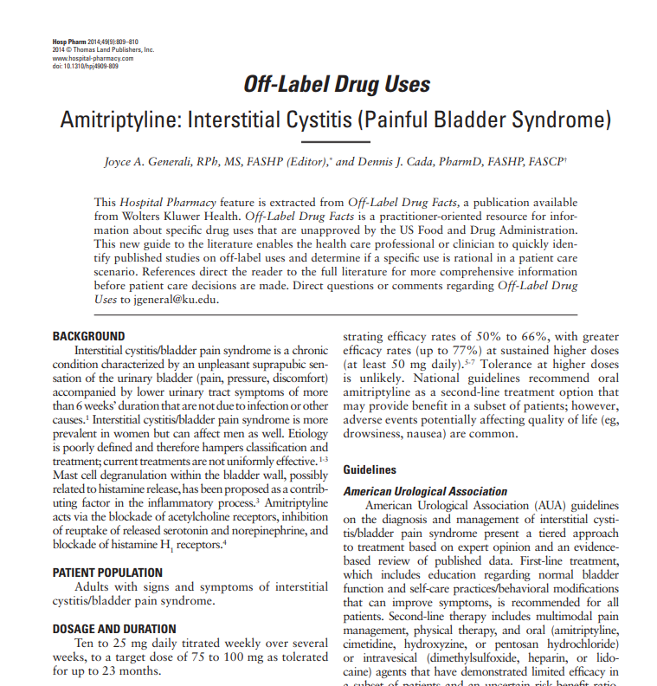
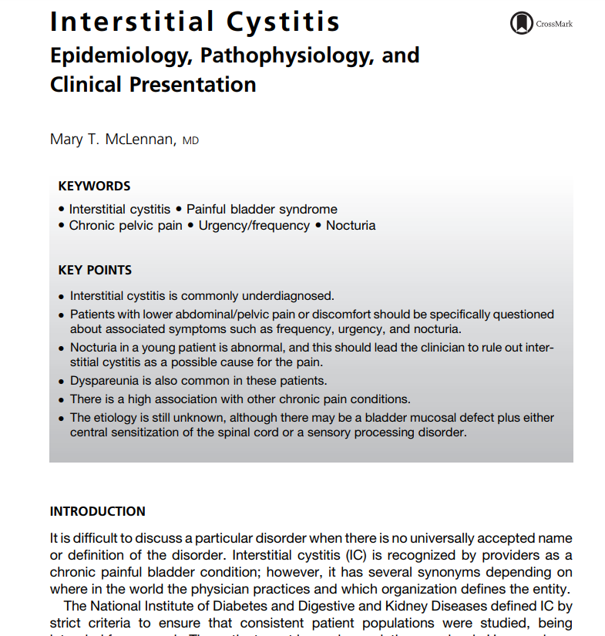
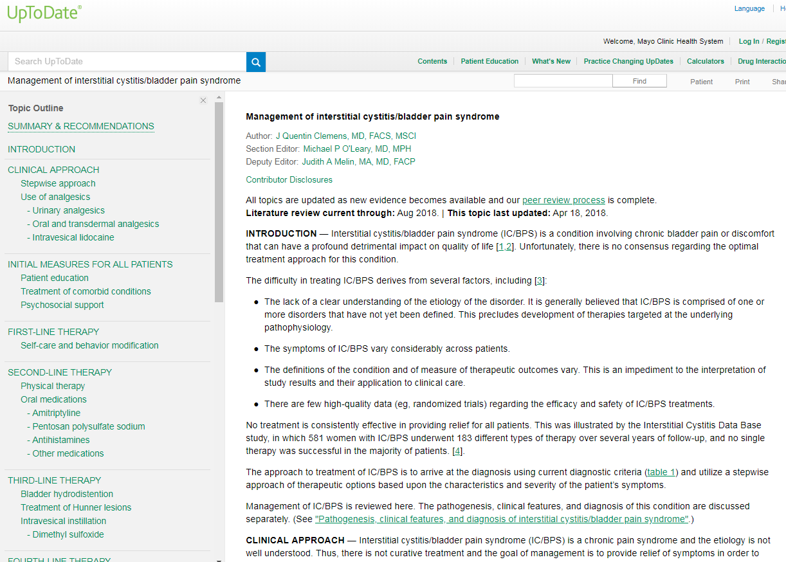
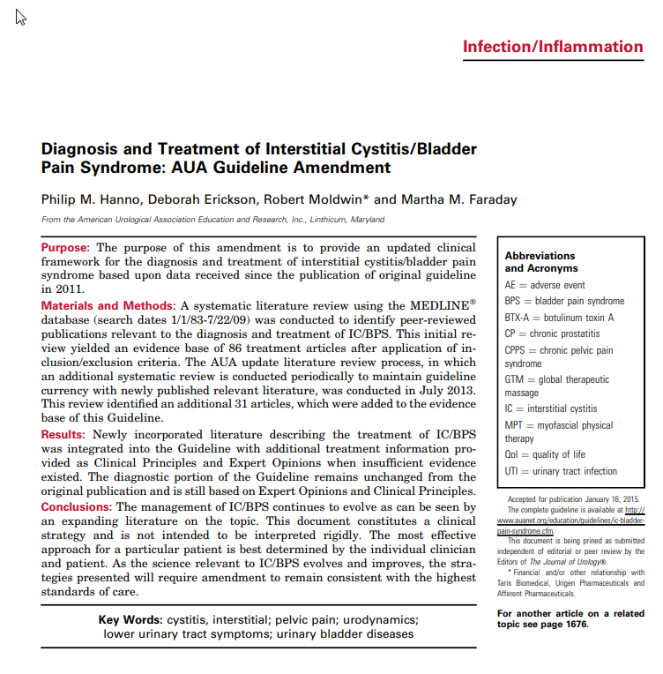
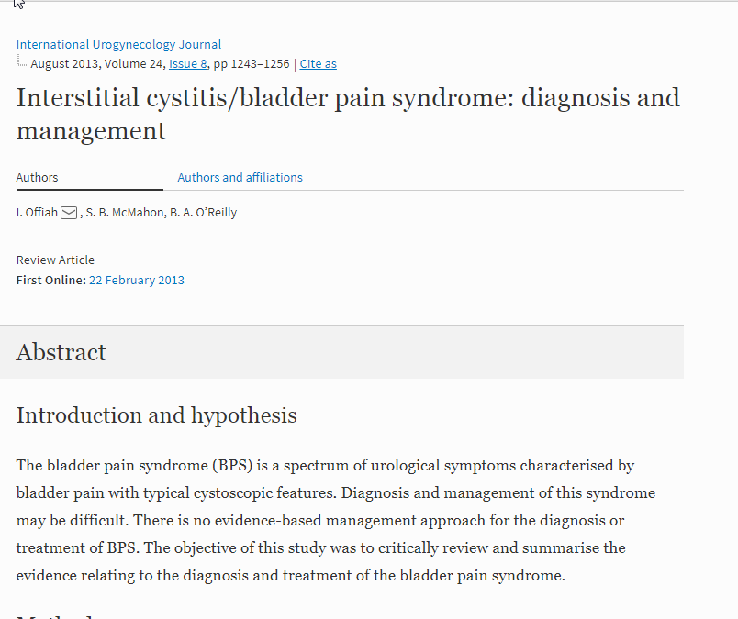
Notes:
I had to fiercely advocate for myself, and was lucky to be where I was, with many clinician colleagues ready to jump in to help me at any moment.

Slide 12
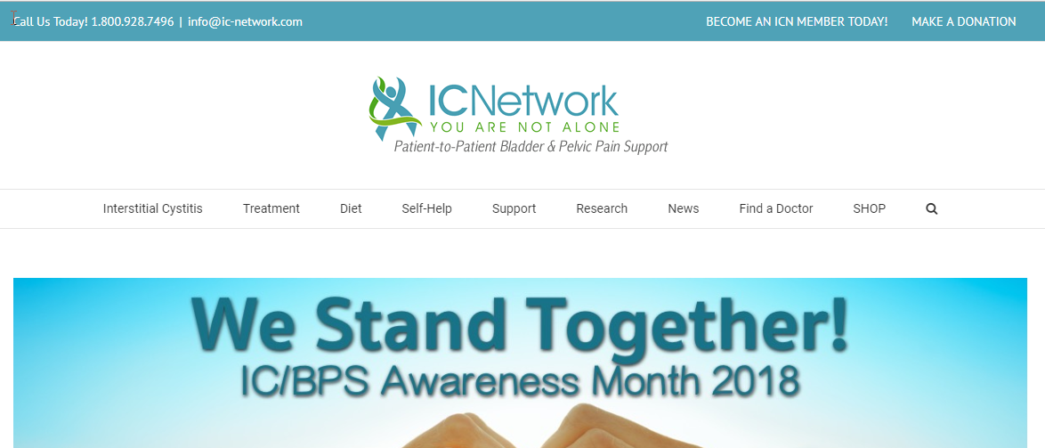

Slide 13
Selecting
Understanding
Accessing care
Problem

Slide 14
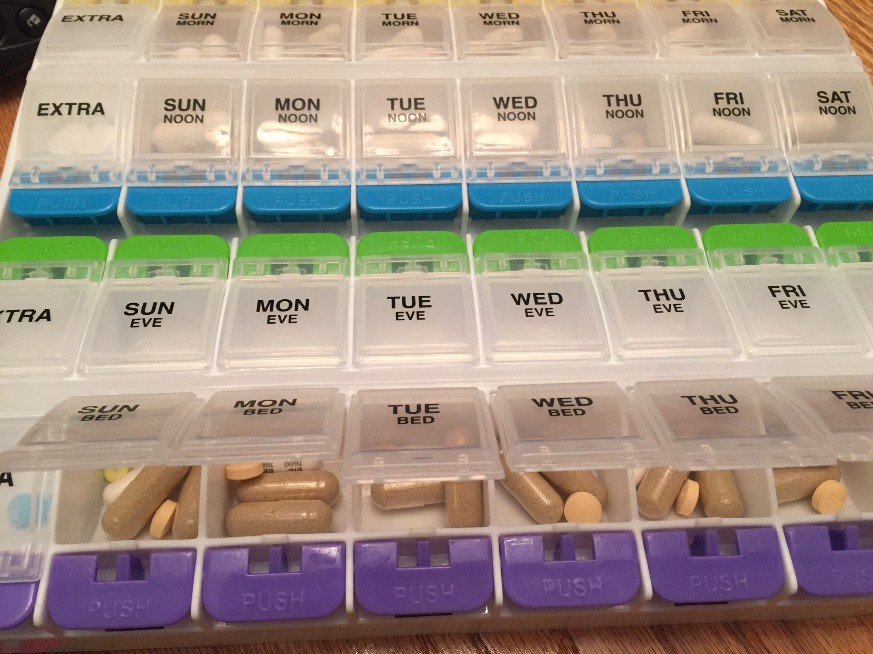
Notes:
He agreed he would oversee my care and start me on the first line therapies for IC, including pelvic floor therapy, oral therapies, and diet modification.

Slide 15
Selecting
Understanding
Tailoring
Accessing care
Problem

Slide 16
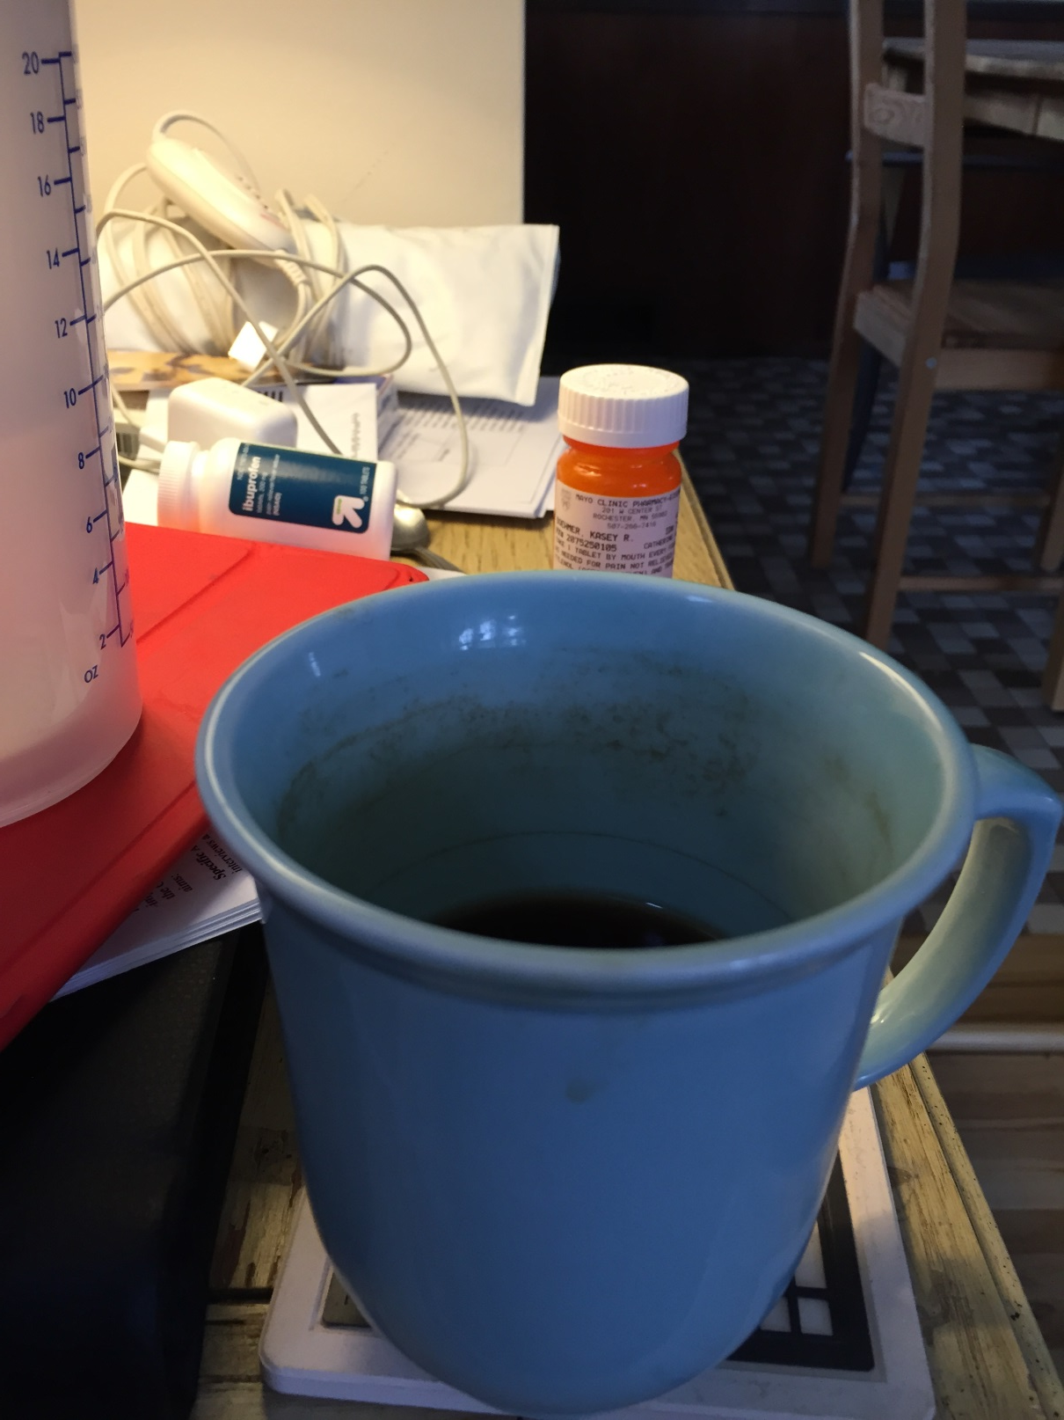

Slide 17
Selecting
Understanding
Tailoring
Accessing care
Problem
Integrating

Slide 18
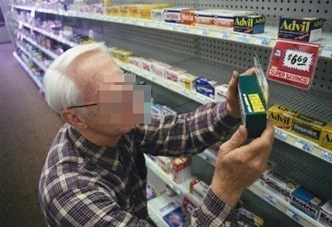
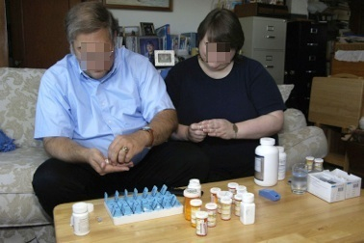


The work of being a patient
Sense-making work
Organizing work and enrolling others
Doing the work
Reflection, monitoring, appraisal
Gallacher et al. Annals Fam Med 2012

Slide 19
Selecting
Understanding
Tailoring
Accessing care
Problem
Integrating
Assessing

Slide 20
Prevalence of Treament Burden
40% of patients say their treatment burden is unacceptable.
Turns out, those of us who are younger, say it is worse…
Tran et al., in preparation

Slide 21
The Process of Fitting Care
Selecting
Tailoring
Integrating
Assessing
Understanding
Revising
Accessing care
Problem
Notes:
All of this – from accessing healthcare to designing a care plan to integrating it into our lives and coming back out into our communities – we have research that is tackling these problems

Slide 22
Capacity
Workload
Biography
Resources
Environment
Work
Social
Boehmer K et al BMC Fam Prac 2016

Slide 23
Burden of treatment
Workload
access
use
self-care
Outcomes
Capacity
Burden of illness
Shippee N et al JCE 2012
Notes:
How we might think about joan’s situation.

Slide 24
The Process of Fitting Care
Selecting
Tailoring
Integrating
Assessing
Understanding
Revising
Accessing care
Back into the community
Problem
Solution
Notes:
All of this – from accessing healthcare to designing a care plan to integrating it into our lives and coming back out into our communities – we have research that is tackling these problems

Slide 25

Notes:
As I healed, and the fire in my bladder began to cool, the fire in my heart and brain about the plight of other patients like me that didn’t have the same resources and capacity. Were they still suffering?
What other conditions left patients to suffer this same fate?
I was in a unique position – I was a researcher of improving care for patients with chronic illness. And so I began to seek out ways to incorporate research for these shunned patients.

Slide 26
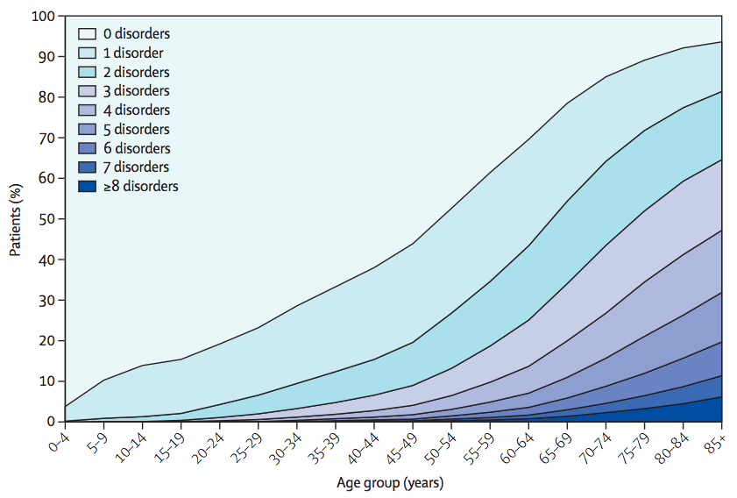
Barnett et al. Lancet 2012
Notes:
I also have asthma, severe allergies, and a heart condition.
I knew I was entering into the world of living with multiple chronic conditions. And this is what this world looks like.

Slide 27

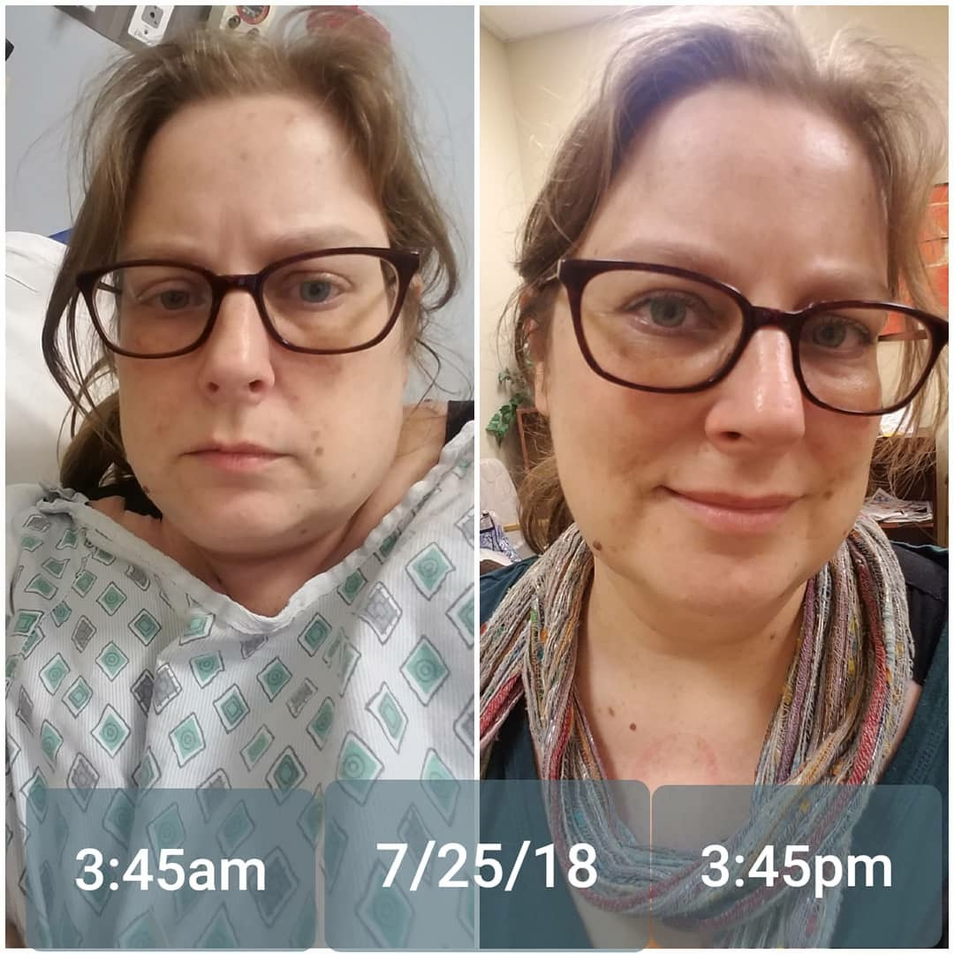
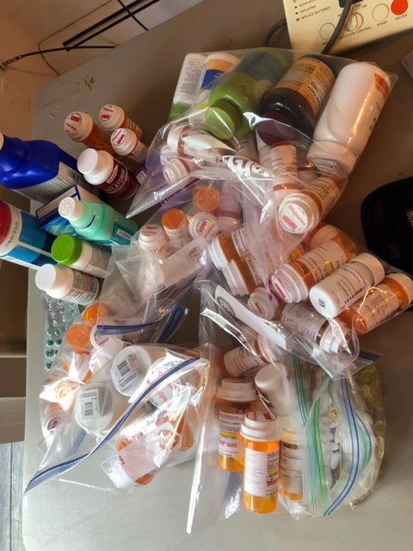

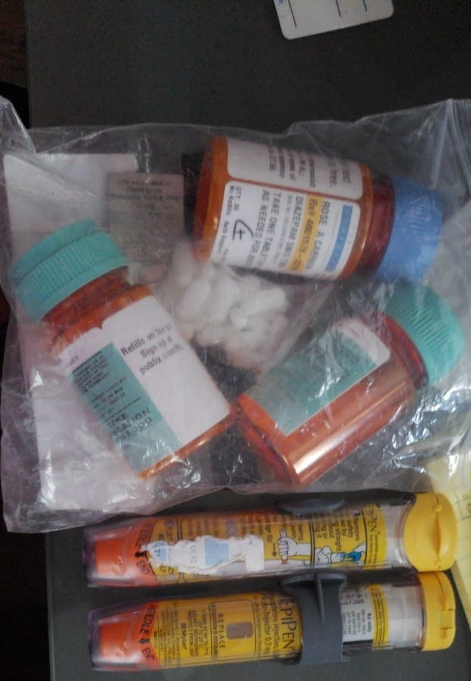
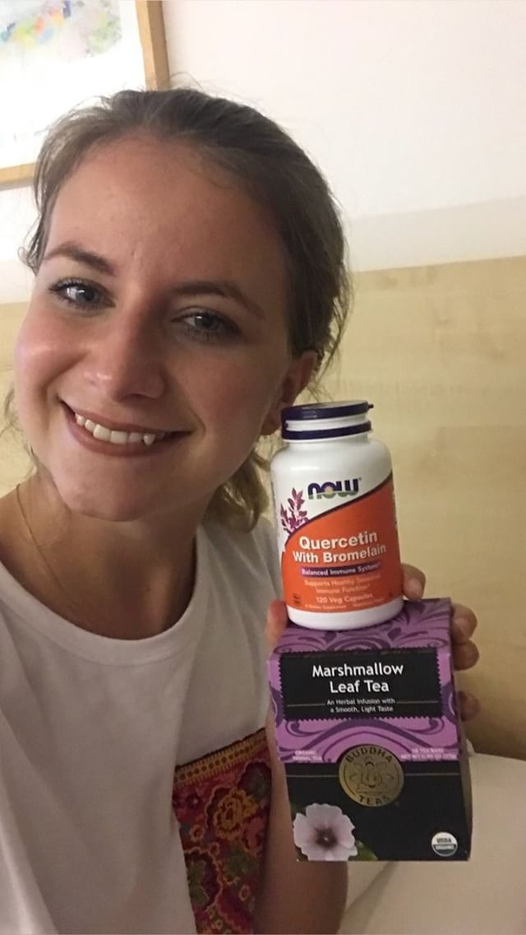




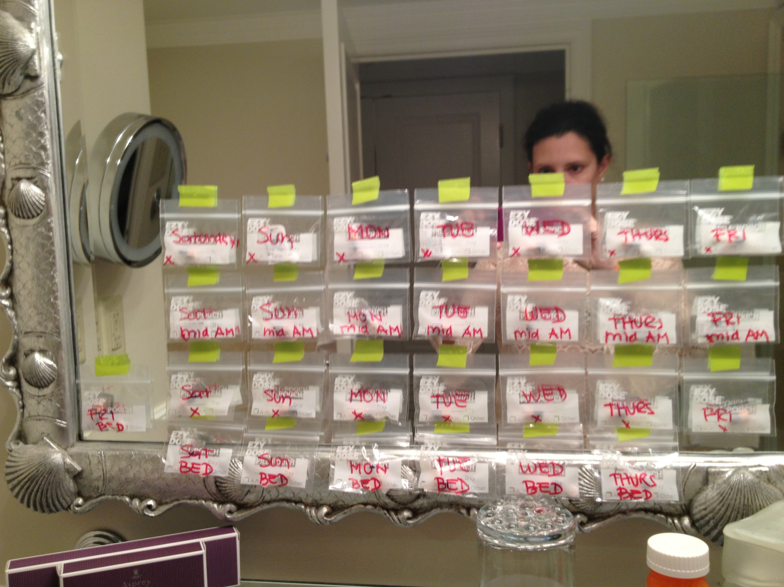

Slide 28
Accessing care
Problem

Slide 29

The Patient Experience of Living with Undercared-for Chronic Suffering

Slide 30
Understanding
Accessing care
Problem

Slide 31
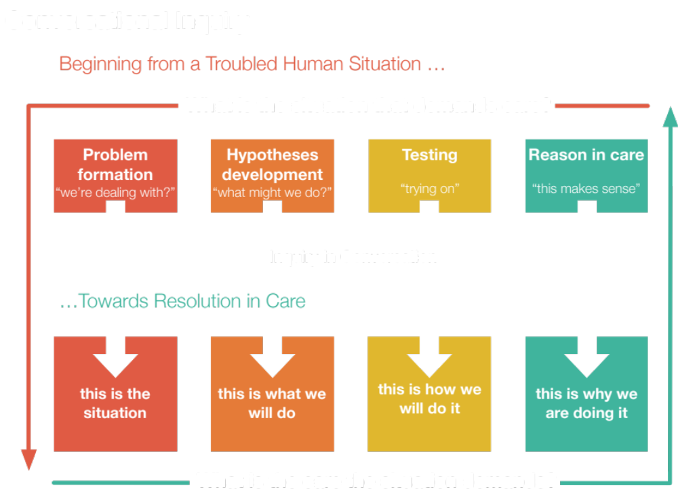

Slide 32
Selecting
Understanding
Accessing care
Problem

Slide 33
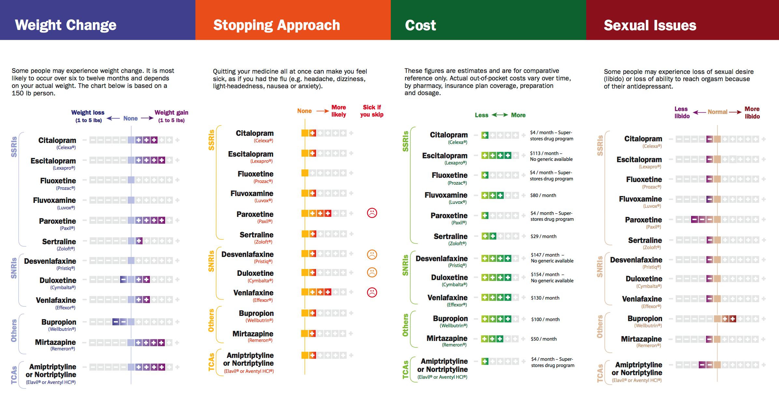
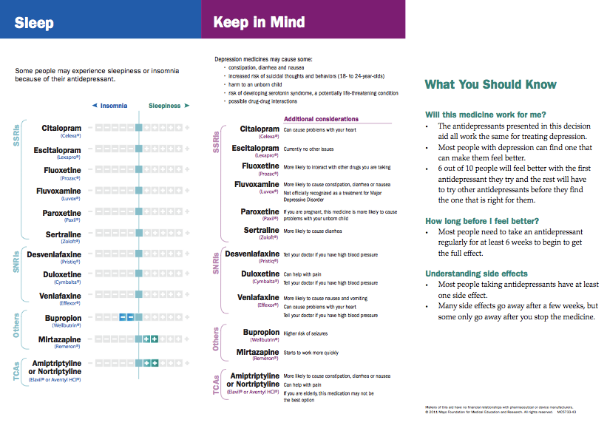
LeBlanc A et al. JAMA Int Med 2015
Notes:
Tailoring by what matters to patients

Slide 34
Selecting
Understanding
Tailoring
Accessing care
Problem

Slide 35


Slide 36
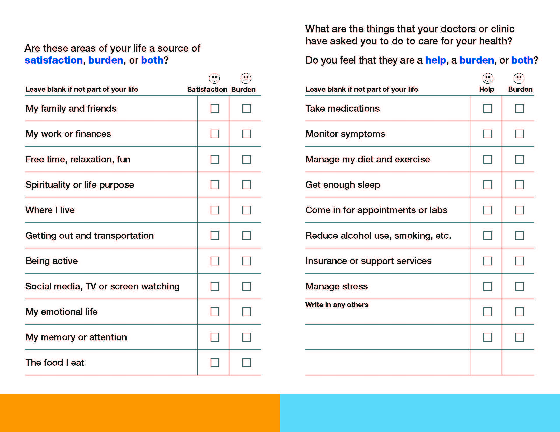
Boehmer KR, et al. 2016, BMC Health Serv Res.
Notes:
You can talk more about how ICAN Works here

Slide 37





Understanding the impact of healthcare cost on patients’ lives
Notes:
health benefits (premiums or claims paid). PRICE. The total amount a provider expects to be paid by payers and patients for healthcare services. Stakeholders CARE PURCHASER. Individual or entity that contributes to the purchase of healthcare services. PAYER . An organization that negotiates or sets rates for provider services, collects revenue through premium payments or tax dollars, processes provider claims for service, and pays provider claims using collected premium or tax revenues. PROVIDER. An entity, organization, or individual that furnishes a healthcare service. Other Definitions OUT- OF- POCKET PAYMENT. The portion of total payment for medical services and treatment for which the patient is responsible, including copayments, coinsurance, and deductibles. PRICE TR ANSPARENCY. In health care, readily available information on the price of healthcare services that, together with other information, helps define the value of those services and enables patients and other care purchasers to identify, compare, and choose providers that offer the desired level of value

Slide 38
Selecting
Understanding
Tailoring
Accessing care
Problem
Integrating

Slide 39

Boehmer et al., Mayo Clinic Proceedings, in press

Slide 40
Selecting
Understanding
Tailoring
Accessing care
Problem
Integrating
Assessing

Slide 41
How much of a problem is it for you to…
Take your medication?
Make the effort to remember all of your medications?
Make sure you follow all the instructions you are supposed to about taking your medications the right way?
Make sure you keep up with the lab tests or other exams that you need because of your health conditions?
Do what you need to do to monitor your own health, like take your blood pressure or check your blood sugar?
Manage all of your medical appointments (e.g., scheduling and getting to appointments you have with your doctor or other lab tests, etc.)?
Attend your doctors' office visits and other appointments?
Put up with any difficulties that you have with your relationship with your healthcare providers?
Deal with all the health care related paper work you have?
Get the information you need to understand what is or is not covered by your insurance?
Pay what you need to for health care for any out-of-pocket expenses or anything not covered by your insurance?
Get the exercise that your doctor has recommended?
Make other changes that your doctor has recommended like avoiding certain foods or alcohol or having to quit smoking?
Are your health needs in terms of your relationship with other people?
That your need for regular medical care or visits reminds you of the health problems that you have?

Slide 42
The Process of Fitting Care
Selecting
Tailoring
Integrating
Assessing
Understanding
Revising
Accessing care
Problem
Notes:
All of this – from accessing healthcare to designing a care plan to integrating it into our lives and coming back out into our communities – we have research that is tackling these problems

Slide 43
CAPACITY COACH
Nurses
Social Workers
Psychologist
YOU
Pharmacist
Nutritionist
Doctors & NPs
Lifestyle Coach
Boehmer et al., Mayo Clinic Proceedings, in press

Slide 44
The Process of Fitting Care
Selecting
Tailoring
Integrating
Assessing
Understanding
Revising
Accessing care
Back into the community
Problem
Solution
Notes:
All of this – from accessing healthcare to designing a care plan to integrating it into our lives and coming back out into our communities – we have research that is tackling these problems

Slide 45


Slide 46
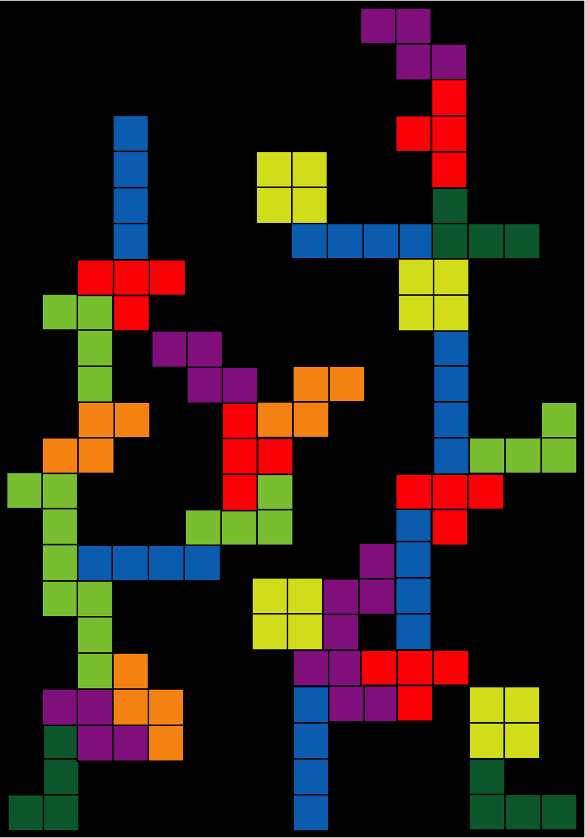
Notes:
When we do this right, care goes from looking like this, to …

Slide 47

Notes:
Looking like this…

Slide 48
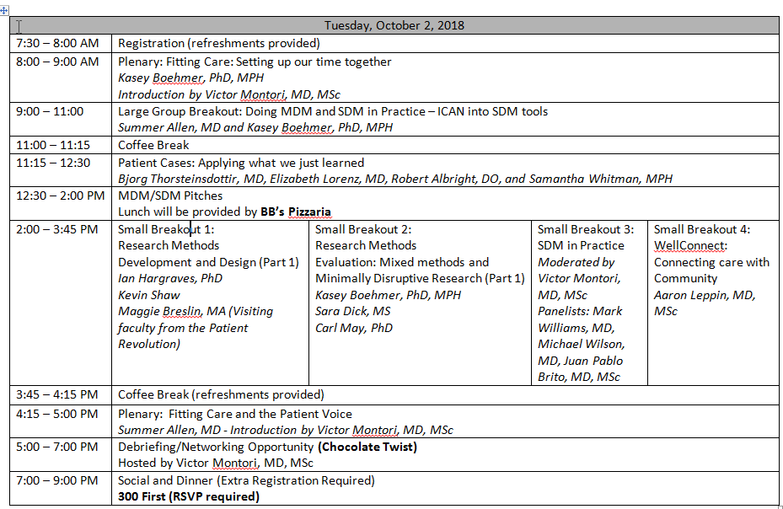
Notes:
Layout of the conference day 1
ICAN & SDM Tools large workshop
Kidney disease large workshop
Lunch provided with Pitches Session
Small group breakout choices
Closing Plenary Summer and patient voice
Networking opportunity – OPEN TO THE PUBLIC @ Chocolate Twist
Course dinner – extra registration required

Slide 49
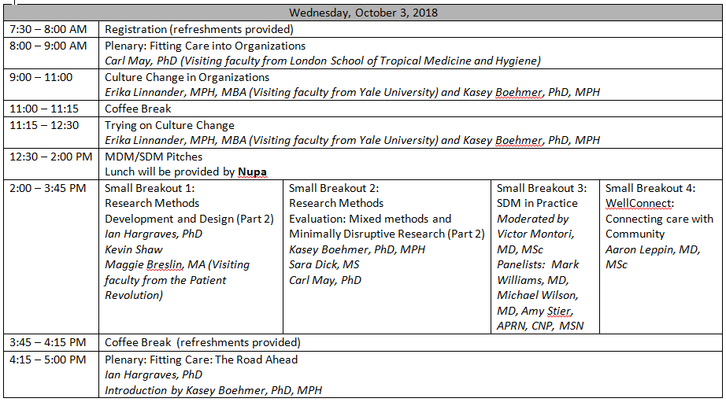
Notes:
Layout of conference day 2
Opening Plenary Carl May
Culture Change workshop 1
Culture Change workshop 2
Lunch provided – networking
Small group breakout choices
Closing plenary, Marleen Kunneman preparing us to go out into the world again

Slide 50
Innovate. Implement. Inspire.

Slide 51
“Nobody – not a voice of authority, not your mama, not the foremost expert in your arena – gets to tell you how big your dreams can be. They can talk all they want… but you get to decide if you’re willing to listen.”
- Rachel Hollis: Girl, Wash Your Face

