Slide 1
Why Do Mixed Methods Research and What are common Mixed Methods designs?
Some guidance

Slide 2
Selecting
Tailoring
Integrating
Assessing
Understanding
Revising
Accessing care
Back into the community
Problem
Solution
Notes:
Why Do Mixed Methods? In this type of work, we rarely can create a robust body of research without both methods.

Slide 3
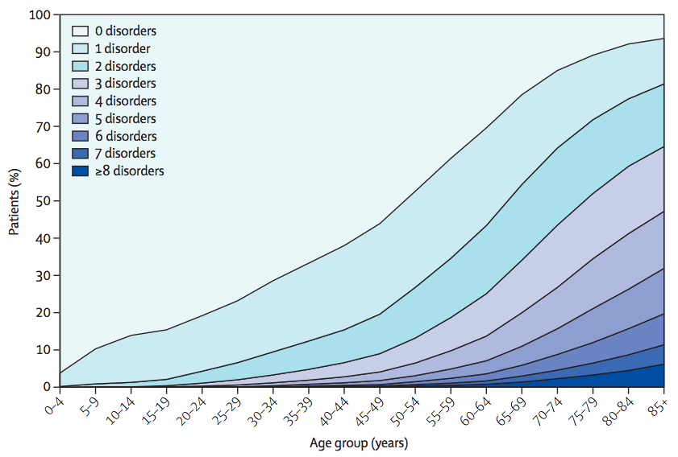
Barnett et al. Lancet 2012
Notes:
I also have asthma, severe allergies, and a heart condition.
I knew I was entering into the world of living with multiple chronic conditions. And this is what this world looks like.

Slide 4


The Patient Experience of Living with Undercared-for Chronic Suffering

Slide 5
Mixed Methods Questions
Epidemiology/Experience

Slide 6
Mixed Methods Questions
What/Why?
What/How?
Characteristics/Differences
Experiences/Measurement

Slide 7
Your Research Question → Design
If you can clearly state what you want to find, the design should naturally follow.

Slide 8

A whirlwind overview of MM Design

Slide 9
Mixed vs Multi-Methods
A program of research may be multi-methods
  E.g. you have 2 quantitative and 2 qualitative studies. Same body of work, but research questions inherently call each for a single method
Mixed methods applies mixing, within a single project
  Your research question dictates you need more than one method to answer it fully

Slide 10
Parallel Convergent
Quantitative
Findings
Qualitative

Slide 11
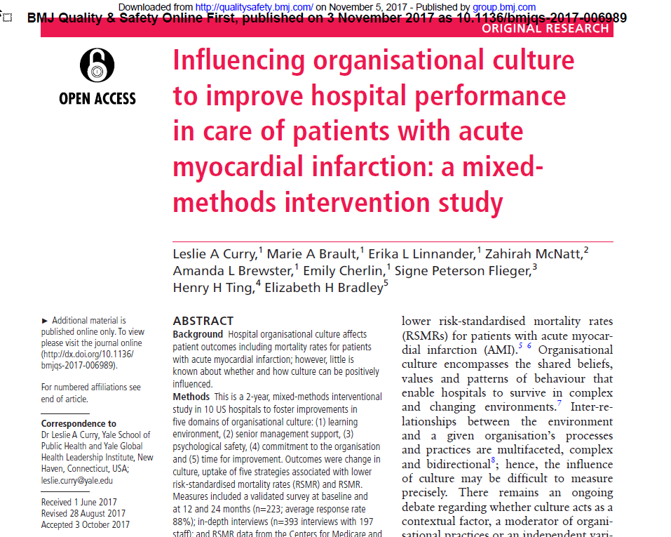
Parallel Convergent

Slide 12
Parallel Convergent
Quantitative:
Risk-Standardized Mortality
Findings:
Culture Changers affected by the intervention saw reductions in risk-standardized mortality
Qualitative:
Interviews & Observations

Slide 13
Embedded
Quantitative
Qualitative
Findings

Slide 14
Embedded
Qualitative
Quantitative
Findings

Slide 15
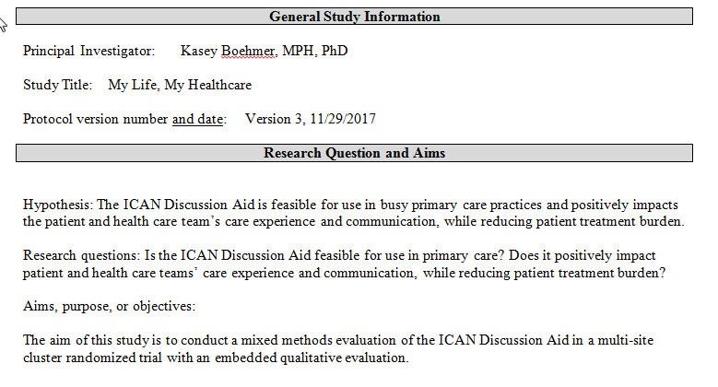
Embedded

Slide 16
Embedded
Quantitative:
Pt/Clinician Communication
Pt Treatment Burden
Staff coordination
Qualitative: Patient Interviews/Staff Focus Groups
Findings:
Did Outcomes Change? If so, why? If not, why not? Differences between sites

Slide 17
Explanatory Sequential
Quantitative
Qualitative
Findings

Slide 18
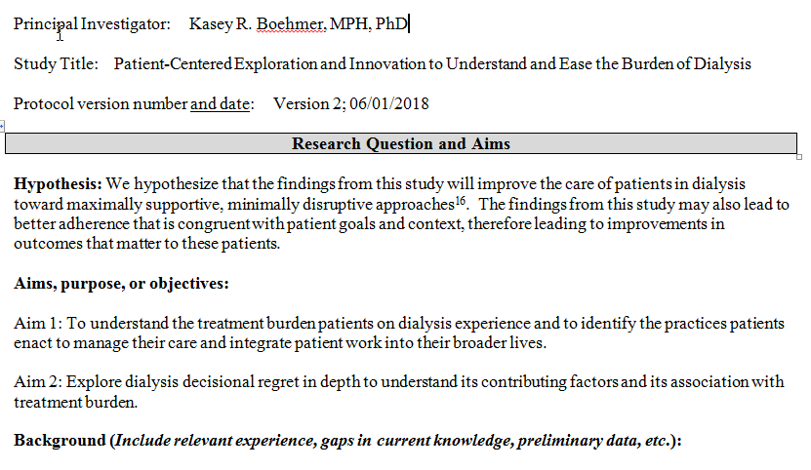
Explanatory Sequential

Slide 19
Explanatory Sequential
Quantitative:
Survey of patients’ disruption from illness and treatment
Qualitative:
In-depth interviews w/ pts in high disruption quartile and low disruption quartile
Findings:
Differences between these cohorts of patients

Slide 20
Exploratory Sequential
Qualitative
Quantitative
Findings

Slide 21
Exploratory Sequential
Measure development

Slide 22
Let’s Workshop Designs!
30 minutes

