Slide 1
Minimally Disruptive Research: a respectful approach to conducting clinical studies

Slide 2
Jill
Withdraws
caretaker
Frustrated
job
Stressed
medication
Survey
A1c
Appointment
36 year old female
Randomization
Chronic disease
Coerced
Clinical appointment
Confused
Concerned
Consent
Phone call
Distracted
Present Early
Notes:
Jill a 36 year old female, who has a follow-up appointment for her diabetes care scheduled for Wednesday to see her endocrinologist.
She receives a phone call from an unknown study staff asking her to present early because she is eligible to participate in a research study.
She becomes concerned as she questions who was calling and how they knew about her appointment.
She agrees to present early, even though it means using more PTO and due to the limited time she parks on the street at a meter instead of weaving around the ramp.
On the day of her appointment the study coordinator calls Jill back to the exam room and goes over the trial consent.
Since Jill was rushing between work to her appointment, she forgot her glasses, so she is distracted and confused as the SC goes through the 15 pages of consent and Jill is beginning to zone out. Her mind is on wondering what her lab values are and looking forward to discussing with her clinician.
Yet, Jill feels coerced to participate because she doesn’t want to let her clinician down.
Due to the research processes, the clinician enters the exam room behind schedule.
Jill begins to internally question every aspect of his appointment wondering if it’s for research or her actual appointment.
Her A1c is high and the doctor begins prescribing a medication. She never was able to bring up that her diabetes might be a little out of control right now because of the stress of changing jobs and becoming a caretaker for her sick mother.
Then, a research staff member comes into the room after the appointment with a 10 page survey. This is her sixth survey this month related to her medical care.
Jill takes the 20 minutes to complete the survey even though she knows the time is running out on the car meter and stressing about a parking ticket.
Jill is concerned, distracted, confused, coerced as she shares her frustration with her husband.
This leads to Jill withdrawing from further participation in the study and the post visit phone call data becomes lost to follow-up.
***
What’s wrong with this scenario?
It’s too much.
***
I bet we can all relate to some aspect of this scenario.

Slide 3
Research is work.

Slide 4
Minimally Disruptive Research
Research must impose the smallest possible footprint on clinical care activities.
CAREFUL and KIND RESEARCH

Slide 5
Research Burden for Patients
Multiple Clinical Visits
Excessive Survey Lengths

Slide 6
MDR Considerations - Patient
Apply a single pre-scheduled visit
Utilize wait time effectively
Collect usable data
Conduct videographic analysis
Engage as stakeholders

Slide 7
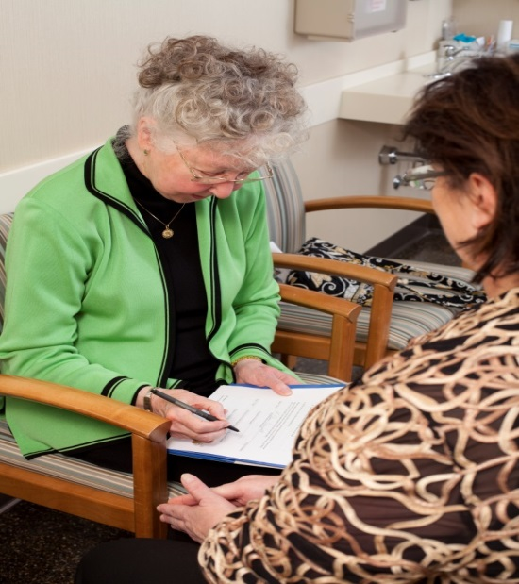
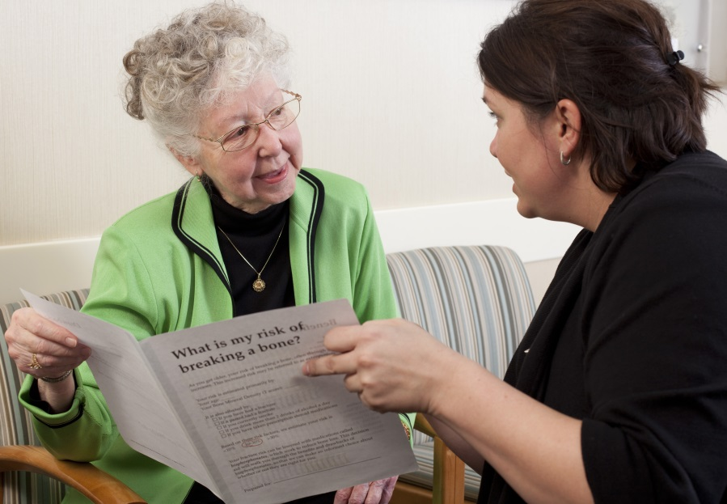


Patient Participation
X
X
Pre-contacts
Clinical Appointment
Post
Follow-up

Slide 8
MDR Value Added - Patient
Subjects become participants
Amplified empathy
Effective use of scheduled time
Increase capacity
Escalate excitement
Reduce lost to follow-up data
Stronger completion rates

Slide 9
Research Burden for Clinicians
Identify Patients
Review Inclusion and Exclusion Criteria
Consent Patients

Slide 10
MDR Considerations - Clinician
Utilize roles effectively
Clinicians as research participants
Develop a clinician champion
Engage as stakeholders

Slide 11
Clinician Participation
X
X
Review Inclusion / Exclusion Criteria
X
Patient Identified
Pt Consent
Clinician Champion /
Confirm Eligibility

Slide 12
MDR Value Added - Clinician
Delegating work to appropriate person
Increase capacity
Escalate excitement
Improve delivery of clinical care

Slide 13
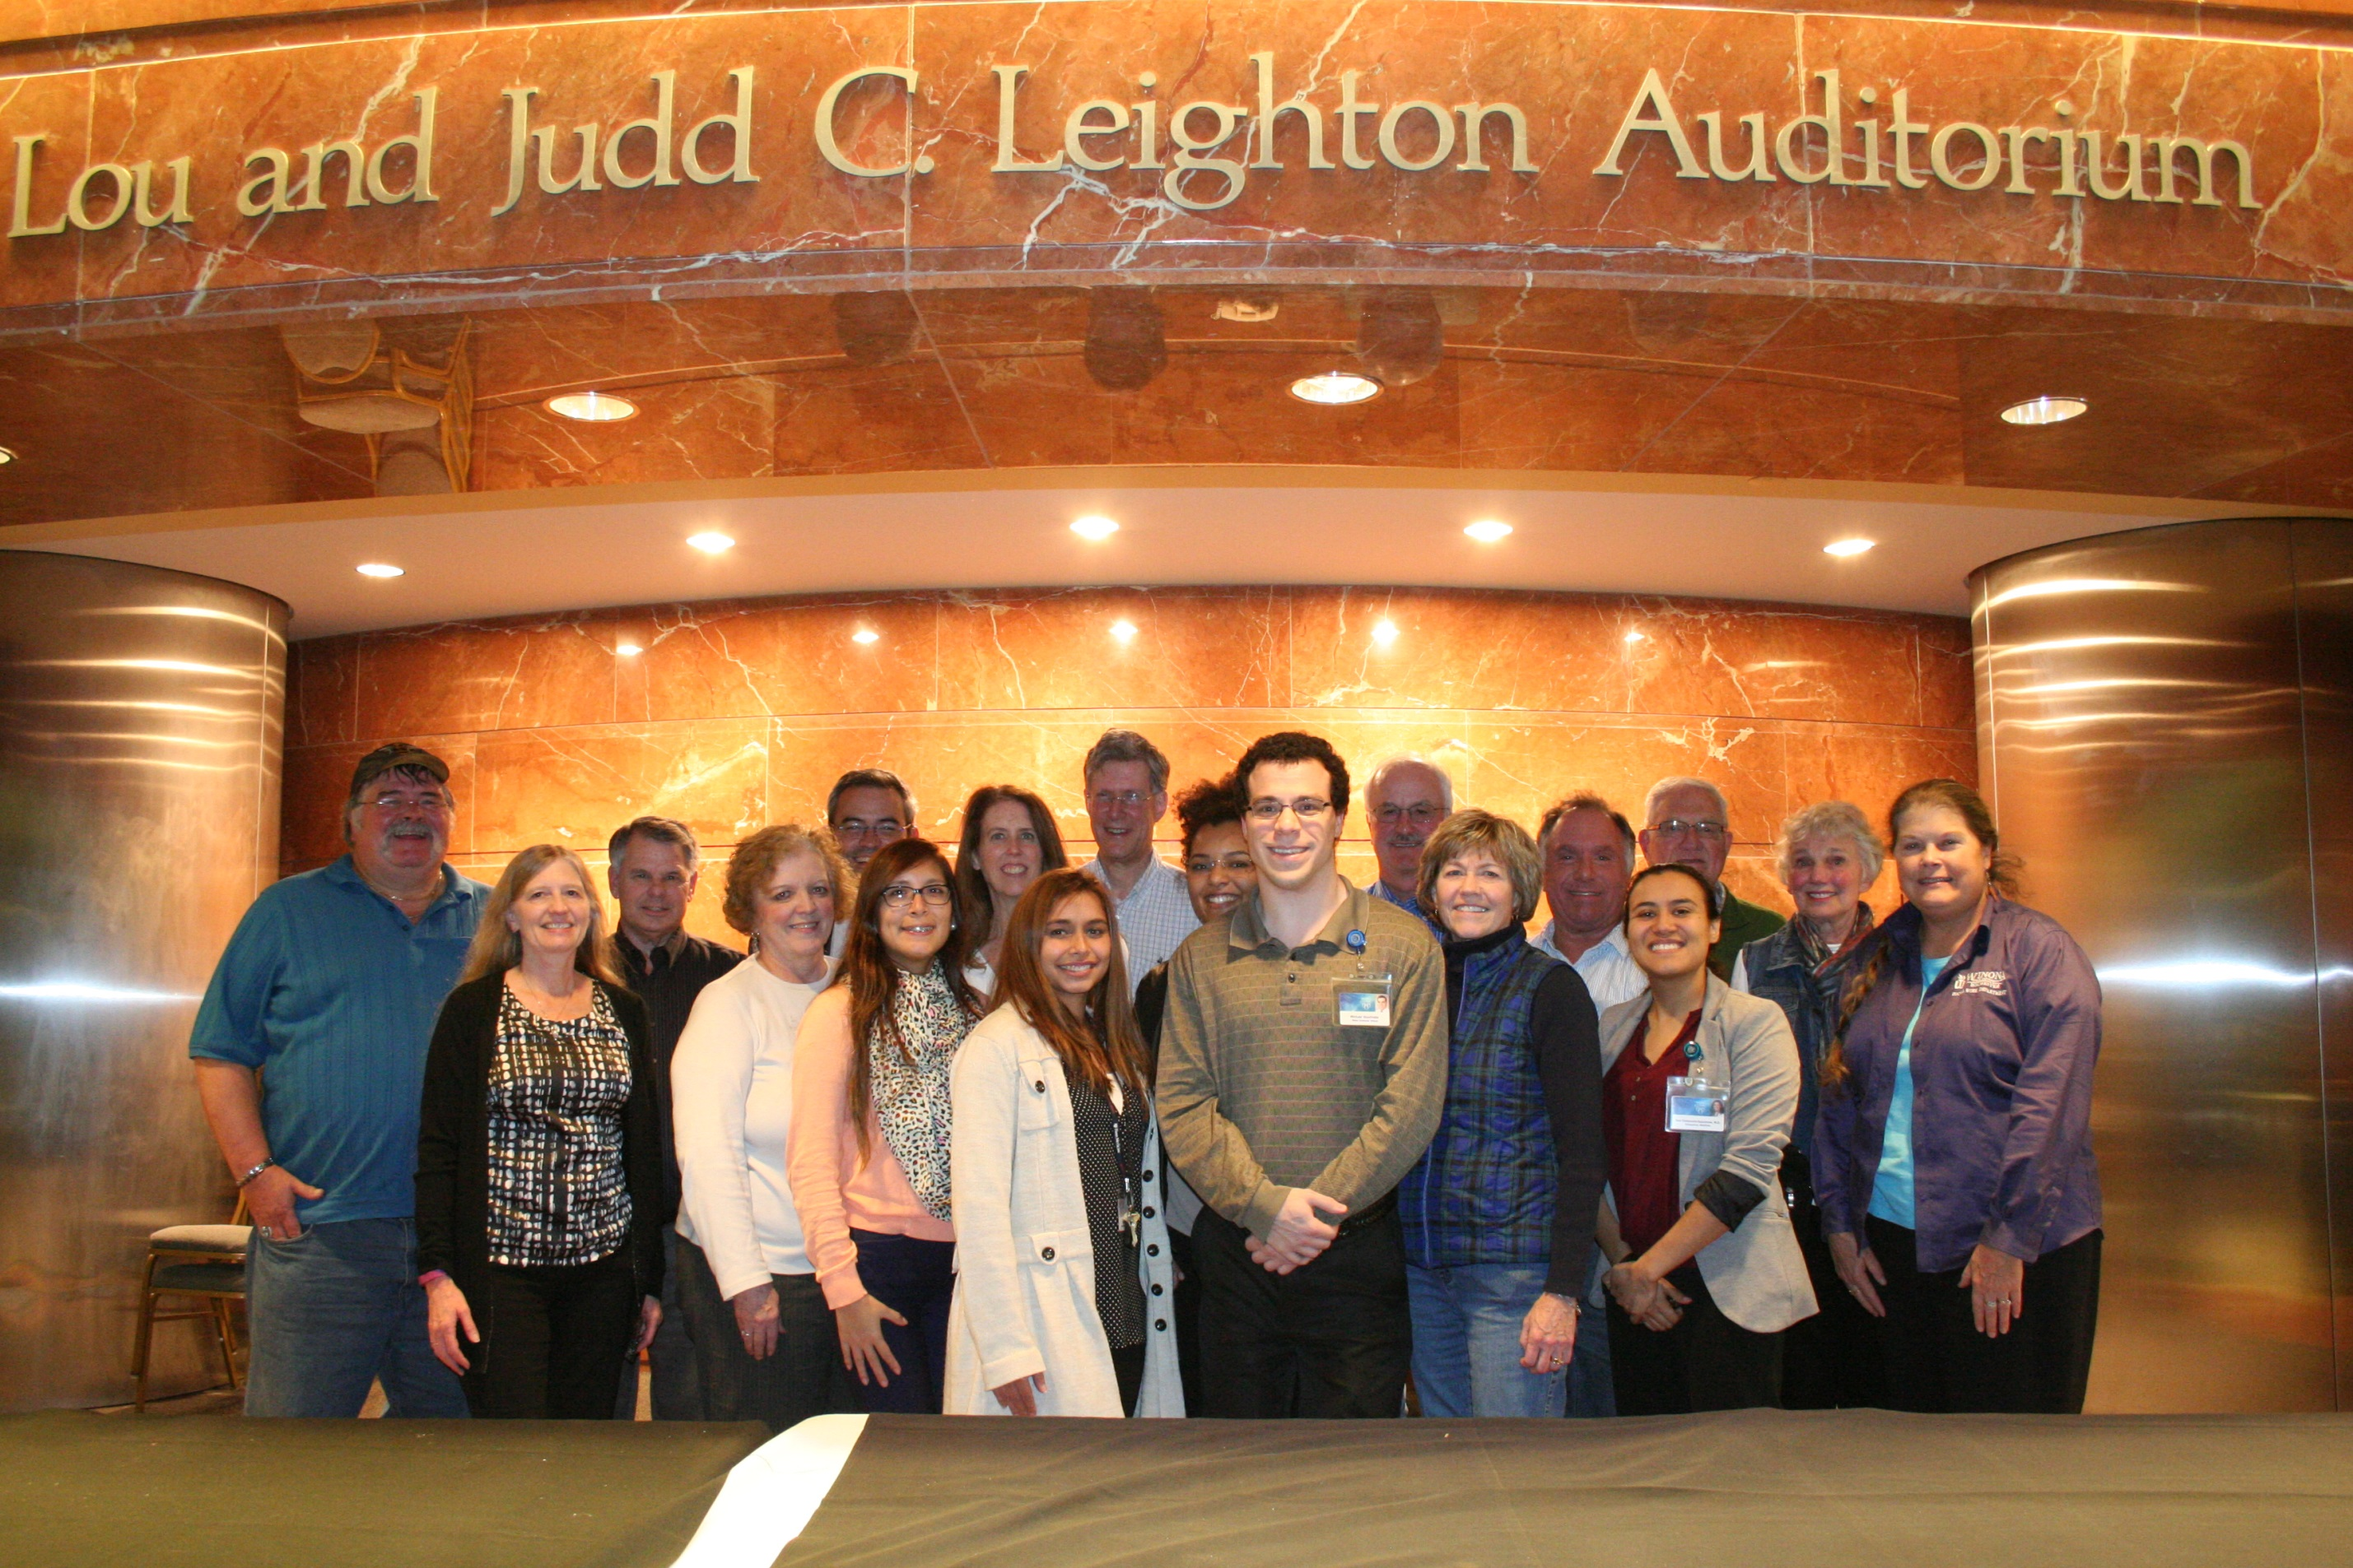
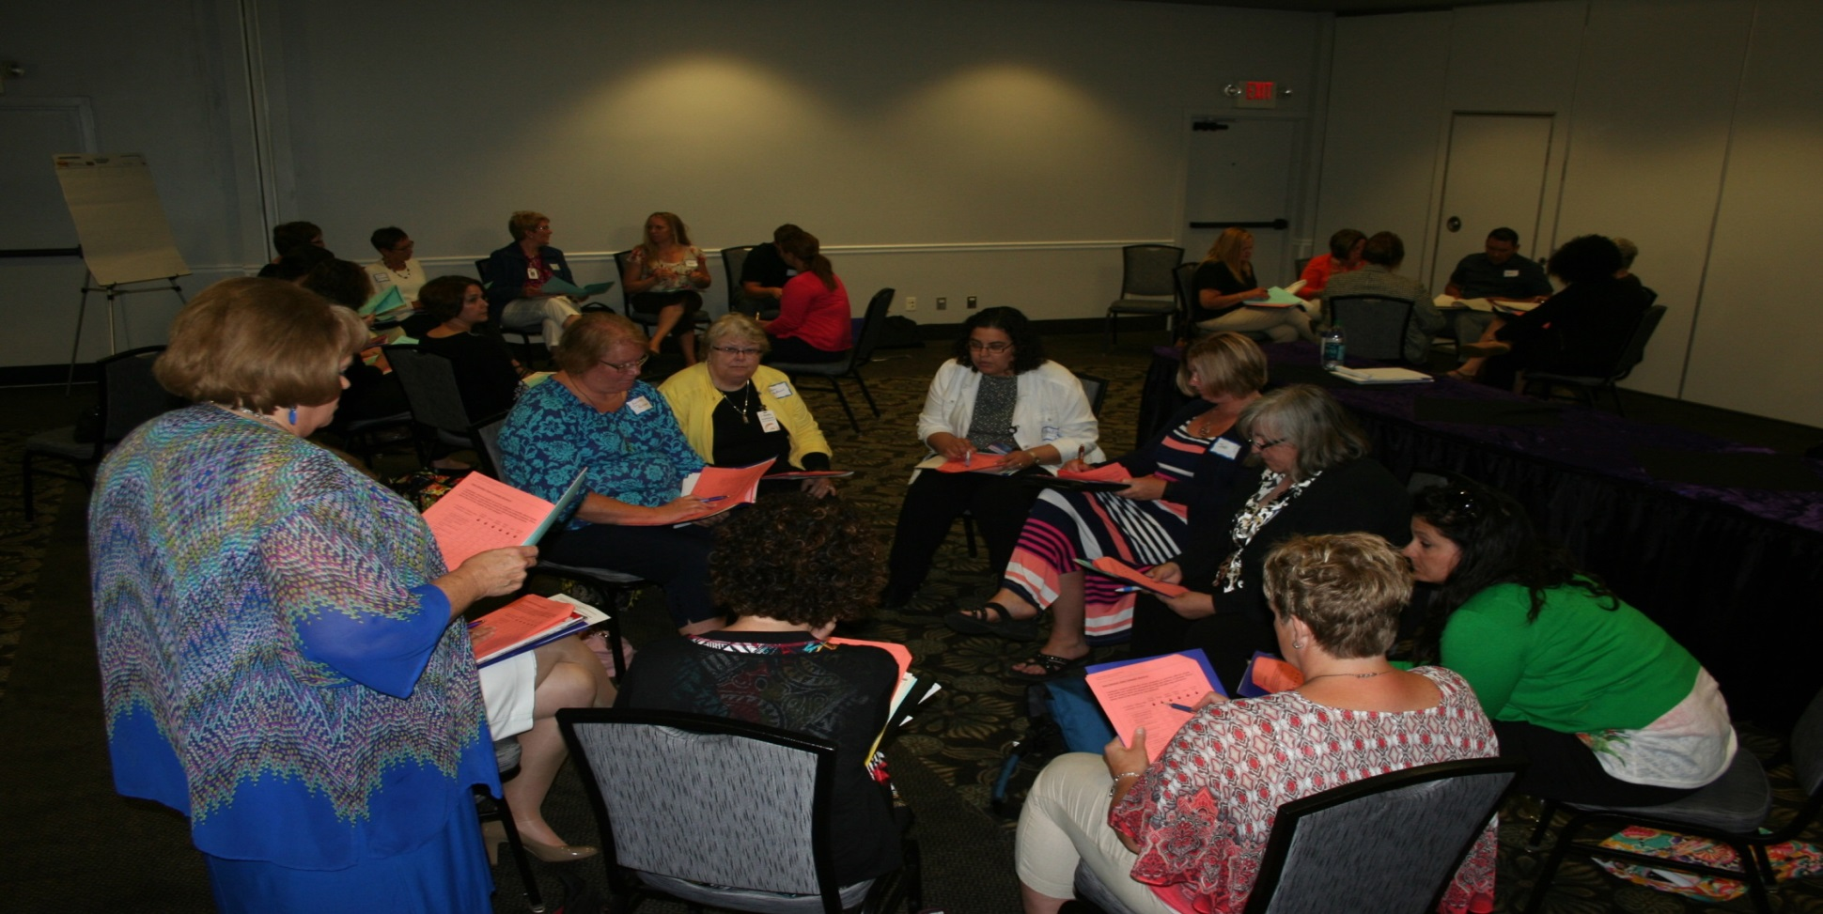
Engage, Engage, Engage!!!

Slide 14
Minimally Disruptive Research
Research must impose the smallest possible footprint on clinical care activities.
CAREFUL and KIND RESEARCH

Slide 15
Jill
Sense of empathy
Increased capacity
Withdraws
caretaker
Frustrated
job
Parking Ticket
medication
Survey
A1c
Appointment
36 year old female
Randomization
Chronic disease
excited
Coerced
Clinical appointment
Confused
Concerned
Consent
Phone call
Distracted
efficient
Less overwhelmed
Present Early

Slide 16
