Slide 1
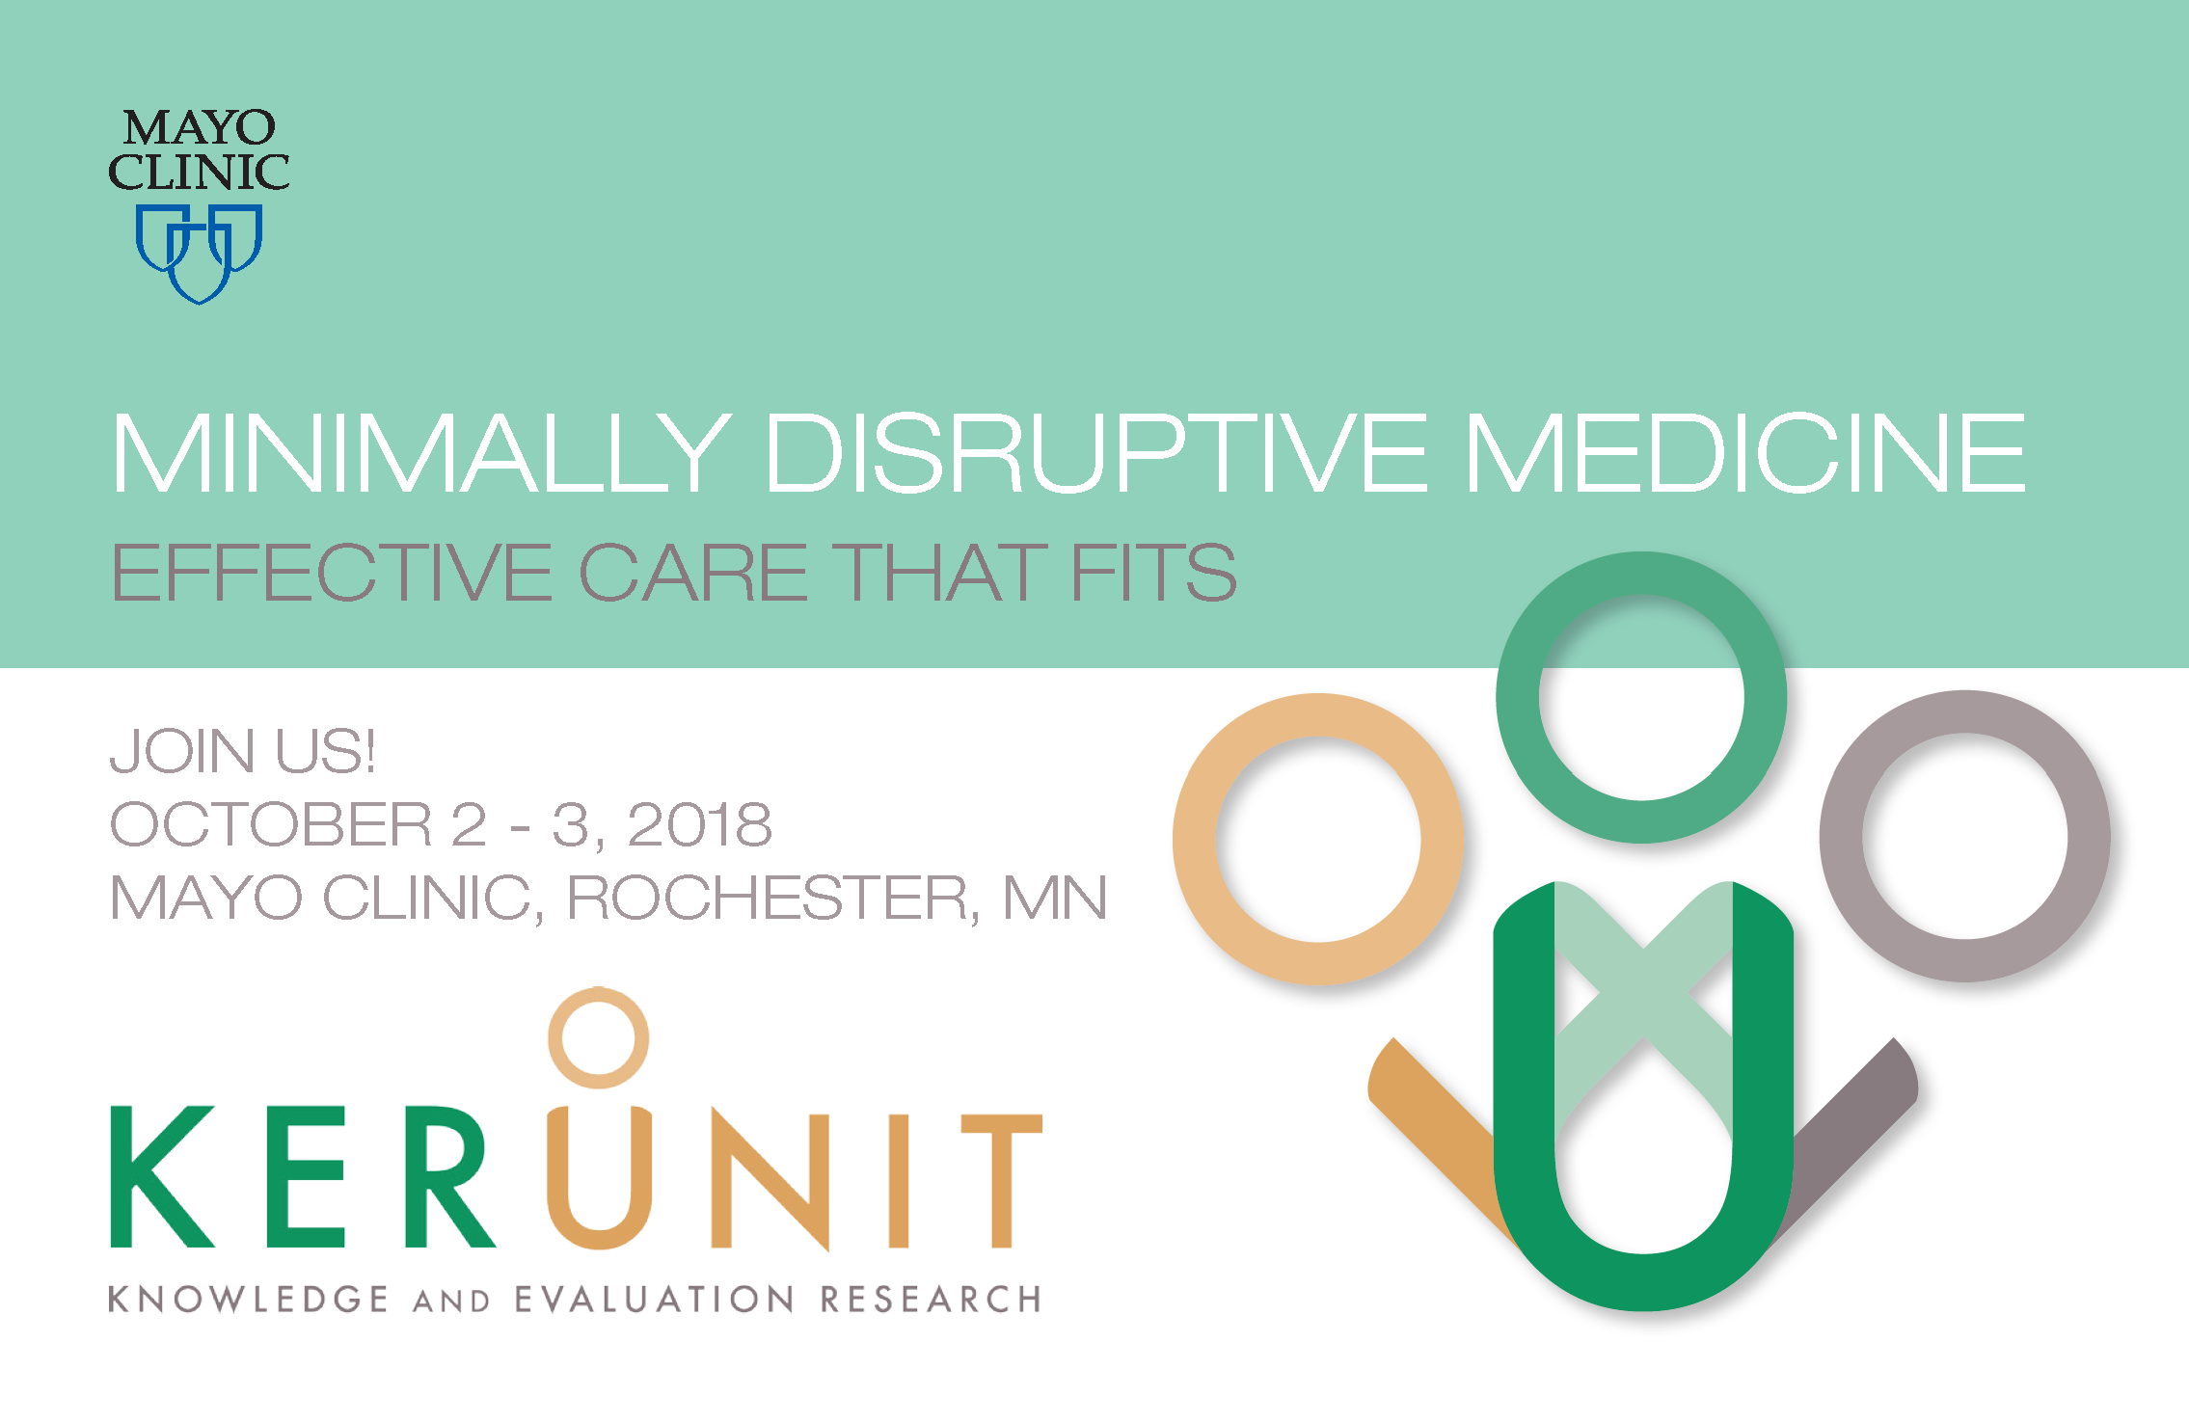
JOIN US
OCTOBER 7 – 8, 2019
MAYO CLINIC, ROCHESTER,MN

Slide 2
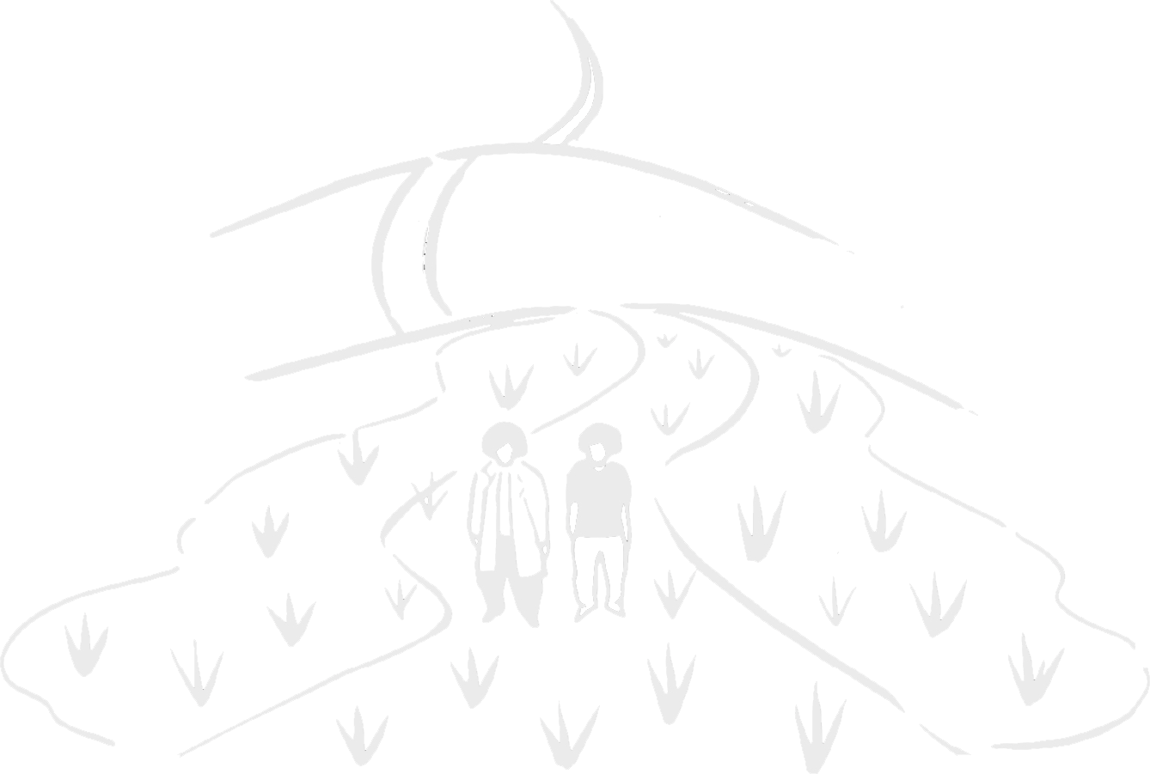
Care that Fits: The Road Ahead
Notes:
Is not about, or not always about the road ahead

Slide 3
Care that Fits The Road Ahead
≠

Slide 4

Disclosures
I do not have financial relationships to disclose.

Slide 5
Some years ago, our practice nurse asked me to see Mrs B, an 85-year-old widow…Her husband, a pleasant chap who had been a builder, had died 5 years previously…her two grown-up sons, who were recurrent petty criminals, both serving prison sentences at the time.
Sweeney, K. Complexity in Primary Care: Understanding its Value

Slide 6
The nurse wanted me to review her comorbidities and test results with her
Diabetes
Hypertension
Osteoarthritis
Macular degeneration
Hallux valgus
Glycosaturated haemoglobin | 9.7%
Blood pressure | 180/96 mmHg
Total cholesterol | 8.0 mmol/l
Body mass index | 29 kg/m²

Slide 7
…I rehearsed the abundant evidence supporting interventions to lower her blood pressure, to improve the control of her diabetes and to reduce her lipid levels…
I confess to feeling just a shade confident as I explained the abnormalities and how we could ‘help’ to reduce her risk…
Sweeney, K. Complexity in Primary Care: Understanding its Value

Slide 8


Slide 9
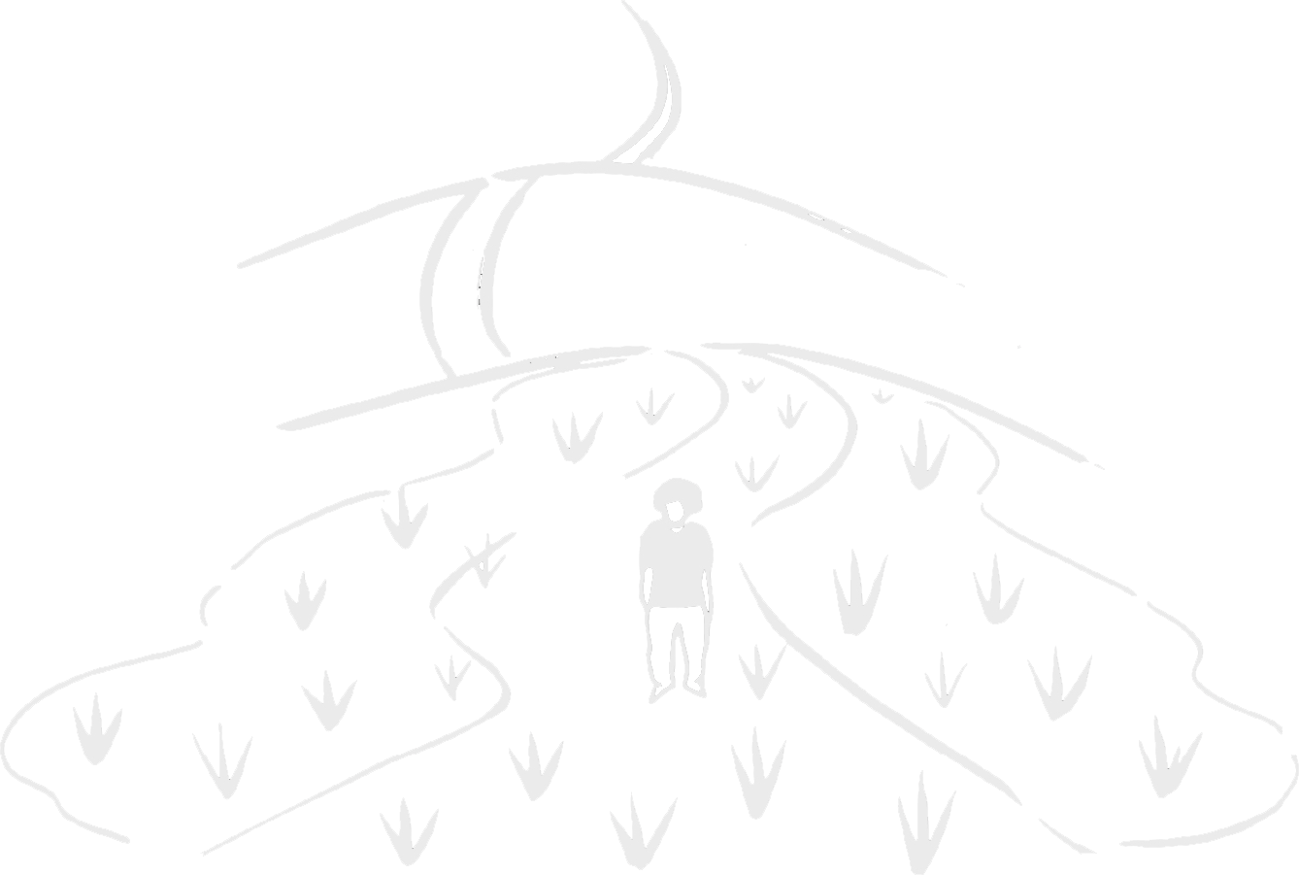

Slide 11


Slide 12
After a few moments I stopped—resting my case as a barrister might say
Sweeney, K. Complexity in Primary Care: Understanding its Value

Slide 13
After a few moments I stopped—resting my case as a barrister might say
Mrs B remained silent for a moment or two. Then she said, “Well, Jack’s dead and the boys have gone”
Sweeney, K. Complexity in Primary Care: Understanding its Value

Slide 14
?
Care
That Doesn’t
Fit

Slide 15
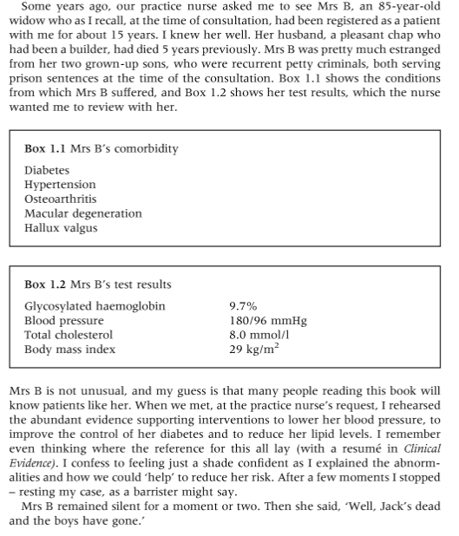
Image: https://www.pbs.org/newshour/health/medicare-begins-paying-doctors-coordinate-chronic-care-seniors

Slide 17
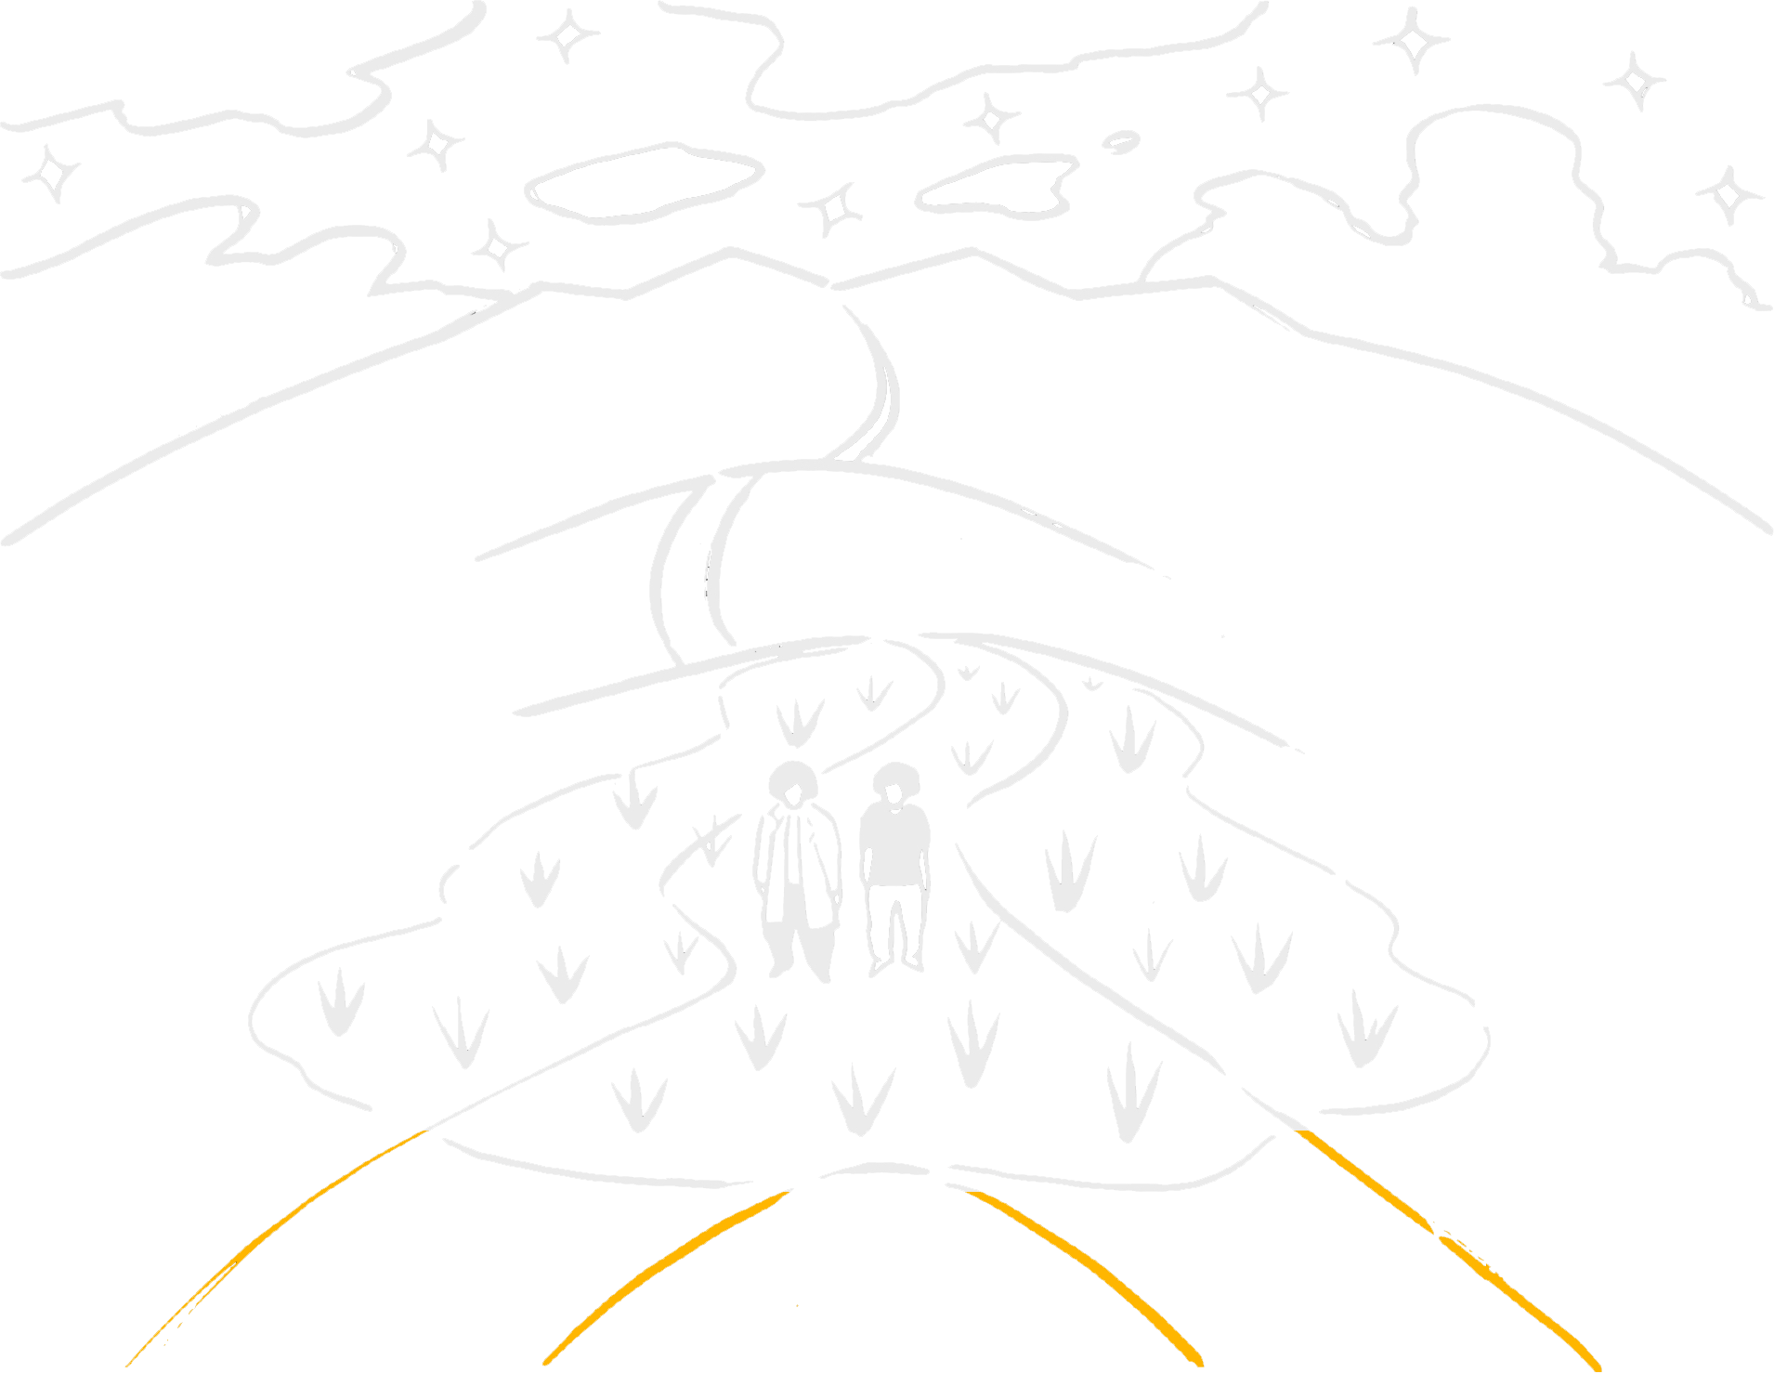
Outcomes
Future oriented

Slide 18
Outcomes
Future oriented
Policies, measures, targets, goals
Evidence
Risk
Harms
Benefits

Slide 19
The purpose of medicine writ large is to attend to and advance the problems of patients and their situations
It is not solely to achieve outcomes

Slide 20
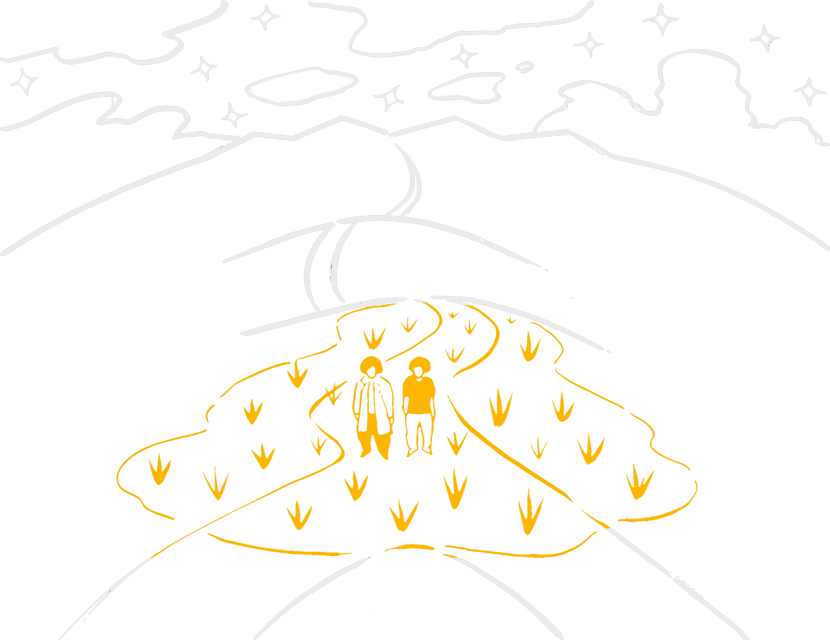
We lose sight of purpose in medicine when we do not pay attention to dealing with the swamp
Notes:
After all the swamp is why a patient is interacting with healthcare in the first place

Slide 21
How do we lose sight of problem and purpose?
Notes:
Not problem of the future
Problem of the now
Not a problem of what will happen
A problem of what’s happening in the present
The vast majority of medicines in this picture are preventative—intended to stop something from happening, rather than intended to make life in the present better

Slide 22
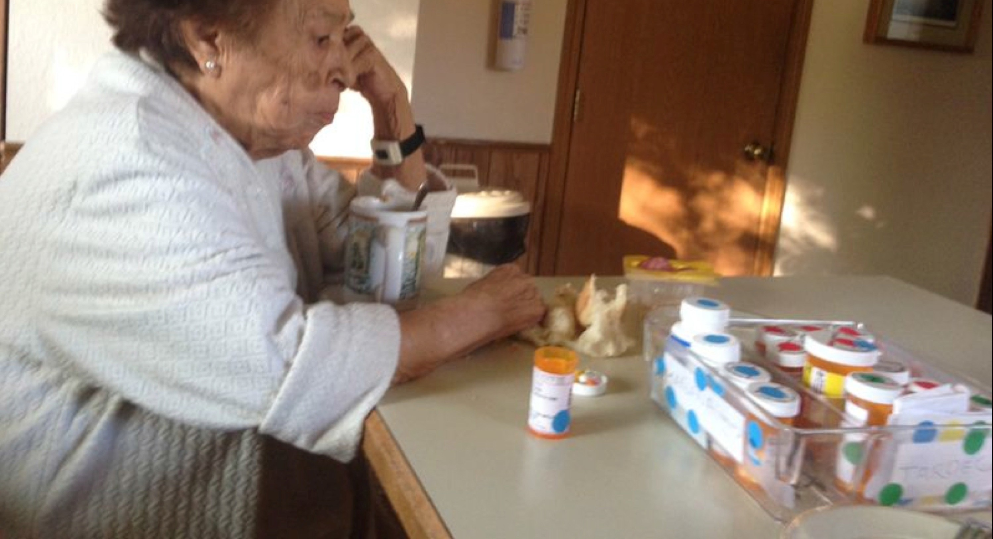
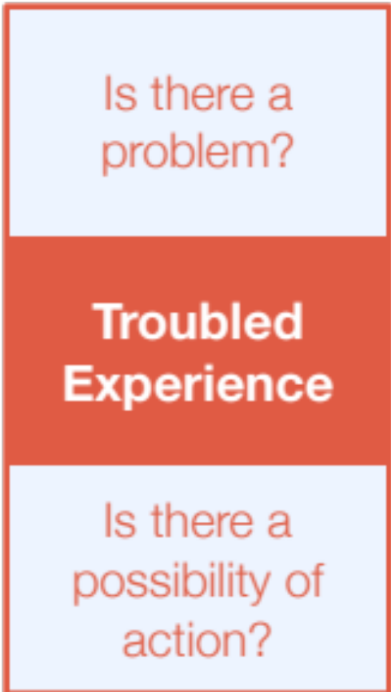

Slide 23
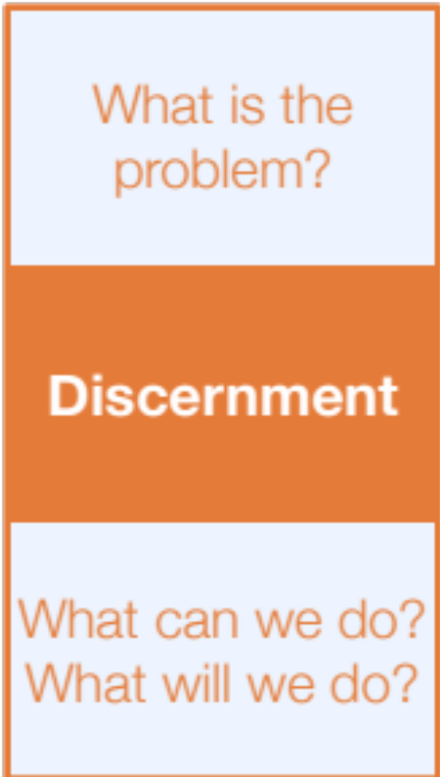

Slide 24
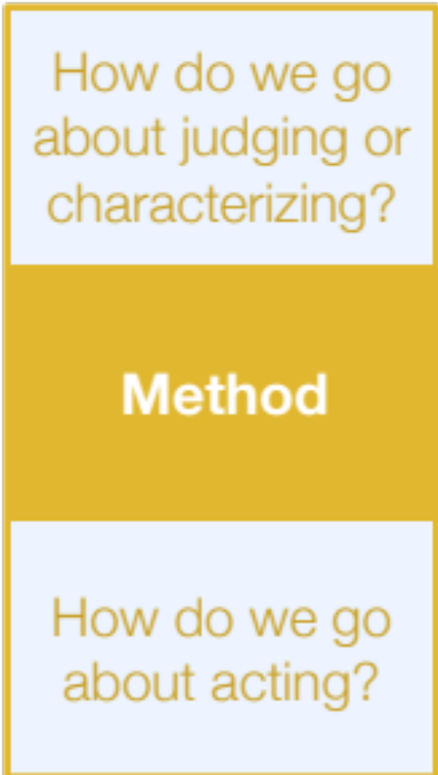
Notes:
As a risk and its mitigation, or as an experience and its re-integration

Slide 25
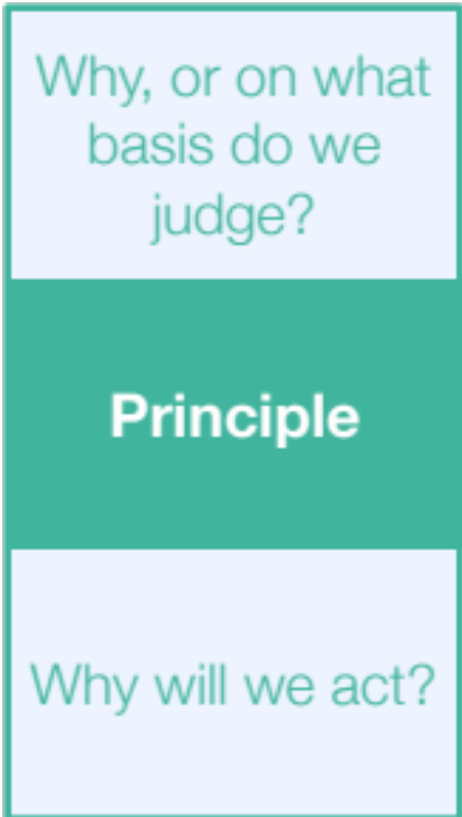
Notes:
Principles of control, autonomy, dignity, nurture

Slide 26
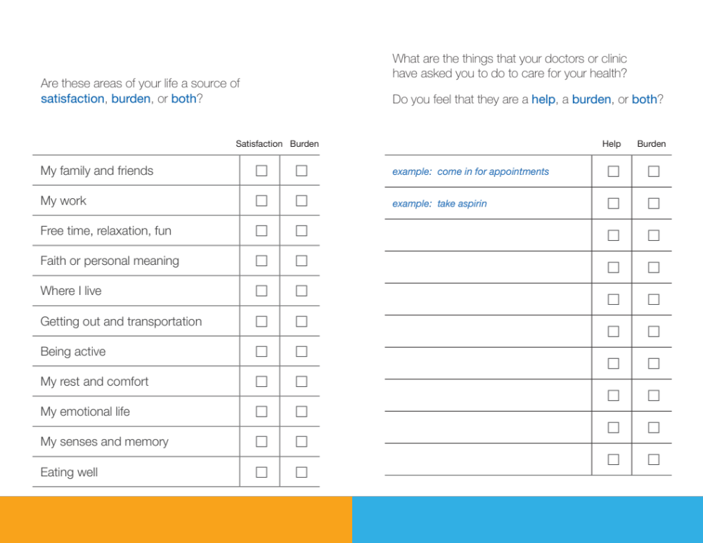

Slide 27
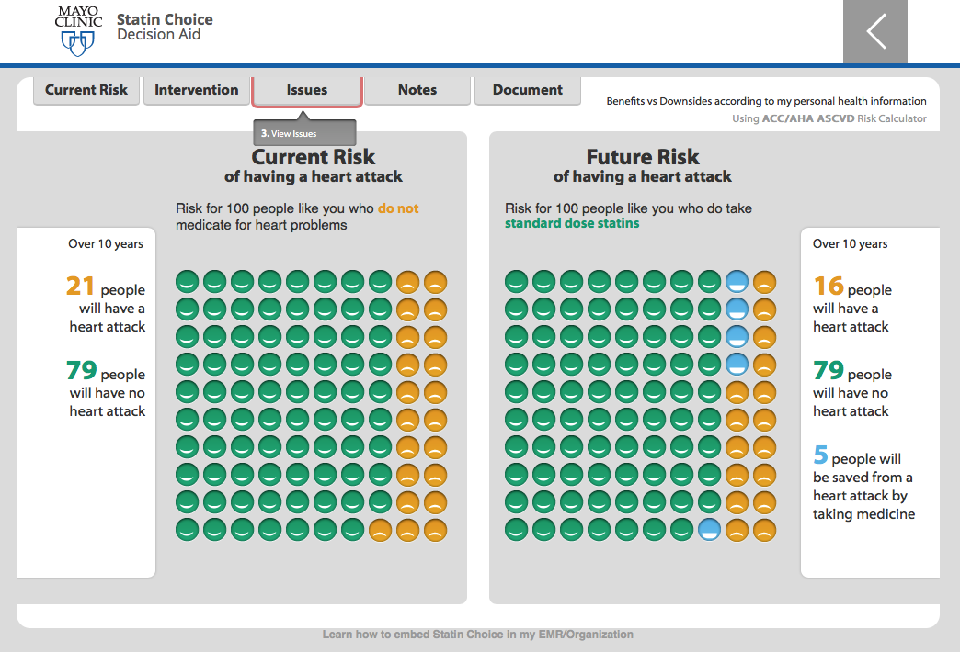

Slide 28
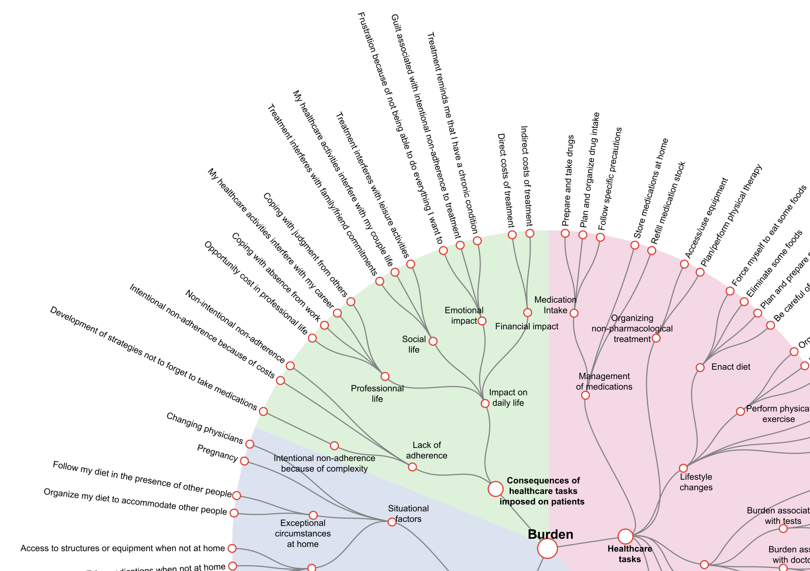
Notes:
Treated categorically/grammatically we would seek to define and asses each of these categories
Treated topically, these two words are commonplace terms having no inherent meaning—they gain substance as we explore the relation of the two

Slide 29
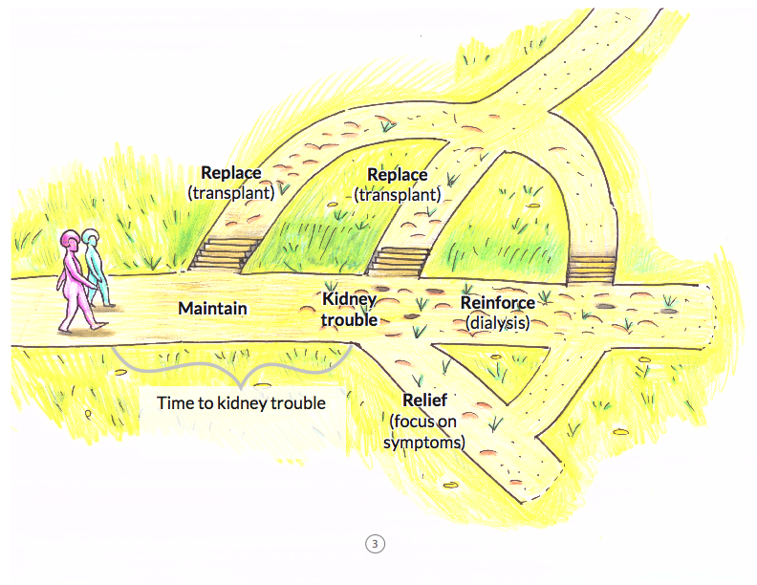


Slide 30
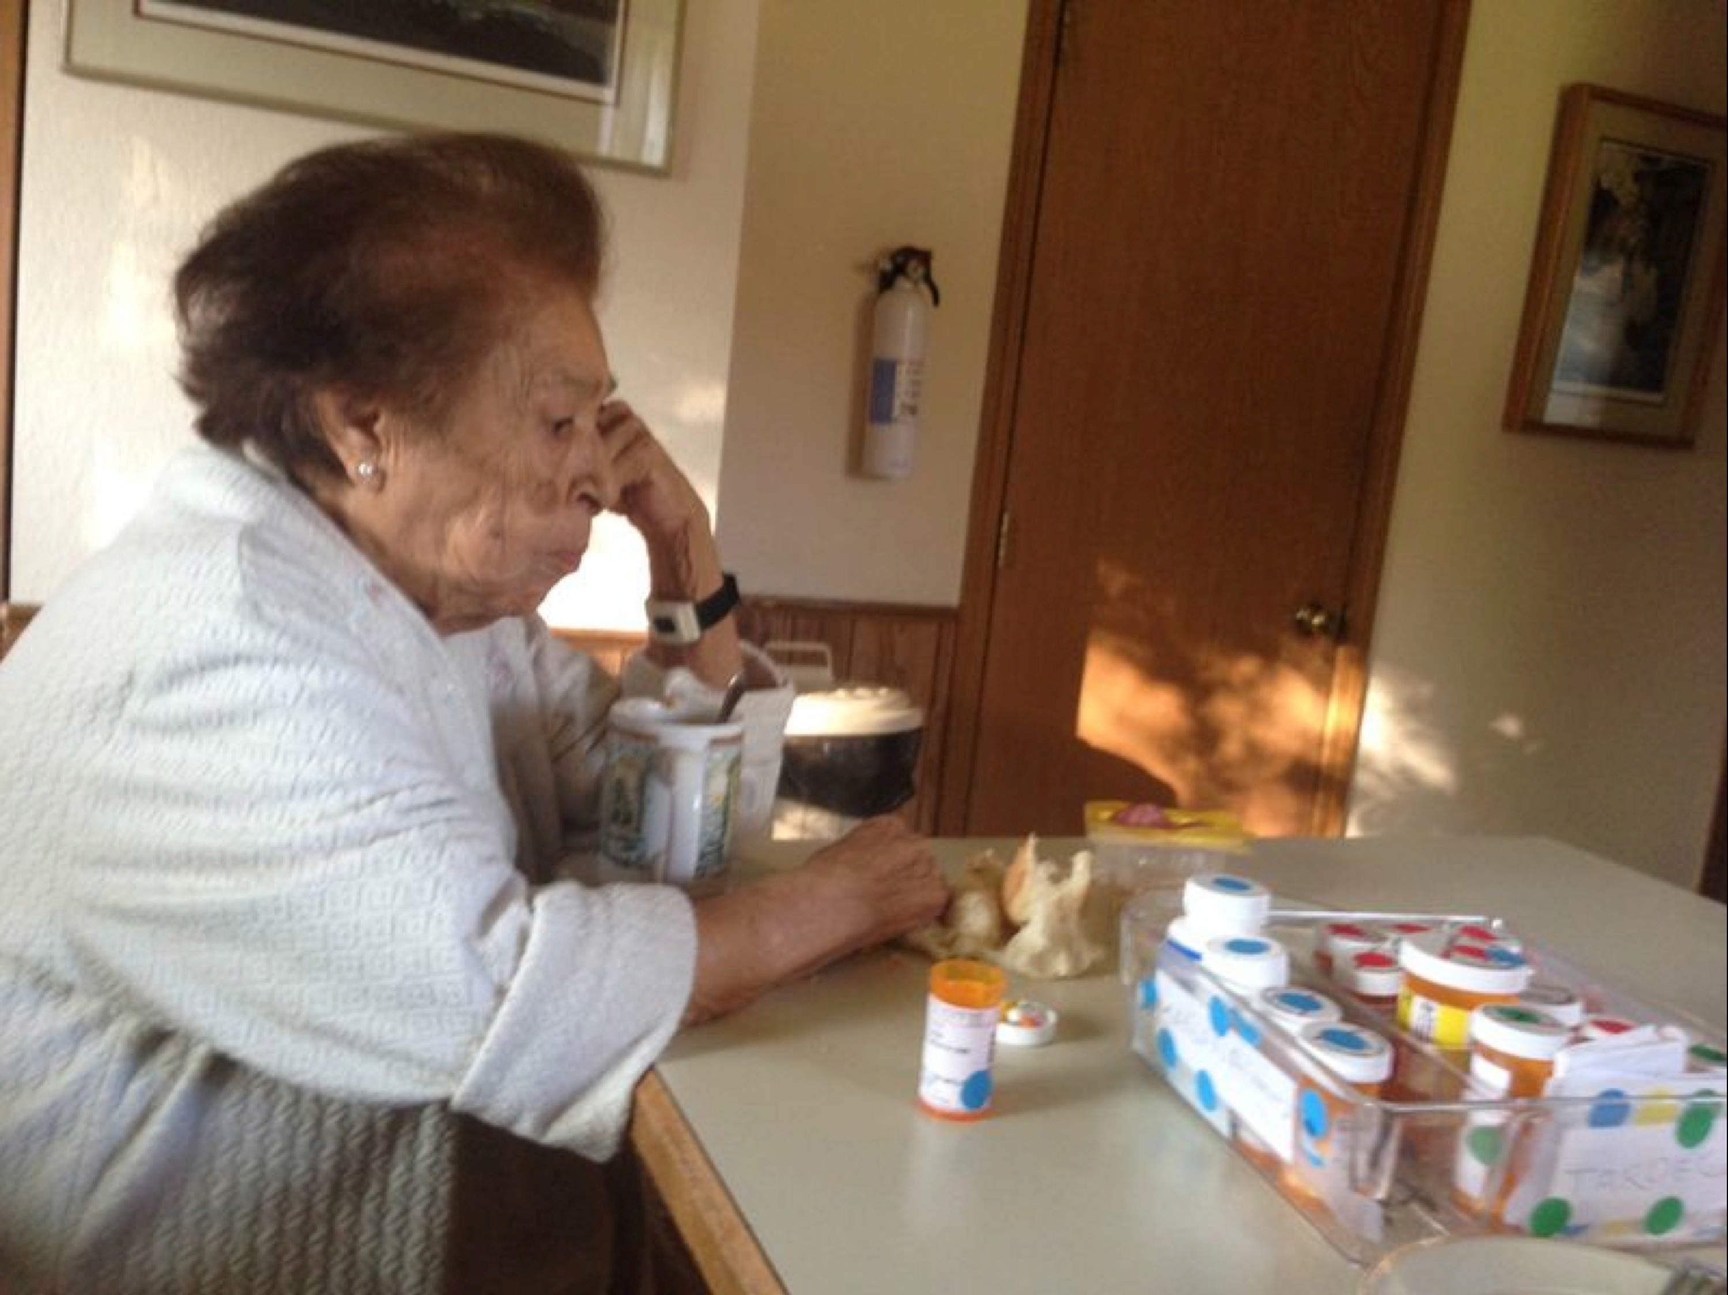
How do we lose sight of problem and purpose?
Current Shared Decision Making isn’t necessarily helping

Slide 31
“Well, Jack’s dead and the boys have gone”

Slide 32
What is the problem to which SDM is the solution?
  Poor clinician behavior
  Insufficient patient involvement
  Uncaring Interpersonal communication
  Lack of patient and clinician understanding
  Underdeveloped empathy
  Evidence uncertainty
  Unclear information
  Variation of patient preference and values
  Compromised ethical principles
  Practice variation
  …
Notes:
Or, another way of posing this question is to ask, what is the problem to which SDM is the solution?
There have been many purposes attributed to SDM
All of these are barriers to patient-centered care

Slide 33
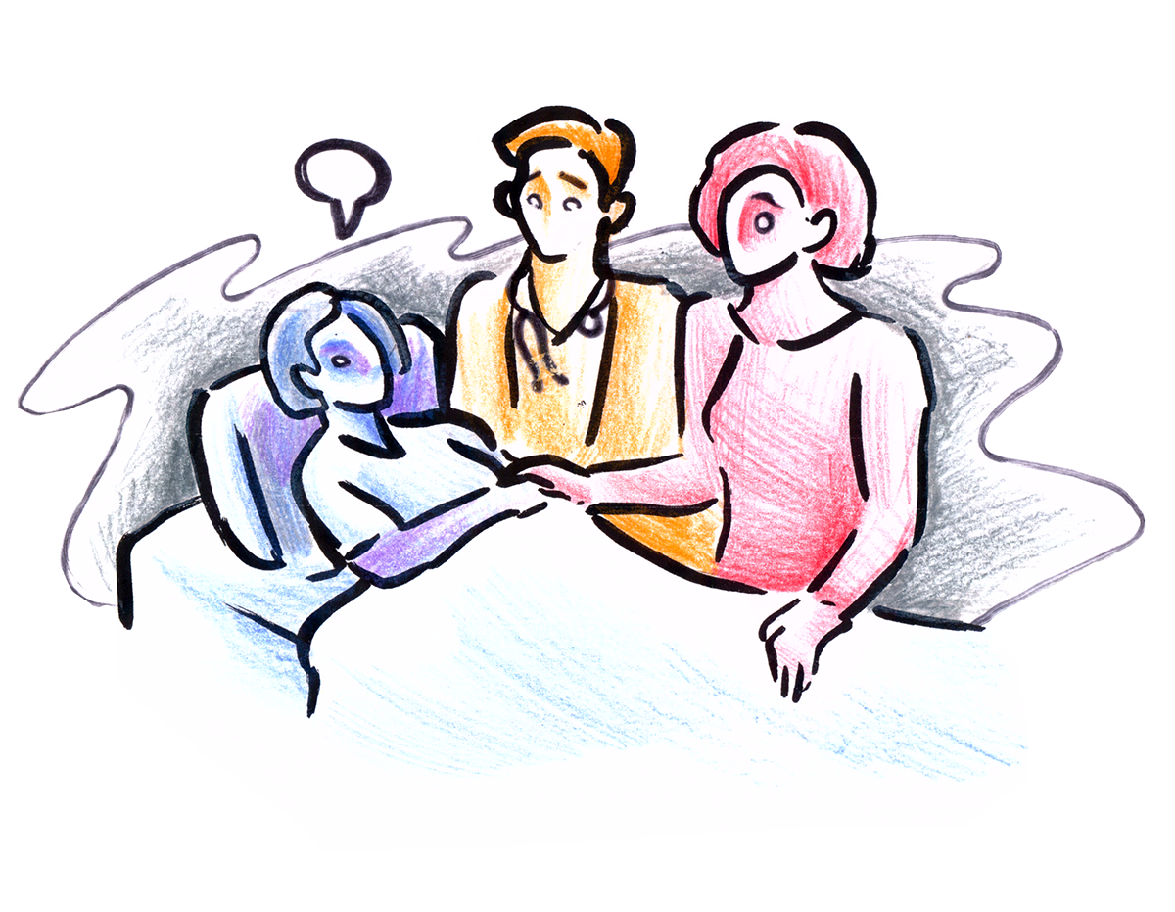
What is the problem to which SDM is the solution?
  Poor clinician behavior
  Insufficient patient involvement
  Uncaring Interpersonal communication
  Lack of patient and clinician understanding
  Underdeveloped empathy
  Evidence uncertainty
  Unclear information
  Variation of patient preference and values
  Compromised ethical principles
  Practice variation
  …
Notes:
Patients don’t seek care in order to overcome these barriers
Removing these barriers still leaves the patient with a problem that requires care.

Slide 34
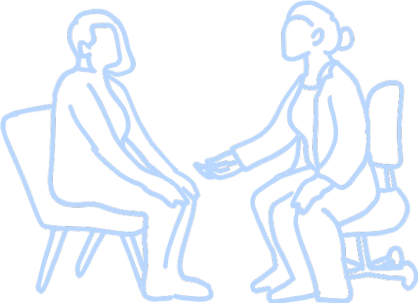
What is the purpose of SDM?
The purpose of SDM, like all medical decision making is to advance patient problems
Notes:
So what happens if we think of the purpose of SDM to primarily be to advance patient problems?

Slide 35
?
Is there problem oriented
SDM

Slide 36
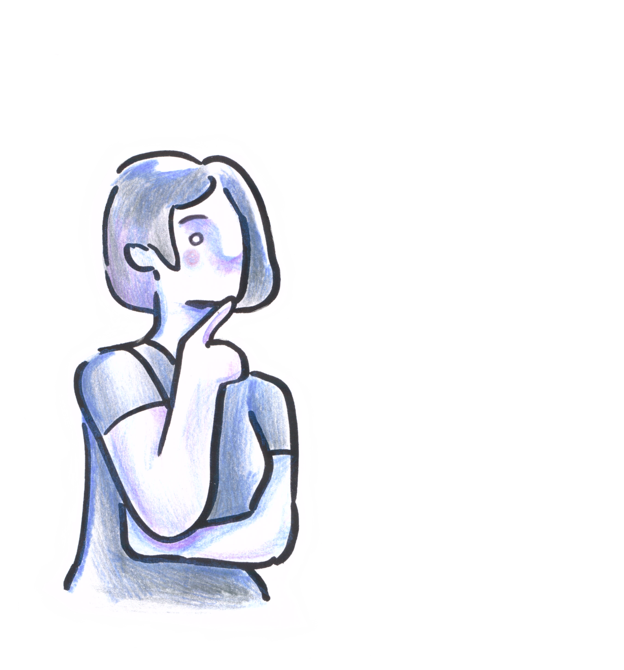
Notes:
I want to probe this question through examination of a young womans’ encounters with healthcare

Slide 37
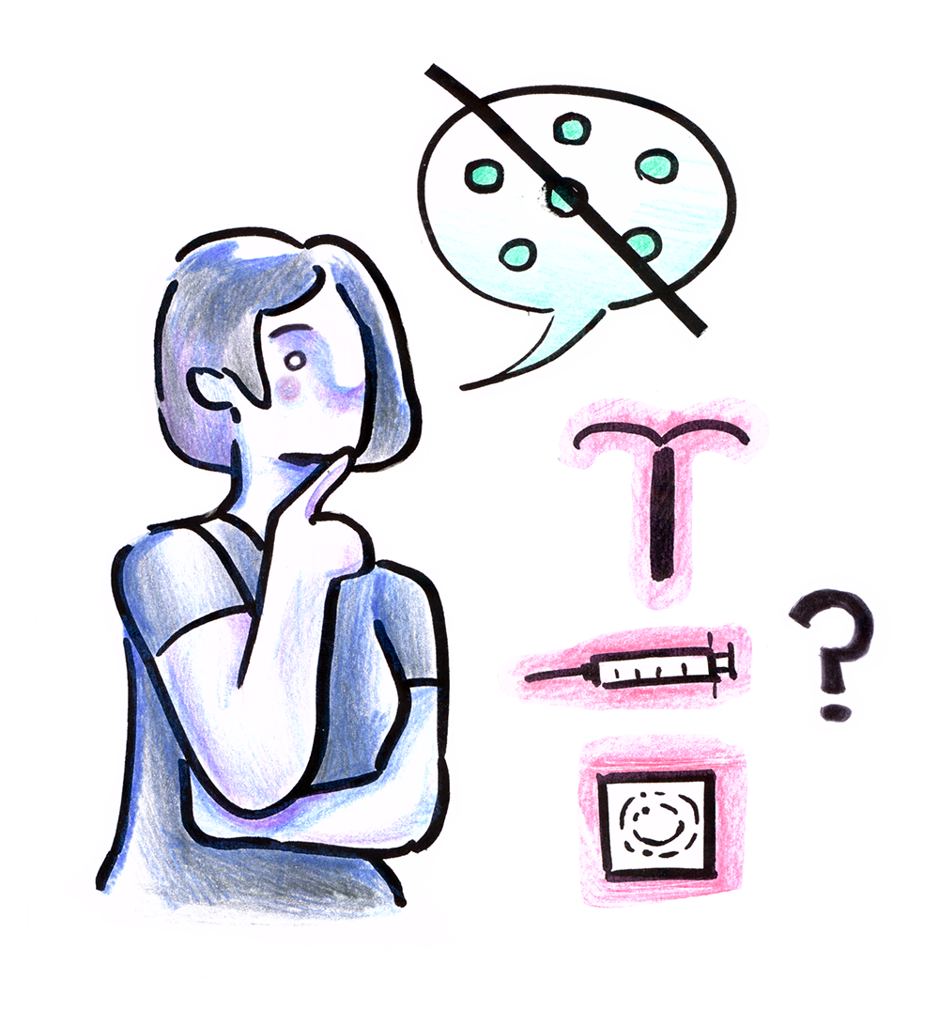
Rachel
1: Dissatisfied with her birth control
Notes:
Situation: Rachel, a newly married 24 year-old-woman is dissatisfied with her current birth control. She has a conversation with her primary care clinician about the pros and cons of other methods of contraception.
Purpose: The purpose of this conversation is to answer the question ”what is the best alternative for Rachel, given her values and preferences?” so that she can make a change
Method: In doing this Rachel and her clinician rely heavily on the pros and cons of the alternatives and understanding Rachel’s preferences

Slide 38

Rachel
2: Conflicted by the baby’s delivery
Notes:
Situation: Rachel talks with her obstetrician. Rachel comes from a country and culture where 90% of births are via C-section but she is interested in vaginal delivery. Rachel is conflicted. Rachel and her doctor discuss the two options to help Rachel understand what she wants. She chooses caesarian.
Purpose: The purpose of this conversation is to answer the question “What does Rachel want, and what can she and her doctor agree to?”
Method: In doing this Rachel and her clinician rely heavily on helping Rachel talk about her inner conflict so that she better understands it and can express what she wants

Slide 39
Rachel
3: Admitted to the ICU with sepsis
Notes:
Situation: Ten days after delivery, Rachel is admitted to the ICU with severe post-operative sepsis. Rachel, her clinicians, and family discuss how to manage her ICU care, how to care for the breast-fed baby, and how often someone from the family should be with Rachel.
Purpose: The purpose of this conversation is to answer the question “ How will the people involved manage and resolve the situation that Rachel’s in?”
Method: In doing this Rachel, her family and clinicians draw heavily on understanding the practical, emotional, and intellectual limitations of the situation, and tailoring response to these issues

Slide 40
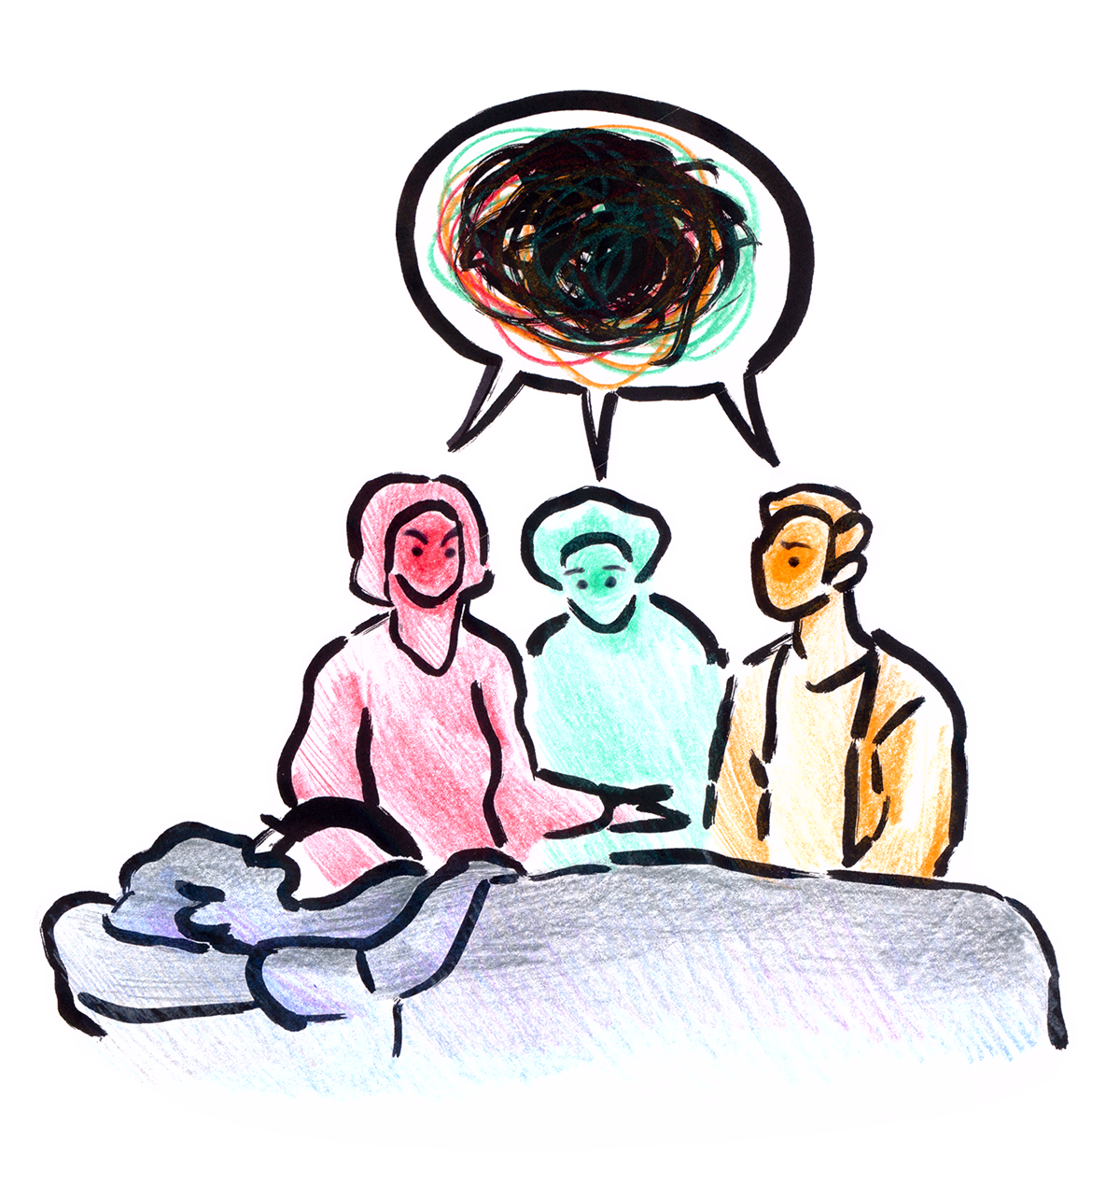
Rachel
4: Rachel’s husband and parents fight
Notes:
Situation: Three weeks later, Rachel is unresponsive and on life support. Her parents and husband argue about what Rachel would want and how to care for the baby. Clinicians focus on helping her family to to peace as to what to do next
Purpose: The purpose of this conversation is to answer the question “What really or ultimately, matters?” so that they will know the right thing to do for Rachel and her loved ones
Method: In doing this her family and clinicians rely heavily on remembering, telling, and listening to stories of Rachel and her life so that they gain greater clarity into what’s really important

Slide 41
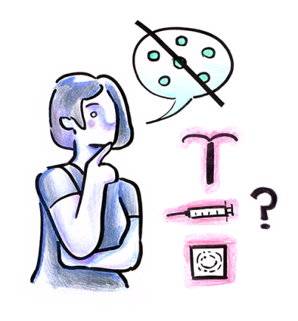
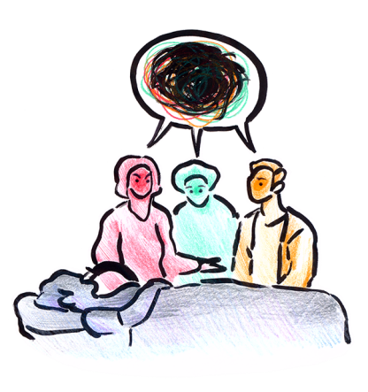

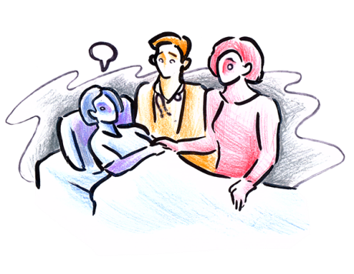
Which is best?
What matters?
All instances where patients, families, and clinicians are making decisions together
What do we want?
How do we manage?

Slide 42
Different
Which is best?
What matters?
What do we want?
How do we manage?

Slide 43
Different
Situations
Problems
Discussions
Interactions
Purposes
SDMs
Which is best?
What matters?
What do we want?
How do we manage?

Slide 44
?
What are these SDMs

Slide 45



SDM is a method
Like any method, its use is determined by the problem it addresses
Many kinds of problems, many kinds of SDM
each with its own purpose

Slide 46

Example | Purpose: To resolve | Kind & Focus | Situation
 | Which alternative is best? | Alternatives | It is uncertain what the harmful and beneficial outcomes of alternative interventions will be for a patient and their preferences

Slide 47

Example | Purpose: To resolve | Kind & Focus | Situation
 | Which alternative is best? | Alternatives | It is uncertain what the harmful and beneficial outcomes of alternative interventions will be for a patient and their preferences
 | What do we want, and can agree on? | People Choosing & Agreeing | Personal or professional concerns, interests, or agenda are ambiguous or in conflict between or within parties

Slide 48
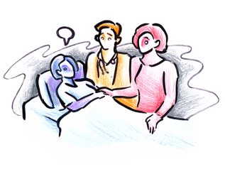
Example | Purpose: To resolve | Kind & Focus | Situation
 | Which alternative is best? | Alternatives | It is uncertain what the harmful and beneficial outcomes of alternative interventions will be for a patient and their preferences
 | What do we want, and can agree on? | People Choosing & Agreeing | Personal or professional concerns, interests, or agenda are ambiguous or in conflict between or within parties
 | How do we manage and resolve the current situation? | Problematic Situation | The problematic human situation and what to do about it is intellectually, practically, and emotionally fraught

Slide 49
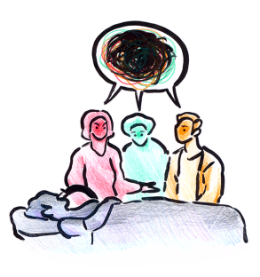
Example | Purpose: To resolve | Kind & Focus | Situation
 | Which alternative is best? | Alternatives | It is uncertain what the harmful and beneficial outcomes of alternative interventions will be for a patient and their preferences
 | What do we want, and can agree on? | People Choosing & Agreeing | Personal or professional concerns, interests, or agenda are ambiguous or in conflict between or within parties
 | How do we manage and resolve the current situation? | Problematic Situation | The problematic human situation and what to do about it is intellectually, practically, and emotionally fraught
 | What ultimately matters? | Humanity | The humanity of an individual or community is compromised

Slide 50
Which is best?
What matters?
Pros and Cons
Stories
Notes:
These SDM’s vary in the problems that they address and what they seek to achieve, and practically in how they’re done. For example, Describing the pros and cons of different life support alternatives is not the primary work that needs to be done when Rachel’s family is frozen by tragedy and torn apart by conflict.
Similarly, Recounting several stories of Rachel’s life is not what Rachel and her clinician need to do to figure out which alternative birth control is best.

Slide 51
communicative behaviors
comprehension
decision criteria
language
information
options
relationships
emotion
people
evidence
individual
values
pros
Which is best?
What matters?
risk presentation
purposes
preferences
cons
What do we want?
How do we manage?
involvement
choice
goals
human
values
uncertainty
ways of talking
methods
Notes:
Each of these kinds of SDMs are familiar and common in practice. Each of these SDMs make use of familiar elements of SDM, but these elements vary in importance in different situations. For example clear risk presentation, or individual’s preferences are of lesser significance when Rachel is on life support.

Slide 52

communicative behaviors
comprehension
decision criteria
language
information
options
relationships
emotion
people
evidence
individual
values
pros
risk presentation
purposes
preferences
cons
involvement
choice
goals
human
values
uncertainty
ways of talking
methods
Notes:
A response that matches the needs of the patient and their situation.

Slide 54


Slide 55
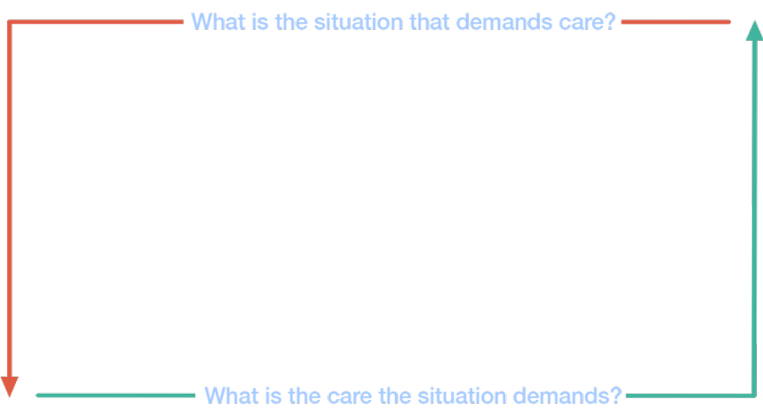

Slide 56
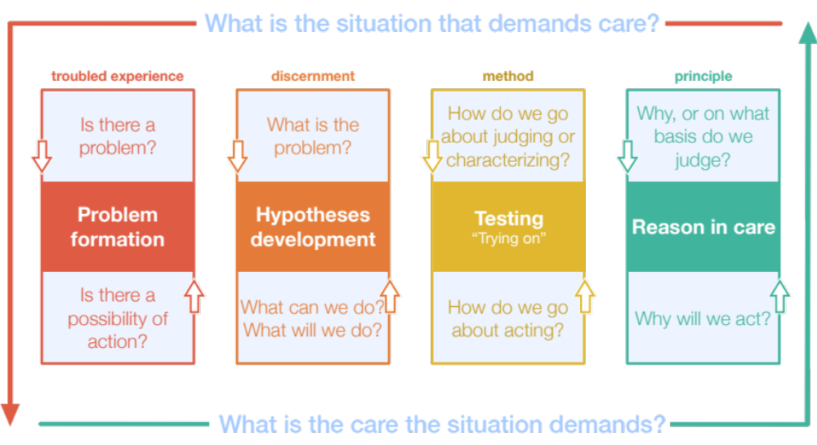
Notes:
Elderly patient approaching ESRD
A sense that something is changing, we’re moving into new problems, and that might require new ways of responding
Developing an account of what the new situation is: It looks like this is what we’re dealing with, these are the sorts of things that we could do—dialysis, focus on symptom control and palliative approaches
Do technical accounts provide an adequate basis for characterizing the situation? Trying on the approaches to see what they would mean, how they would work, and what life would be like
Examining our principles of care—is medical control still appropriate—is focusing on dignity what is really required?

Slide 57
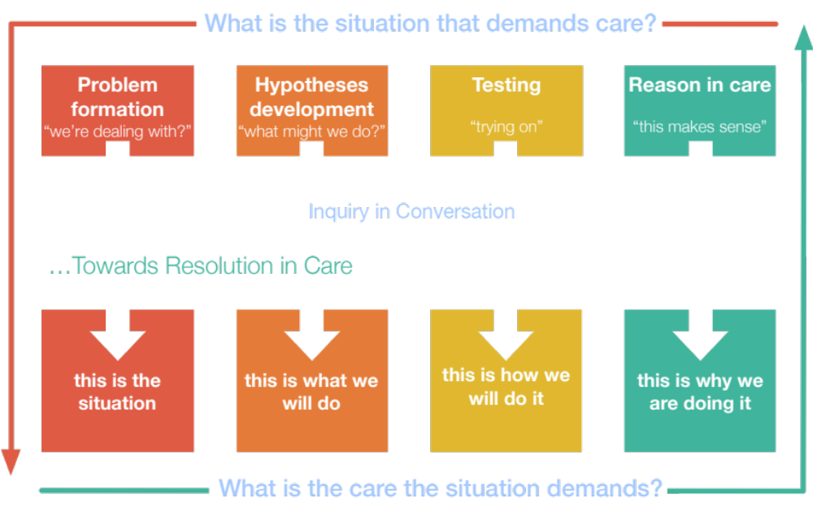
Notes:
Elderly patient approaching ESRD
A sense that something is changing, we’re moving into new problems, and that might require new ways of responding
Developing an account of what the new situation is: It looks like this is what we’re dealing with, these are the sorts of things that we could do—dialysis, focus on symptom control and palliative approaches
Do technical accounts provide an adequate basis for characterizing the situation? Trying on the approaches to see what they would mean, how they would work, and what life would be like
Examining our principles of care—is medical control still appropriate—is focusing on dignity what is really required?

Slide 58
Care that makes intellectual, practical, and emotional sense
Is consistent with evidence-based practice

Slide 59
Care that makes intellectual, practical, and emotional sense
Is consistent with evidence-based practice
Can be implemented and sustained in a patient’s day-to-day life

Slide 60
Care that makes intellectual, practical, and emotional sense
Is consistent with evidence-based practice
Can be implemented and sustained in a patient’s day-to-day life
Addresses, supports, and advances the emotional experience
of illness and treatment

Slide 61
Care that makes intellectual, practical, and emotional sense
Is consistent with evidence-based practice
Can be implemented and sustained in a patient’s day-to-day life
Addresses, supports, and advances the emotional experience
of illness and treatment
Integrates, balances, and adapts the intellectual, practical, and emotional elements to the demands of the patient’s situation

Slide 62
Is optimal

Slide 63

Is agreeable

Slide 64
Is responsive

Slide 65

Is human

Slide 66
Care that Cares
Care that Fits
Thank you

Slide 67
JOIN US
OCTOBER 7 – 8, 2019
MAYO CLINIC, ROCHESTER,MN

