Slide 1
Value
Understanding what it all means – MDM, SDM, ICAN
and
Fitting Care and the Patient Voice
in to Practice
Summer V. S. Allen, MD
Department of Family Medicine
Southeast Minnesota Medical Director for Patient Experience
Knowledge and Education Research (KER) unit

Slide 2
Learning Objectives
Understanding what MDM, SDM and ICAN look like in practice
Learn how to fit care and the patient voice in to everything we do and how it can be effective in improving health and well-being
Understanding how to bring together MDM, SDM, ICAN and the voice of patients and communities and potential impact on improving health and well-being
Disclosures
None

Slide 3
VALUE
Noun: the regard that something is held to deserve; the importance, worth, or usefulness of something.
Verb: consider (someone or something) to be important or beneficial; have a high opinion of.
Google and Merriam-Webster’s dictionary

Slide 4
WHAT’S WRONG WITH THE CURRENT PROVIDER-PATIENT RELATIONSHIP?
28% of patients could list their medications
37% could state the purpose of their medication
14% could state common side effects
42% could state their diagnosis
50% of all prescriptions went unfilled
50% of filled prescriptions were taken improperly
Makaryus A, Friedman E, Mayo Clin Proc. 2005

Slide 5
BARRIERS TO MEANINGFUL RELATIONSHIPS
Cost
Insurance
Too Busy
Not sure what to do

Slide 6
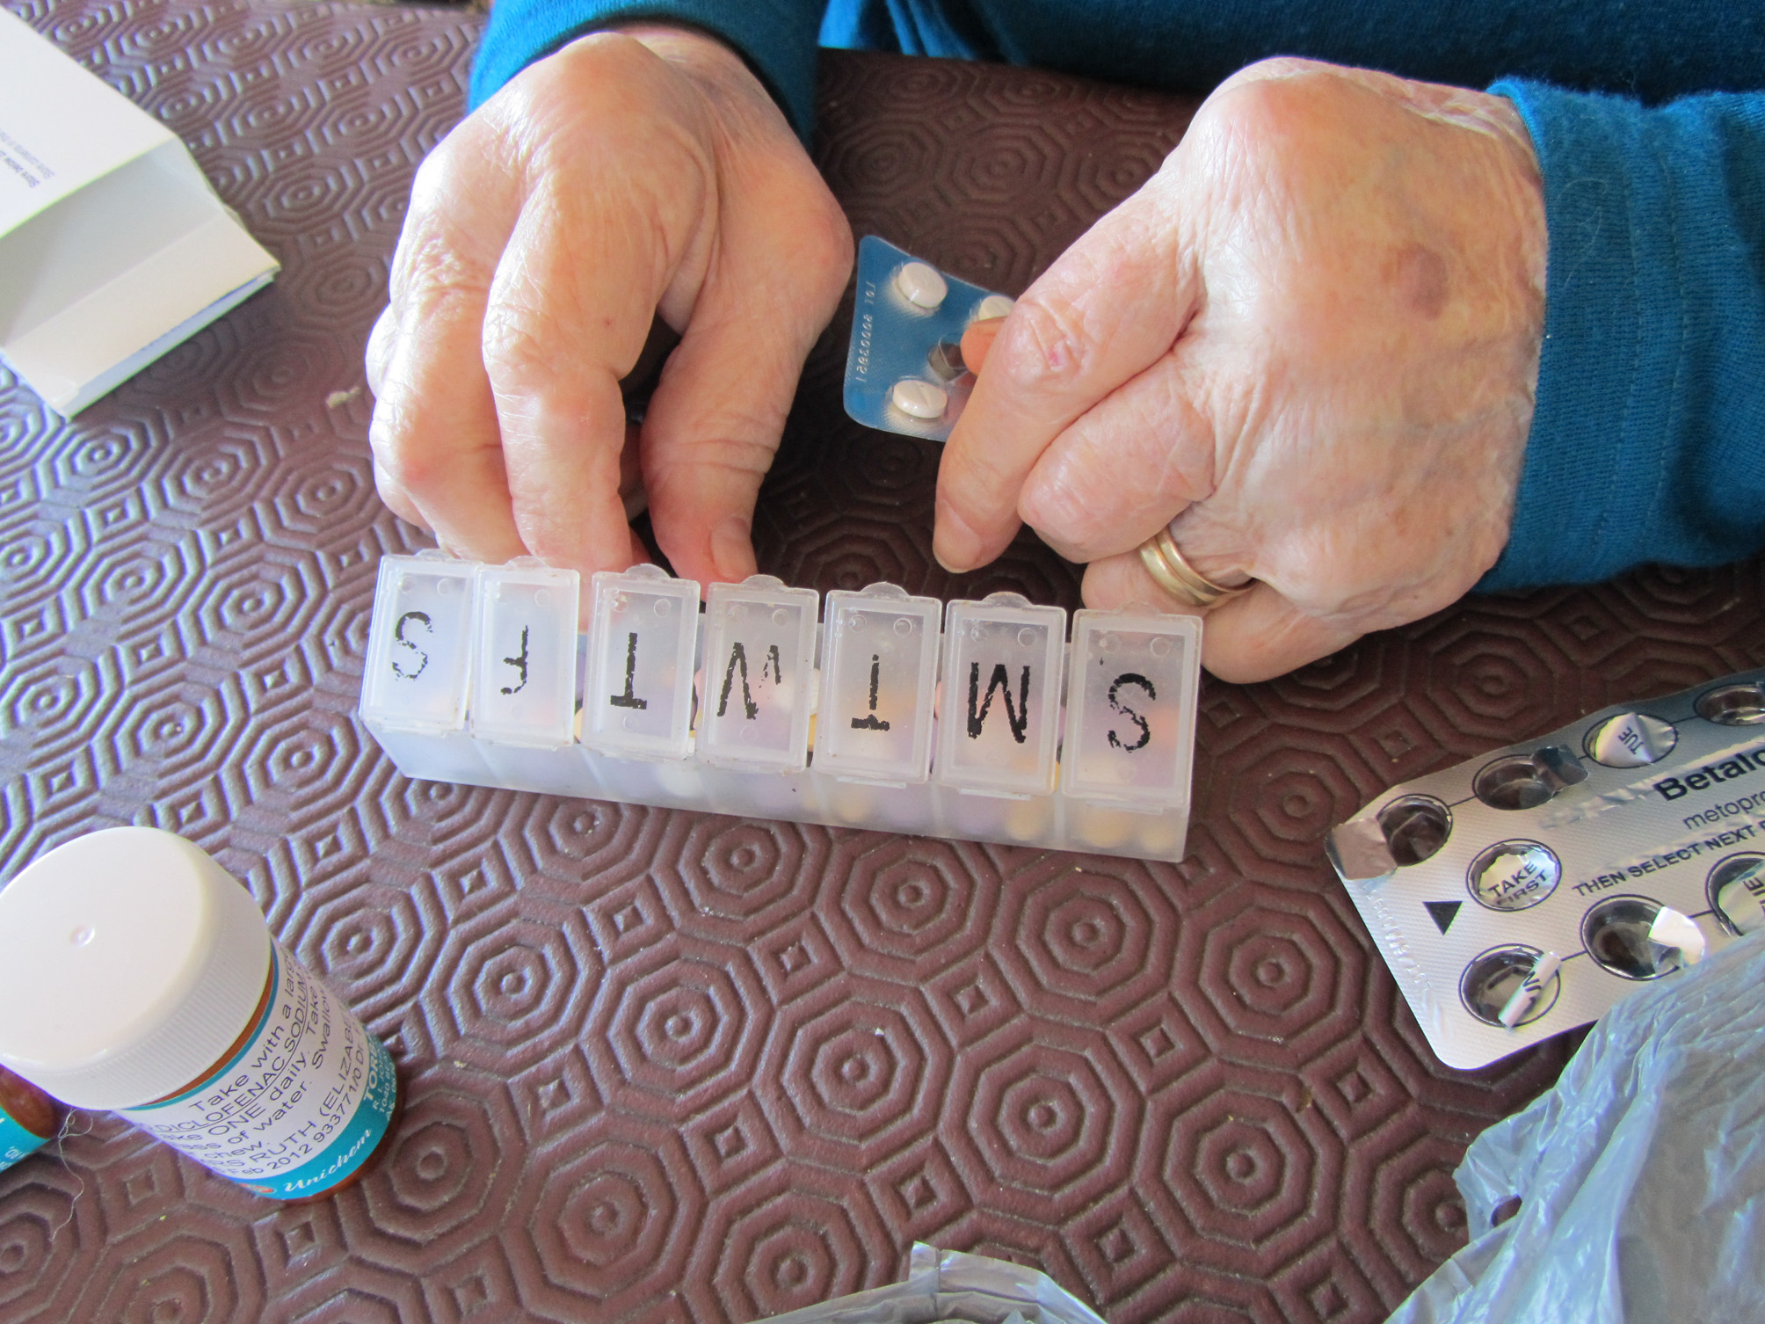
Jowsey et al BMC Public Health 2012

Slide 7
A survey of 627 US primary care clinicians
50% of my patients get too much care
50% of primary care docs are too aggressive
60% of specialists are too aggressive
35% practice much more aggressively than what they would like
Sirovich BE et al. Arch Intern Med 2011

Slide 8
People define health not as the absence of disease but as the ability to function in their daily lives

Slide 9
People are looking for services that support their health rather than systems that rid them of disease

Slide 10
Evidence-based guidelines
are
disease-specific

Slide 11
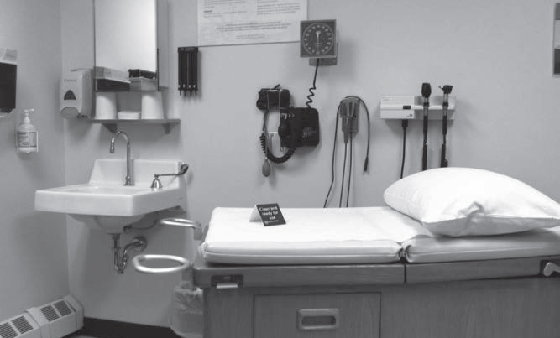

Slide 12
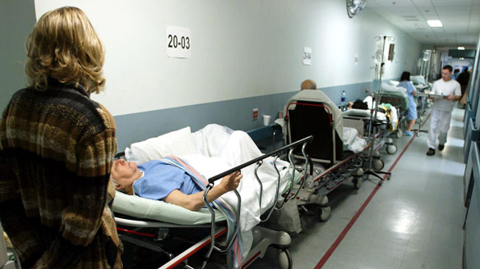
How can people trust a system that seems to value their experience so little?

Slide 13
Much of the work we do in patient care we don’t fully understand. This work may be a waste or it might really matter to the patient.
We don’t know where we are creating value.

Slide 14
The system doesn’t support us understanding the unspoken needs of the patient

Slide 15
The system doesn’t support us understanding the unspoken needs of the patient and this gets in the way of understanding what patients really need

Slide 16
The health care system cannot respond to the needs of the patient without talking to them first

Slide 17

Patients don’t know what they don’t know

Slide 18
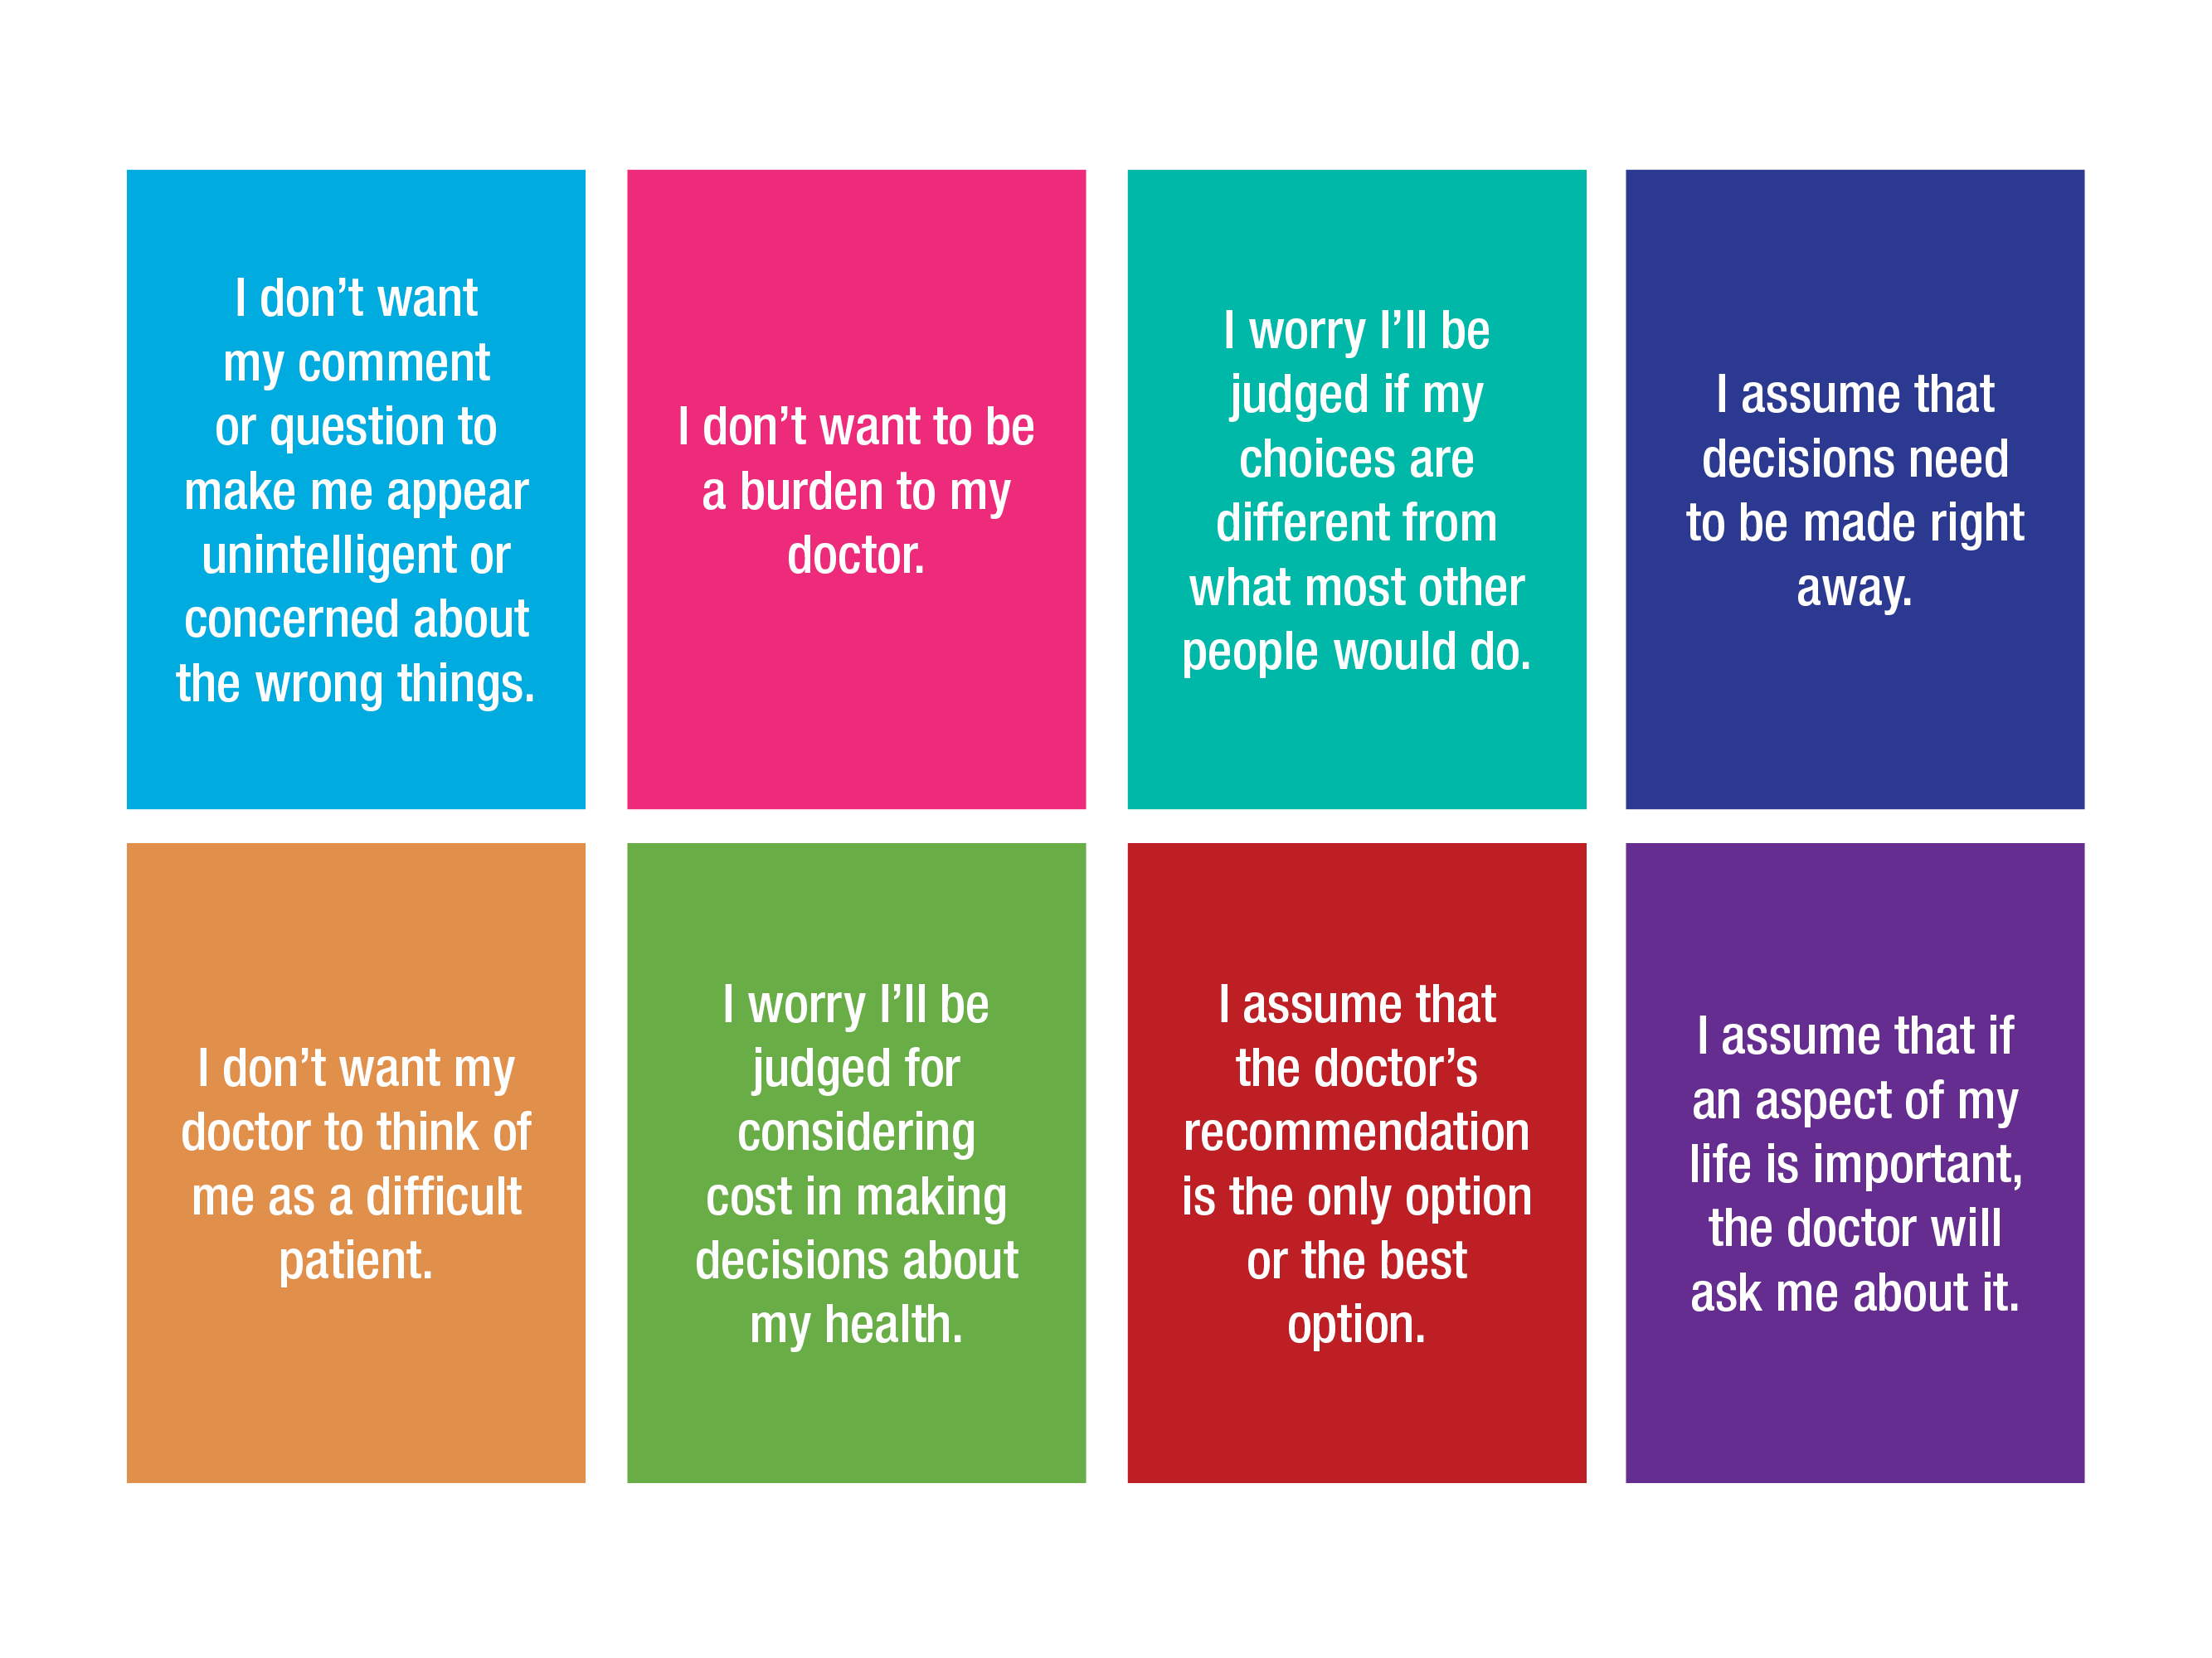

Slide 19
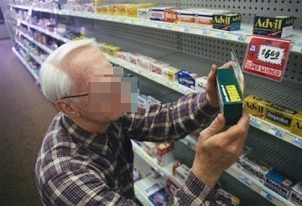
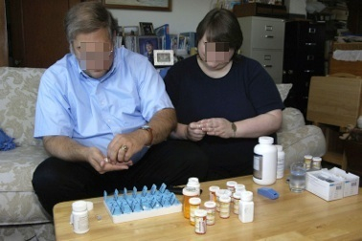
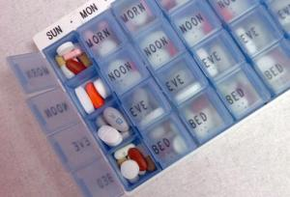

The work of being a chronic patient
Sense-making work
Organizing work and enrolling others
Doing the work
Reflection, monitoring, appraisal
Gallacher et al. Annals Fam Med 2012

Slide 20
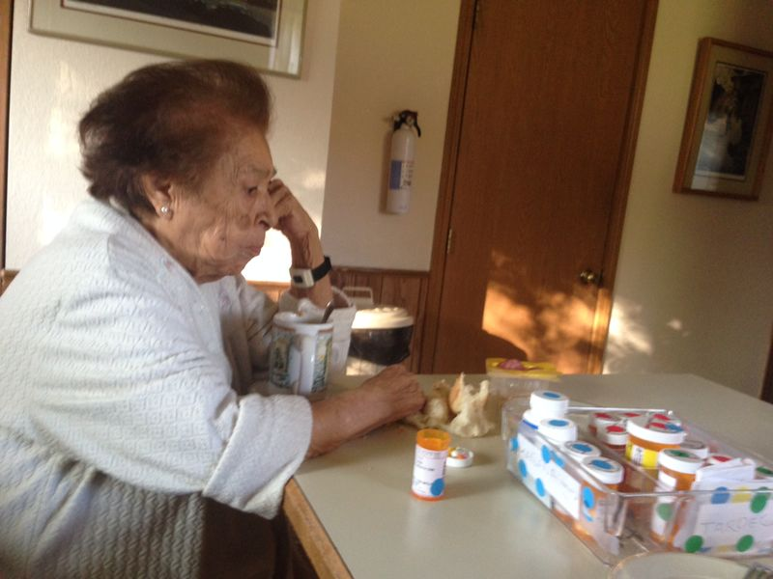
People with more chronic conditions attend more visits, get more tests, and more medicines
Shippee ND, In press
Of 83 workload discussions in 46 primary care visits (24 min):
70% left unaddressed
Bohlen et al. Diabetes Care 2012
2 hours/day spent on health-related activities
Jowsey et al BMC Public Health 2012

Slide 21
Resilience
Bandwidth
Literacy
Environmental
CAPACITY
Social
Financial
Mental
Physical

Slide 22
Minimally disruptive healthcare
Health care delivery designed to reduce the burden of treatment on
patients
while pursuing patient goals
May CR, Montori VM, Mair FS. BMJ 2009; 339:b2803

Slide 23
People collaborate in spite of the tools they are given to use, not because of them.

Slide 24

Technology changes human behavior and interaction.

Slide 25
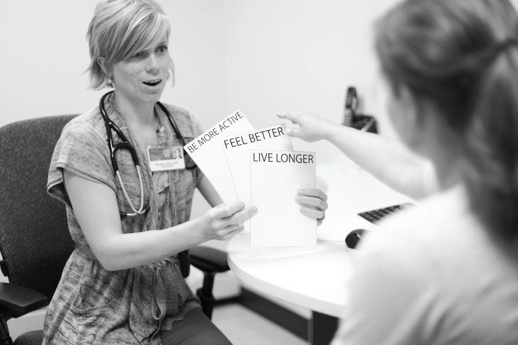

Slide 26
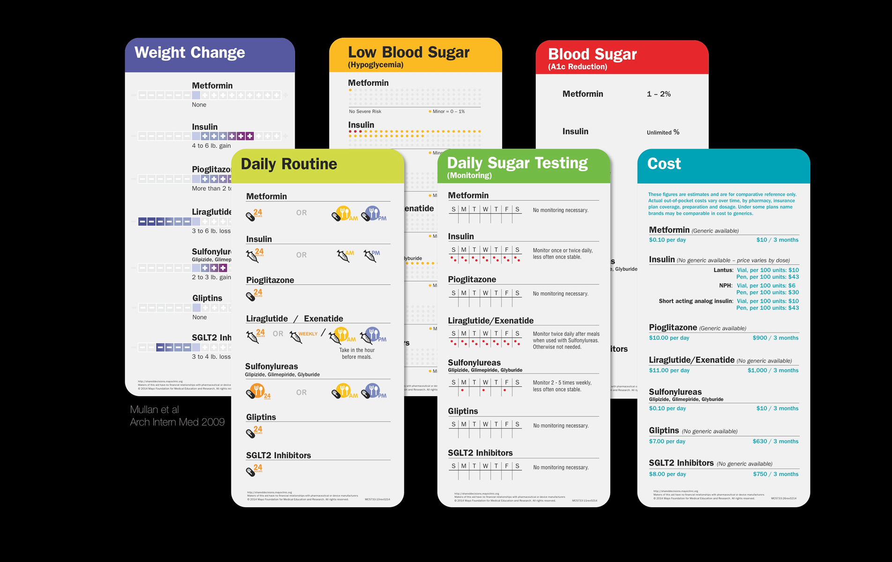

Slide 27


Slide 28
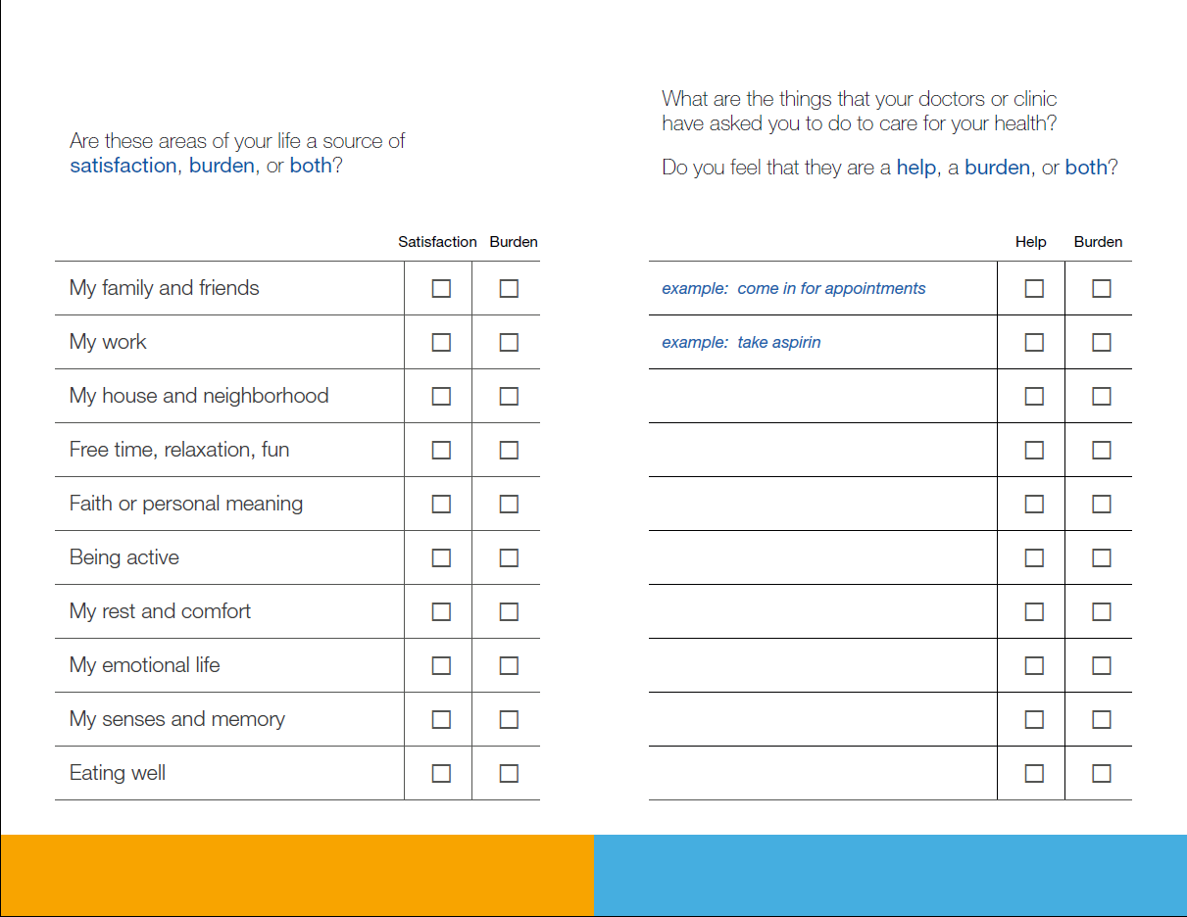

Slide 29
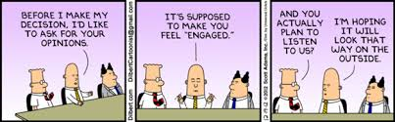

Slide 30
Shared decision making is…
A conversation between clinicians and patients in which they think, talk, and feel through the situation.
Evidence-based options are hypotheses, which are tested in the conversation until the best solution for the situation becomes clear.

Slide 31
Shared decision making is…
What is the situation that demands action?
What are the actions that the situation demands?
Conversational dance
JafiriNiami, Hargraves et al (2015) Design

Slide 32

THE PATIENT VOICE
COMMUNITY-CLINIC PARTNERSHIP:
Austin & Albert Lea
THE PATIENT VOICE
COMMUNITY-CLINIC PARTNERSHIP:
Austin & Albert Lea

Slide 33
The nature of the problem
THE PATIENT VOICE
COMMUNITY-CLINIC PARTNERSHIP:
Austin & Albert Lea

Slide 34
The problem of access
Clinic
“People need to be educated to use our services better.”
Financial and operational constraints to increasing staff and resources
Individuals
“The clinic needs to make it easier to be seen.”
Lack of perceived agency, limited sense of responsibility
For each group, it is the other side that must change in order to address the problem.

Slide 35
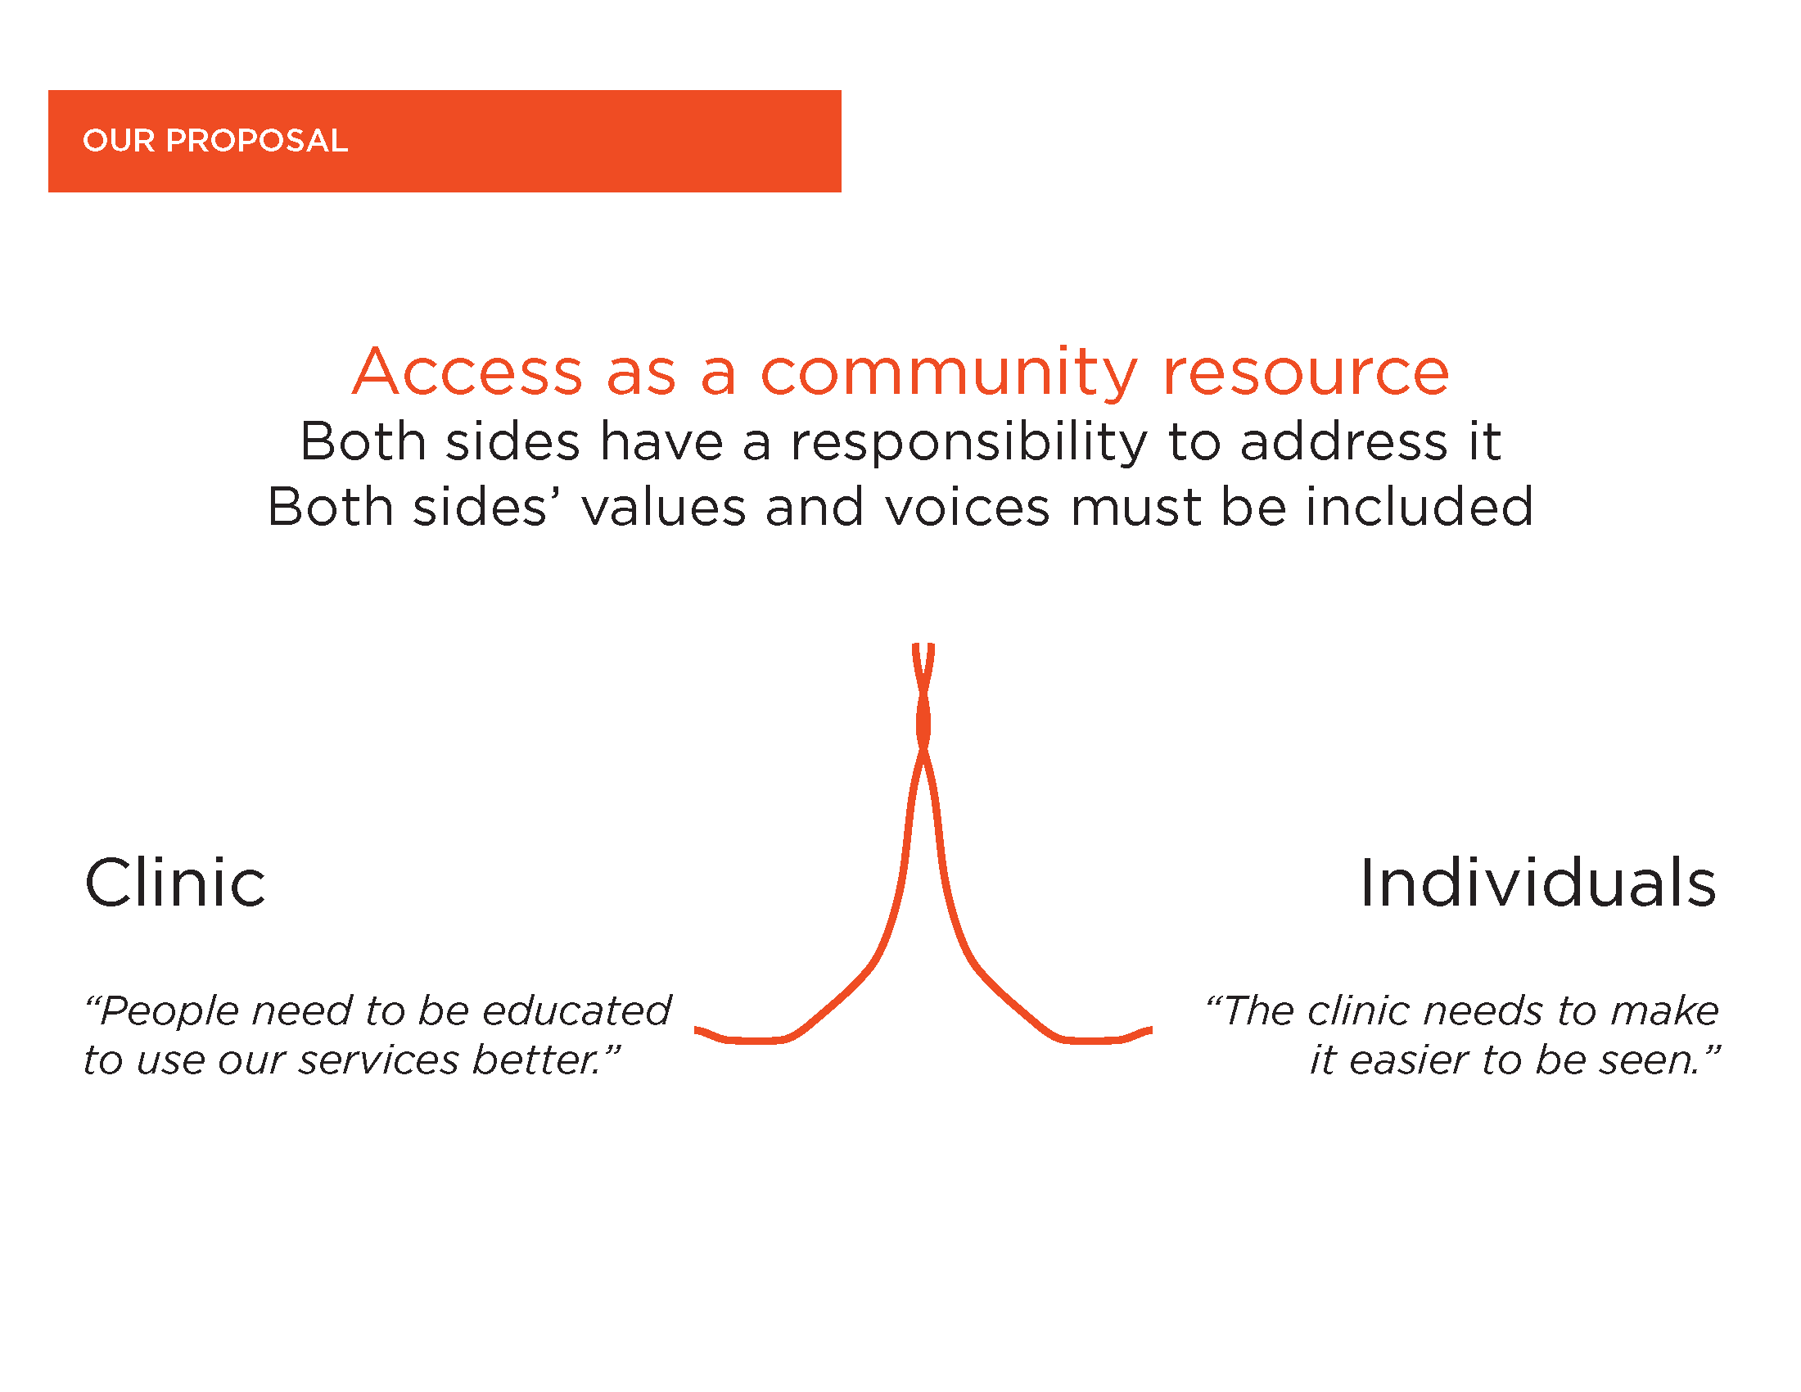
Our proposal
Access as a community resource
Both sides have a responsibility to address it
Both sides’ values and voices must be included
Clinic
“People need to be educated to use our services better.”
Individuals
“The clinic needs to make it easier to be seen.”

Slide 36
Our approach
THE PATIENT VOICE
COMMUNITY-CLINIC PARTNERSHIP:
Austin & Albert Lea

Slide 37
Rooted in relationships & stories
Listening and hearing stories of how the problem manifests from all sides
Reaching out to populations who stories are often not considered
This “bringing together” requires building trust and benefits from facilitation (the role of Patient Revolution) so that the conversations can address areas of conflict in productive ways
Relationships allows for partnership to overcome conflicts and barriers that would usually sink the effort

Slide 38
Challenging Assumptions
Not being constrained by current thinking, preconceived solutions, expected outcomes
Try to understanding data in relationship to human experience
Creative thinking can create new possibilities in ideas that seem unacceptable (How might we turn people away from the emergency department in a careful and kind way?)

Slide 39
Building to learn
Hypotheses are tried out in real world settings as small experiments
Experiments help to understand what benefit they would have and allow us to understand what tools and support people would need in order to undertake the new behavior
Solutions are rarely a single idea but instead a network of concepts. Experimentation allows us understand what is most critical and how they will work together
Prototypes and experiments encourage participation before feedback

Slide 40


Thank you
allen.summer@mayo.edu

