Slide 1
Antidepressant Shared Decisions
Mark Williams, MD

Slide 2
Why Shared Decision Tool on Antidepressants?
Depression a common and disabling problem
  10% of primary care population
  Among top reasons for disability worldwide
Depression highly stigmatized and poorly defined
Evidence and information on antidepressants highly impacted by manufacturer data plus reports in popular press
No clear front-runner among antidepressants for first time use.

Slide 3
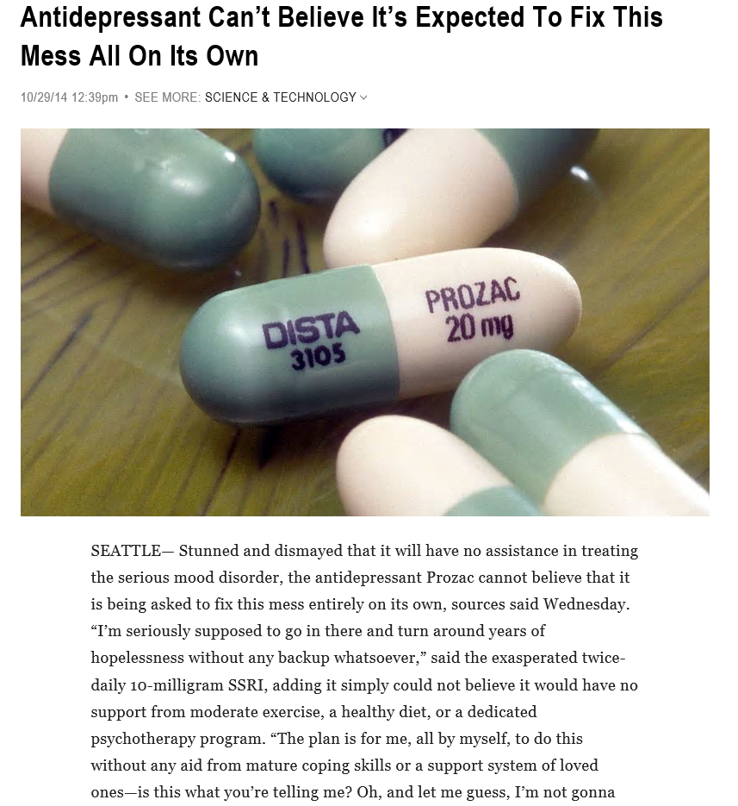

Unrealistic expectations
https://www.theonion.com/antidepressant-can-t-believe-it-s-expected-to-fix-this-1819577122

Slide 4
Process
Synthesize clinical evidence and develop a tool to refine based on feedback by stakeholders.
  AHRQ synthesis of evidence
  Psychiatry, primary care, patients, and health plan representatives
Clustered practical randomized trial
  Enroll clinicians and patients to use the tool
  Observe their encounters
  Review taped observations

Slide 5
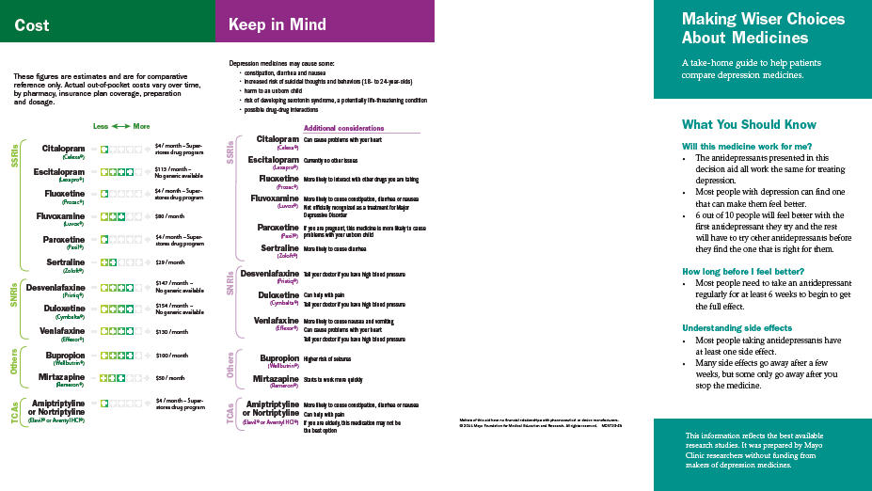
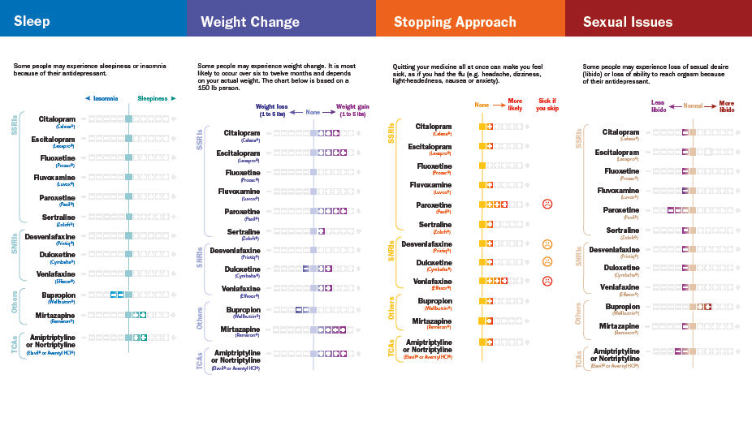
Depression Decision Aid for Choosing an Antidepressant
Starting point of use of the tool is choosing a medicine.
Not about diagnosis or other options
Synthesis of evidence from Comparative Effectiveness of Second Generation Antidepressants in the Pharmacologic Treatment of Adult Depression by AHRQ https://effectivehealthcare.ahrq.gov/topics/antidepressants-update/research-protocol

Slide 6
Using the Cards
Advantages
  Information easy to understand, and neutral in regards to drug company
  Helps to get everyone on the same page and check assumptions
Challenges
  Where to put them?
  Patient present for other things – brief visits
  Patients may have been on other drugs

Slide 7
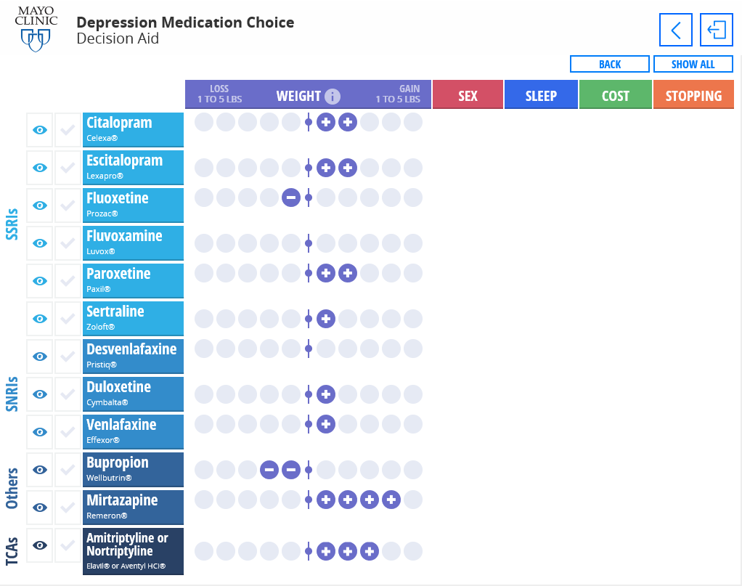
On-line version
http://depressiondecisionaid.mayoclinic.org

Slide 8
Challenges with this Particular Area
Depression is a complicated problem stuffed into a 15 minute visit.
  How to avoid over-simplifying but prescribing an antidepressant when not really needed?
About 50% of patients do not take the medication prescribed. Seems like following up is key but access to the primary care follow up is an issue.
The relationship between the provider and the patient is often as therapeutic as whatever treatment is offered—how to encourage that?

Slide 9
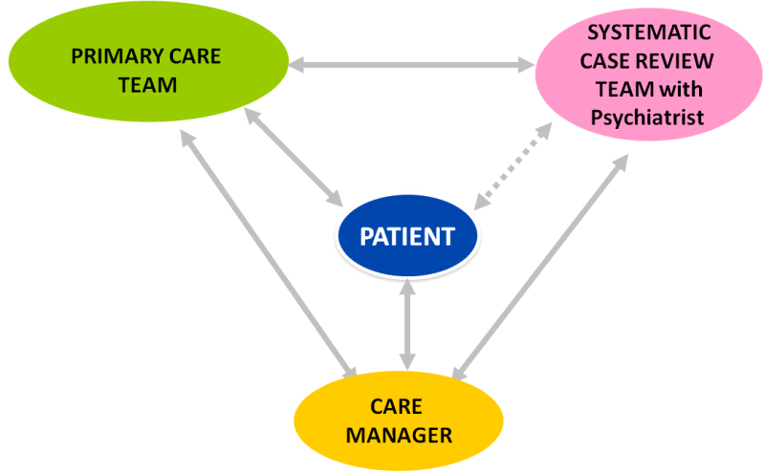
Beyond Physician/Patient
Care coordination
  Depression
    Nurse Care coordinator – keeps track of patient and depressive symptoms and advocates for the patient with health system.
      Prescriptions all written by primary care provider or mental health provider
  Decision aid use by care coordinator?
    Clarify patient’s preferences to prescriber
    Keep care coordinator on ‘same page’?

Slide 10
Care Coordinator Feedback
The patient has a longstanding history of anxiety and depression but has always been ambivalent about starting a medication. When she finally agreed, she was started on sertraline (50 mg) and had terrible side effects so stopped after three days.
The patient appreciated having the discussion and I think we have some good options, including the fact that we were able to review the specifics of the medication she has been on in the past for migraines as well as the antidepressant that her mom is currently on.

Slide 11
Results with this Patient and Care Coordinator
Patient preferences:
  she is not concerned about weight gain
  would like to avoid sexual side effects
  not worried about sleep
  not worried about cost
  not worried about discontinuing
This information provided to team of psychiatry overview and primary care provider in helping suggest options for the patient

Slide 12


Questions?
Notes:
Issues to think about:
Depression is much more complicated than antidepressants alone. How to encourage the patient and provider to understand that complexity. Maybe the right decision is not a medication at all?

