Slide 1

Code Status in the Hospital
DNR
Michael Wilson, MD
Assistant Professor of Medicine
Pulmonary and Critical Care Medicine
wilson.michael1@mayo.edu

Slide 2
Code status
Preference for CPR
  Situation: cardiac arrest, heart stops, breathing stops, unresponsive, “dead”
  Treatment 1: CPR (chest compressions, shocks, medications, breathing support)
  Treatment 2: no CPR (and prepare for death)
Preference for intubation
  Situation: awake with severe shortness of breath or unresponsive and choking on secretions
  Treatment 1: intubation and mechanical ventilation
  Treatment 2: palliative opioids to relieve dyspnea (and prepare for death)

Slide 3
Complexities
Condition may never happen
Previously stated wishes may not apply
Leads patients to contemplate death
Sometimes surrogates make the decision
Current orders do not capture the “why”
2 independent decisions (often confounded)
DNR ≠ Automatic DNI (survival / recovery are vastly different)
DNR ≠ Do not treat me or I am ready to die
Many DNI ≠ true DNI
    Many DNI = Do-not-leave-me-intubated-for-a-really-long-time
    I am okay with a trial of intubation with the ability to stop if that trial becomes protracted

Slide 4
Frameworks for decision making

Slide 5

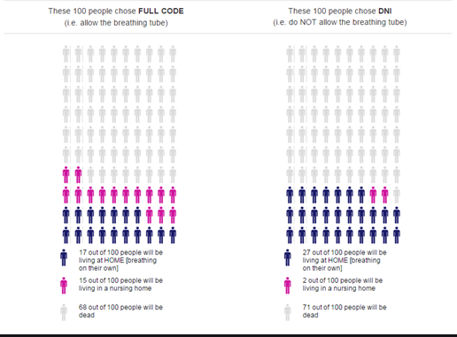

Framework | Steps
1. Option preference | Describe options Describe benefits, harms, outcomes of each option “Which option do you prefer?” “Which option makes the most sense to you?”

Slide 6
Framework | Steps
1. Option preference | Describe options Describe benefits, harms, outcomes of each option “Which option do you prefer?” “Which option makes the most sense to you?”
2. Agreement with a recommendation | Formulate and share recommendation “If your heart were to stop, I recommend we attempt to restart it with CPR. Is this all right with you?”

Slide 7
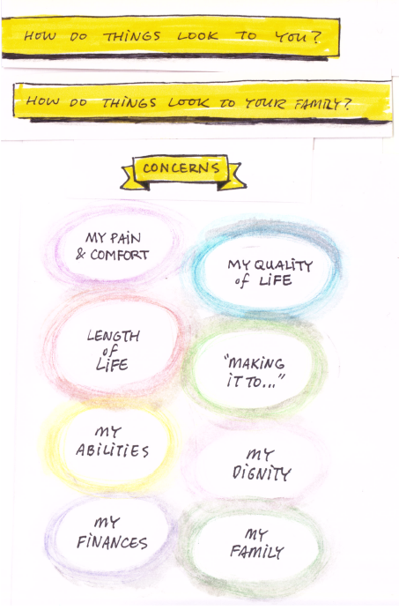
Framework | Steps
1. Option preference | Describe options Describe benefits, harms, outcomes of each option “Which option do you prefer?” “Which option makes the most sense to you?”
2. Agreement with a recommendation | Formulate and share recommendation “If your heart were to stop, I recommend we attempt to restart it with CPR. Is this all right with you?”
3. Goals of care | Discuss diagnosis and prognosis Assess goals of care. “Given this, what are your primary goals of medical care?” “What is important to you when thinking about the future” Prioritize goals if needed Formulate and share recommendation “Based on this, I recommend we attempt CPR if you heart were to stop. Is this all right with you?” If needed describe rationale for recommendation

Slide 8
Framework | Steps
1. Option preference | Describe options Describe benefits, harms, outcomes of each option “Which option do you prefer?” “Which option makes the most sense to you?”
2. Agreement with a recommendation | Formulate and share recommendation “If your heart were to stop, I recommend we attempt to restart it with CPR. Is this all right with you?”
3. Goals of care | Discuss diagnosis and prognosis Assess goals of care. “Given this, what are your primary goals of medical care?” “What is important to you when thinking about the future” Prioritize goals if needed Formulate and share recommendation “Based on this, I recommend we attempt CPR if you heart were to stop. Is this all right with you?” If needed describe rationale for recommendation
4. Phase of life | Assess phase of life “What was life like for you before coming to the hospital?” “What things do you have to live for?” “Are you at a point in your life where you see your story continuing or do you see your story coming to a close?” Assess acceptable treatment burden “How much are you willing to go through to gain more time?” Formulate and share recommendation “Based on this, I recommend we attempt CPR if you heart were to stop. Is this all right with you?”

Slide 9


